Slide 1
Community rehabilitation: Why is it important?
Natalie Beswetherick OBE MCSP MBA FCSP
Director of Practice & Development
Chartered Society of Physiotherapy
North West ERN Conference
Chorley14th October 2017
Notes:
Chorley key points
Why backing rehab campaign is important
The importance of immediate care on the overall system – how it sits between the hospital and community and its position as a key driver for change
The unique skills that physiotherapists offer for effective delivery of patient care and collaboration across the healthcare system – how physiotherapists can demonstrate value in this setting and who they need to be influencing
- the CSP’s approach to improving rehab for patients and what members can do
- the challenges we are facing in the current system; the opportunities influencing STPs
- plus any information she would like to glean from members in the North West who are working hard to bridge the gap between acute and community care.
Share review of orthopaedic rehabilitation as part of BOA - GIRFT
Consider the findings and recommendations
Demonstrate how effective rehabilitation can benefit patients, the community and the tax payer
Due to the increasing age of the population, in the UK and throughout the world, the incidence of hip fracture is a major health concern. In the UK 76,000 people year suffer a hip fracture; the incidence is projected to rise. Hip fracture carries with it a high risk of mortality. Only 30% of people fully recover, the rest are left with long-term disability. Also significant costs to health and social care, £2billion in England in 2013.
TKR rehabilitation is an area of high activity for UK physiotherapists. Over 100,000 were performed in the UK in 2013. The existence of a large number of post-operative protocols highlights the likelihood of wide variation in practice.
The continuous audit approach is technically similar to that of NHFD, but with the additional complexity that the clinical care crosses multiple providers. The challenges this audit faces are not only the collection of data from multiple settings, but also following patients over a protracted period, to measure both treatment adherence and outcomes -

Slide 2
Overview –
CSP Vision
Backing Rehab campaign
Impact and influence
Challenges and opportunities

Slide 3
Our Vision for physiotherapy –
TO TRANSFORM LIVES,
Enabling people to do amazing things
MAXIMISE INDEPENDENCE
Optimising functional potential and well-being
EMPOWER POPULATIONS
Equipping people with self management strategies

Slide 4
Backing Rehab campaign –
October 25th parliamentary reception and launch
Target MPs – including from HSC, PAC, ministerial health team, shadow health team
Working with Stroke Association, BOA, NOS, BLF, Macmillan
Build around the launch of a film ‘Rehab Matters’ – giving community rehab the red carpet treatment

Slide 5
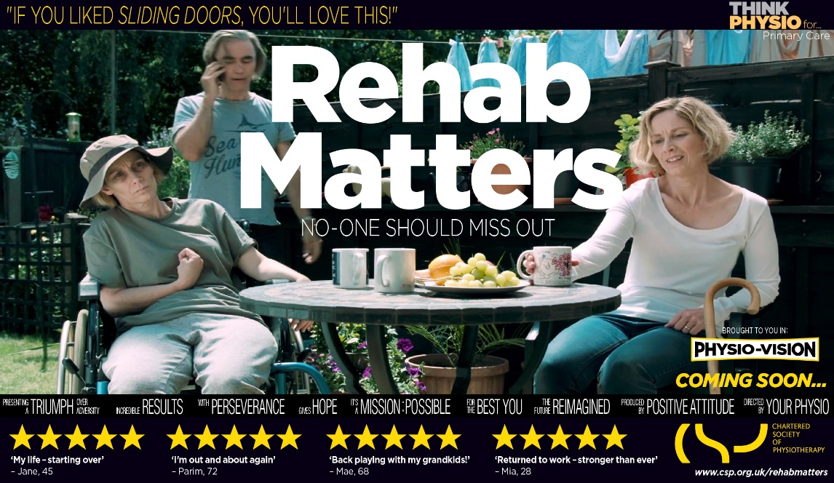
…

Slide 6
Evidence -
45% of people who have had a stroke feel abandoned when they leave hospital. The average wait for physiotherapy rehab varies between 1 and six weeks
50% of people who have had a hip # are not offered rehab when they leave hospital and if they are, most wait for over four weeks. 25% will need long-term care and 80% are left requiring help with daily activities, such as shopping or driving

Slide 7
Key messages for impact and influence -
Community rehabilitation reduces the number of people becoming needlessly disabled and prevented from leading active lives.
Community rehabilitation services are heroes of the health system – it’s time to give them the red carpet treatment
As well as transforming lives PTs key to making the NHS / social care sustainable for the future – shift to more rehabilitative system

Slide 8
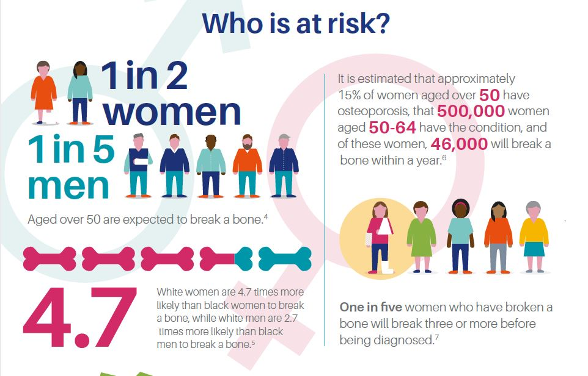
Osteoporosis

Slide 9
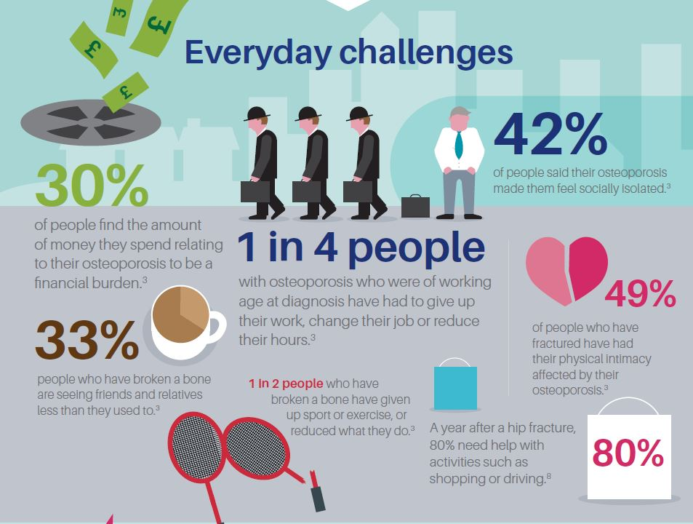

Slide 10
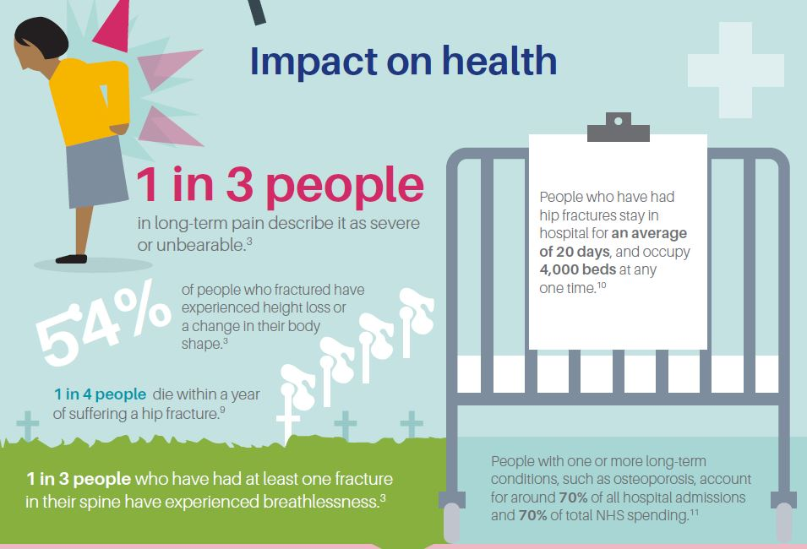

Slide 11
Evidence -
People with COPD who attend pulmonary rehab classes spend 50% less time in hospital, are 26% less likely to be readmitted and have lower levels of related anxiety and depression. Only 34% of people in need of pulmonary rehab are referred, and of those 37% wait longer than three months
People immobile at home and not confident to move, are at risk of complications, eg. depression, pressure sores, chest infections and DVTs – associated with increased re-admission rate, hospital LOS, A&E attendance, use of GP time, social isolation and loss of daily living skills

Slide 12
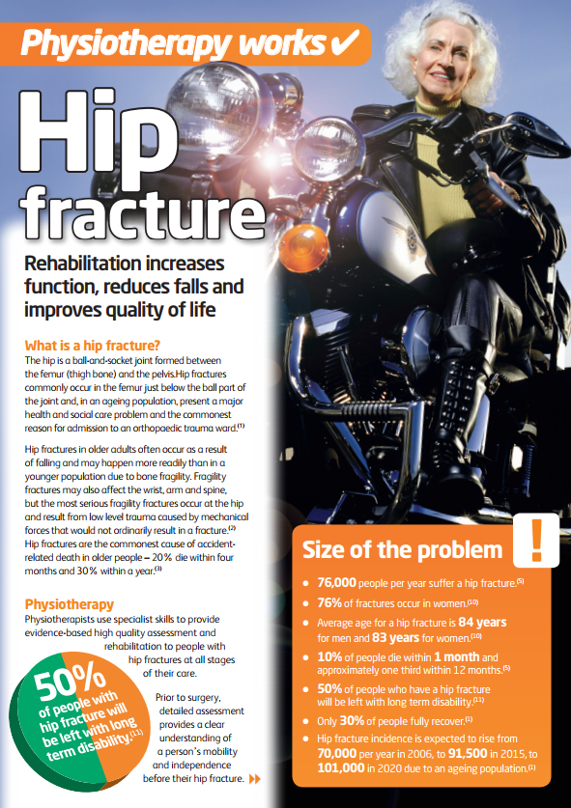
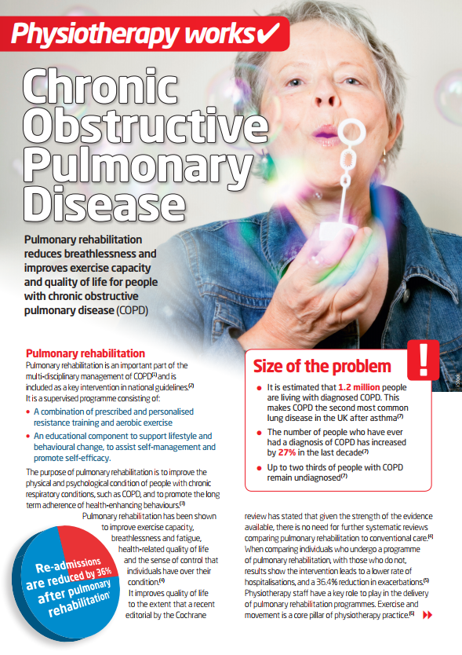
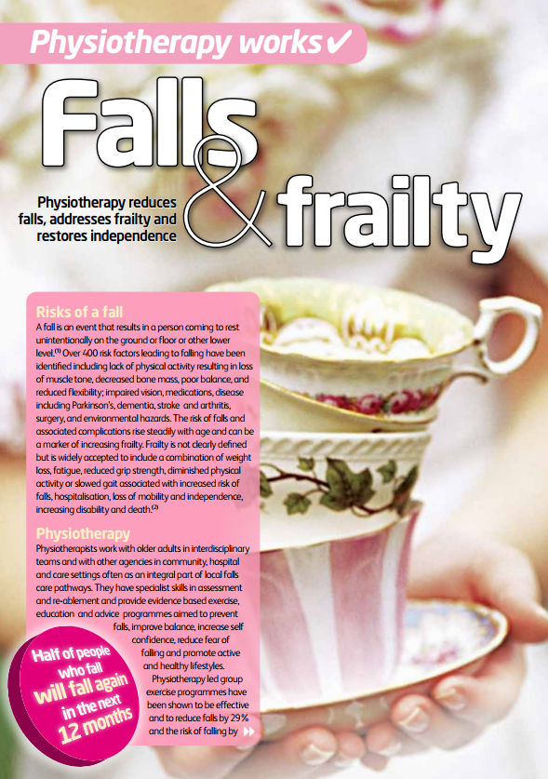
Evidence briefings -

Slide 13
What you can do -
Look at your STP/ACO plans
Identify key influencers
Look outwards – share evidence of impact
Use case study evidence and present case for change

Slide 14
Case Study -
Bradford Teaching Hospitals NHS Foundation Trust - Early Supported Discharge (ESD) pathway helps people regain their independence and function following hip fracture or other orthopaedic problems:
  Saved the Trust 2,698 orthopaedic bed days equating to an estimated cost savings of more than £600,000.
  Readmission rates fell from 10-12% to 5-6%

Slide 15
Case Study -
Barking, Havering and Redbridge CCG redesigned services to deliver home-based responsive care and rehabilitation 08.00-20.00 7/7 days a week. Outcomes:
  Very high levels of patient satisfaction
  A more rapid recovery (9 days versus 21 in hospital)
  Improvements in outcome (94% of patients improvement in timed up and go)

Slide 16
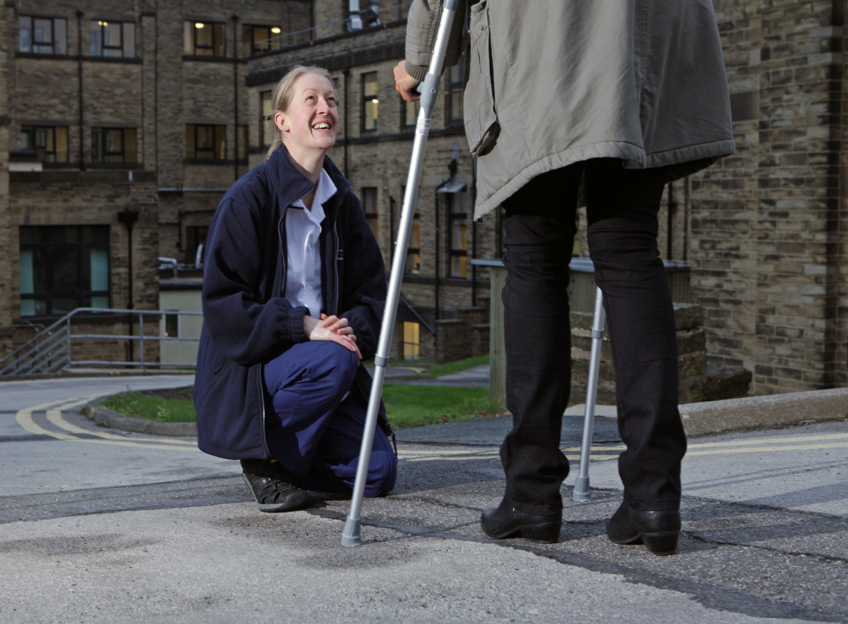

Slide 17

Notes:
Following the success of this year’s Leadership Development Programme (LDP), we are delighted to announce that we are accepting applicants for cohorts three and four, for the 2018 programme. The programme will run with two cohorts (up to 24 people in each) in the South Central and North West regions. The LDP is a 10-month modular programme, delivered using a variety of provoking, engaging and fun learning methods to allow you to learn from the programme team, yourself and your cohort colleagues. Participants will enjoy around £6000 worth of CPD – absolutely free!
To be eligible for a place on the programme you will need to:
wish to develop specific leadership skills and behaviours to achieve more from your current role
lead or manage people and/or services but have not had formal development in these fields
be a CSP member working in the South Central or North West regions
contribute to services delivered in the community (you may be employed in an acute, private or other organisation, but patients will receive your services in non-hospital settings. This includes members working across primary, secondary and tertiary care boundaries e.g. outreaching into the community)
have the approval of your employer to undertake the programme
have the appetite and interest in spending time (some of it your own) on this important CPD
have the willingness to try new ways of thinking and operating in the workplace whether independent, NHS or private sector
For more information and details on how to apply, please visit www.csp.org.uk/LDP
Application deadline: Sunday 15th October 2017.
Successful applicants will be invited to interview.

Slide 18

Thank you
beswetherickn@csp.org.uk
@natbeswetherick

