Slide 1

Welcome!
CSP South East Coast Regional Network
Empowering you to transform your patients' care - Learning from success

Slide 2
We’re live streaming this event
on Twitter via Periscope
@CSPSouthEast
Tweet us
#MyLocalCSP #CSPSouthEastSuccess

Slide 3
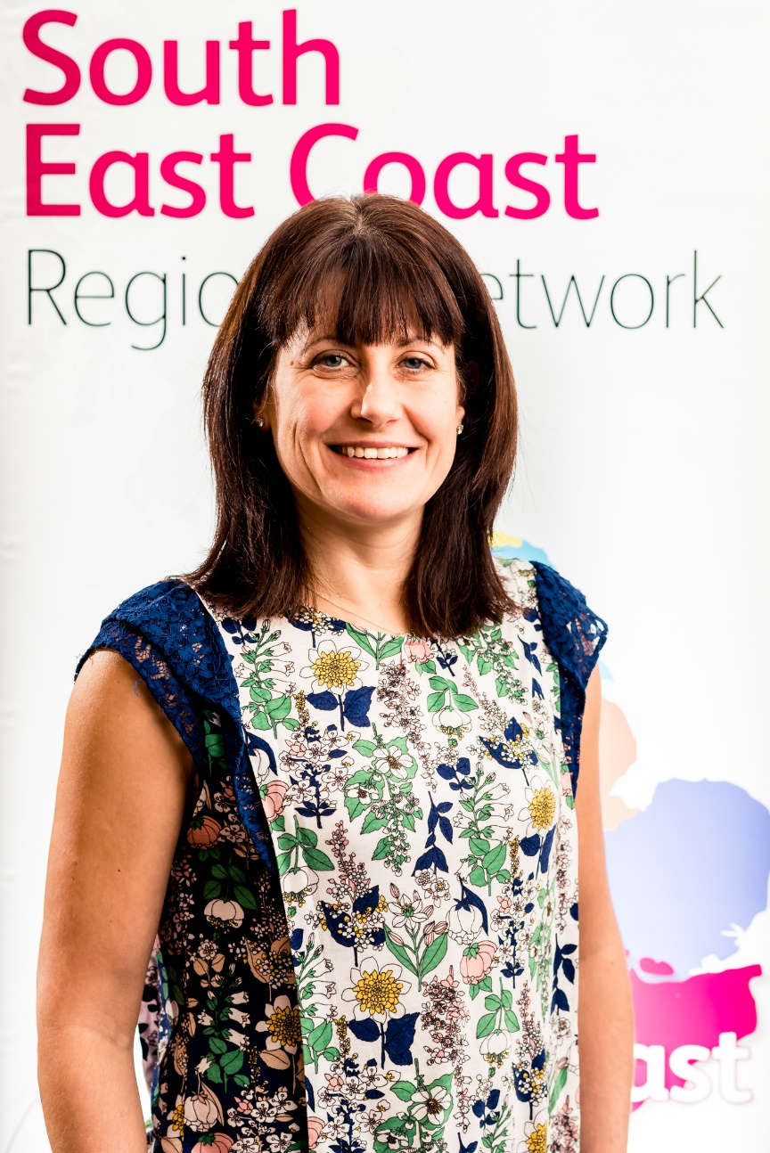
Chair – Zoe Smith, Head of Palliative Care, Medway Community Healthcare CIC (covering Medway and North Kent)

Slide 4
CSP South East Coast core team members
Our core team of South East Coast members covers many of the counties across the region. We are always looking for new members to join the core team – we are particularly seeking representation from Surrey. If you are interested email Chair Zoe Smith - southeastcoastchair@csp.org.uk

Slide 5
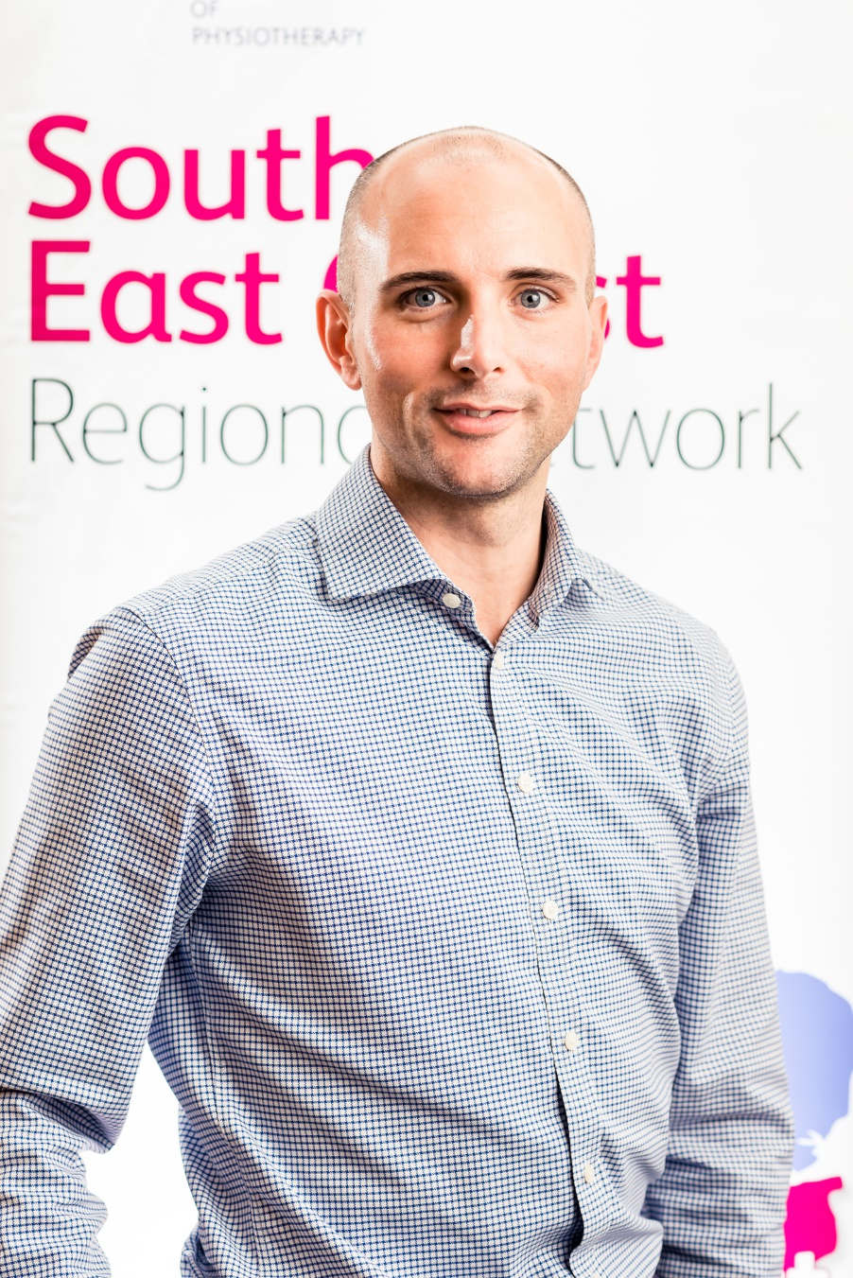
Matthew Carr, Clinical Director, Sussex MSK Partnership (covering East Sussex)

Slide 6
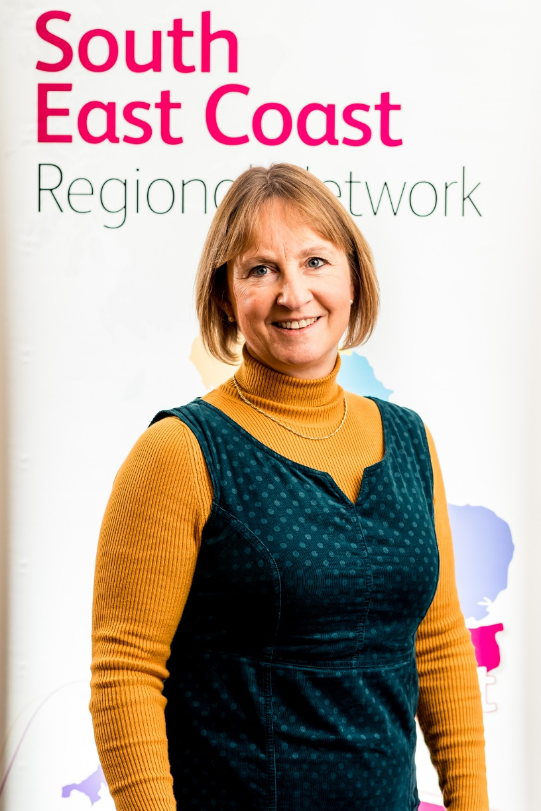
Sheila Doughty, Physiotherapy Professional Lead, West Sussex, Brighton & Hove, High Weald, Lewes and Haven Sussex Community Foundation Trust

Slide 7
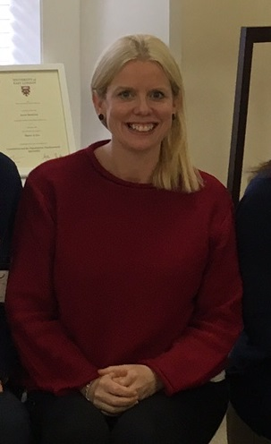
Sarah-Jane Ryan, Principal Lecturer, University of Brighton, School of Health Sciences – supporting education across the South East

Slide 8
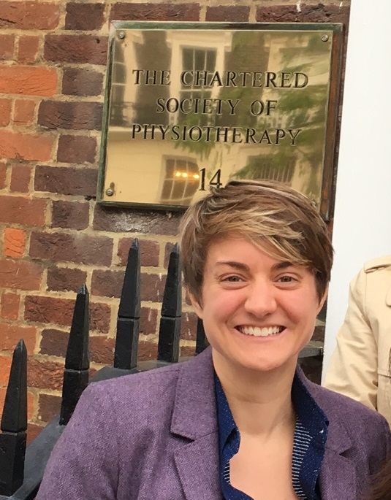
Katy Lyne, Deputy General Manager - Out of Hospitals, East Sussex Healthcare NHS Trust

Slide 9

The power of Networking
Natalie Beswetherick OBE MCSP MBA FCSP
Director of Practice & Development CSP
October 29th South East Coast RN Conference

Slide 10

Definition of network
An arrangement of intersecting horizontal and vertical lines

Slide 11

Definition…
…a group or system of interconnected people

Slide 12

networking
…interacting with others to exchange information and develop professional or social contacts

Slide 13

DEFINITION OF SOCIAL CAPITAL
…the networks and relationships among people who live and work in a particular society enabling it to function effectively…

Slide 14
Why is networking and your social capital important?
Getting the right post for you on graduating
Being able to influence your patients, your clinical educator, your line manager
Career development and progression
Having your voice heard – influencing decision-makers

Slide 15

Networks you can join
Students, stewards, H&S networks
Regional Networks
Professional networks
SoMe – Twitter, Facebook, WhatsApp
@we AHPs #PhysioTalk

Slide 16
Networking can be powerful and impactful
“ The richest people IN THE WORLD look for and build NETWORKS, everyone else looks for work”
Robert Kiyosaki

Slide 17
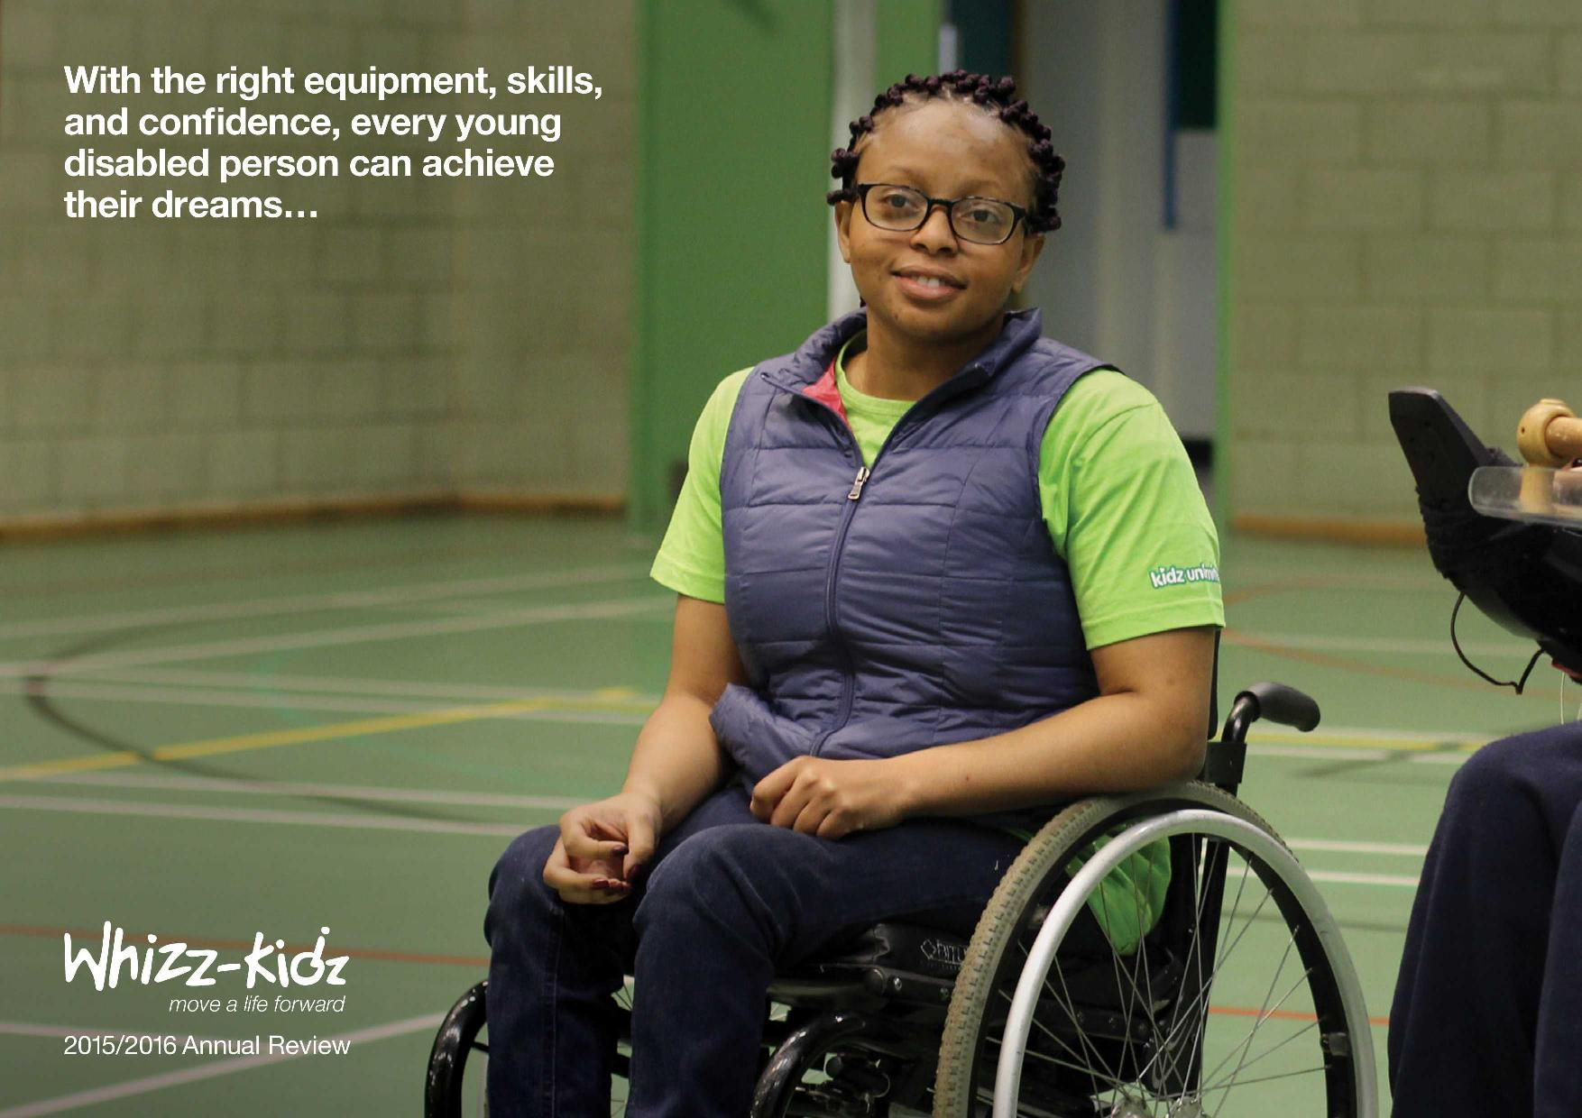
Whizz kidz Ceo:
Ruth owen obe
Applied methodical rigor to develop her network to achieve a meeting face to face with Secretary of State for health to influence commissioning of wheelchair services for children

Slide 18

The power of social networking!
DONALD TRUMP
President of the United States

Slide 19

Top tips for Networking
Networking is 2-way – be generous with your time, expertise & support
Think of who you want to network with and why
Set aside time every week to network
In a room of people – say hello to at least 5 strangers

Slide 20

Top tips for Networking
Take a note of the person’s name, job title or organisation
Listen attentively - be “present”
Ask for help or advice - can change the balance of power
Accept invitations to social events

Slide 21
Top Tips for networking
Join a professional organisation, working group or club
Keep a record of who you meet and some relevant information and use it next time you meet
Remember building a relationship takes time so don’t rush

Slide 22
“if you want to go somewhere, it is best to find someone who has already been there”
Robert Kiyosaki

Slide 23

Thank you
References
An A-Z of Management (2018) - Roy Lilley
Networking : do what you do best (2014) Karen Middleton Frontline July 2nd
How to make every contact count (2014) Karen Middleton Frontline August 6th

Slide 24
Transforming MSK services in East Sussex
Reflecting on the journey

Slide 25
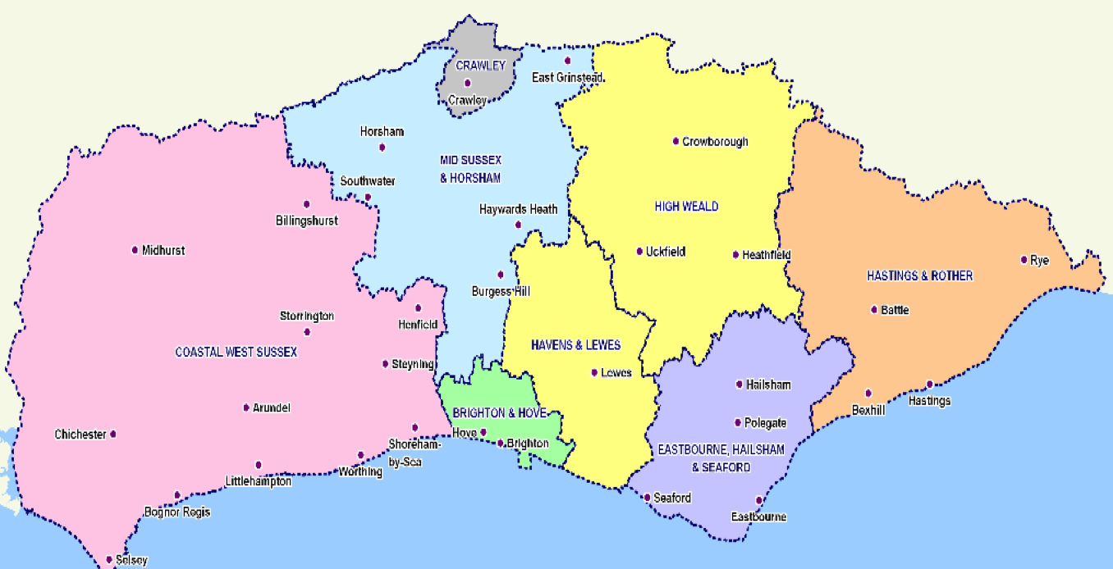

Slide 26
Local MSK Landscape pre-SMSKPE
Highly variable patient experience and access to MSK services
Outdated service design
Evidence of poor patient engagement in decision making
6th highest regional spend on MSK service nationally, per weighted population
Unsustainable spend on elective orthopaedic surgery; 20% greater than population-matched CCG’s

Slide 27
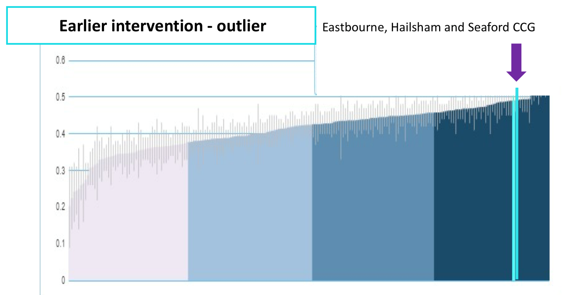

Slide 28
Transformation requirements
Reduce variation in practice – move closer to peer comparators
Develop a sustainable financial model
Improve accessibility
Improve patient experience and service quality
Update service model including improved supported self care

Slide 29
Phase 1
- convincing the stakeholders
- communicating an appealing vision
Epistemic / Scientific knowledge
Ethical / Personal knowledge
Phronetic / Professional craft knowledge
Knowledge types in expert clinical practice

Slide 30
Phase 2 – Achieving the vison
What? | How?
Reduce inappropriate clinical variation | Involve all parties Establish agreed clinical pathways
Develop a financially sustainable model | Understand your finances Plan strategically Spend to save
Improve accessibility | Evaluate your market Evaluate your options
Improve patient experience and service quality | Be pragmatic Chose meaningful quality measures
Update service model including improved supported self care | Know your field Plan engagement with a wide range of stakeholders

Slide 31

Phase 3 – demonstrate your impact
Audit
A
S
D
P

Slide 32
Questions?

Slide 33

Launching and Developing Rehab4U
Julia Buck
29 October 2018

Slide 34
Introduction
Julia Buck
  Qualified physiotherapist 1989 (St Mary’s Hospital, London)
  Specialised in Neurology 1994 (Leicester Royal Infirmary)
  1996 started a private practice alongside my NHS work (Eastbourne DGH and Community Stroke Team)
  2008 left NHS clinical practice to set-up Rehab4U with another neuro physiotherapist
  Today 13 clinicians and therapists work in the business

Slide 36
How I’ve developed the business
First patient – referred by a local Stroke Consultant
First 10 years – all word of mouth, now:
  70% of new patients are referred by word of mouth (local clinicians)
  30% self-referred via own website search or CSP website
  Have around 100 patients in treatment with Rehab4U
Have 6 agreements with local charities and nursing homes to provide neuro and other services
Grown the the staff numbers to 13 all known and local clinicians now providing:
  Neuro physiotherapy
  Occupational therapy
  MSK physiotherapy
  Later Life and Dementia physiotherapy
  Speech and language therapy
  Podiatry
  Counselling
  Exercise professional
  Sports and Massage therapist
  Rehabilitation Support Workers

Slide 37
Highs and Lows
Highs
  Patients – passionate about making a difference
  Working for yourself – flexibility, no organisational restraints and can be more creative
  Can see patients long-term (progress & maintenance)
  Better able to build relationships with patients
  Better paid than NHS
  Patients are more engaged
Lows
  Buck stops with Buck
  No NHS contract T&Cs
  Unpaid holidays
  Running a clinical business (invoicing, mandatory training, staff ‘issues’)

Slide 38
Unique Selling Points
Holistic (not just physio)
Responsive (usually seen within 72 hours)
Keeping costs down for patients
  Rehabilitation Support Workers and Exercise Professionals – blended support
  Group exercise classes
Ethically working alongside the NHS
Hand-picked team by me. They are great!

Slide 39
Why us?
Our vision is to support clients with long and short term needs to manage any physical issues they have and to be as independent as possible.
Many of our clients use our services to maintain their current levels of function whether that be mobility, fitness or posture.

Slide 40
Questions
Julia@rehab4u.co.uk
www.rehab4u.co.uk

Slide 41

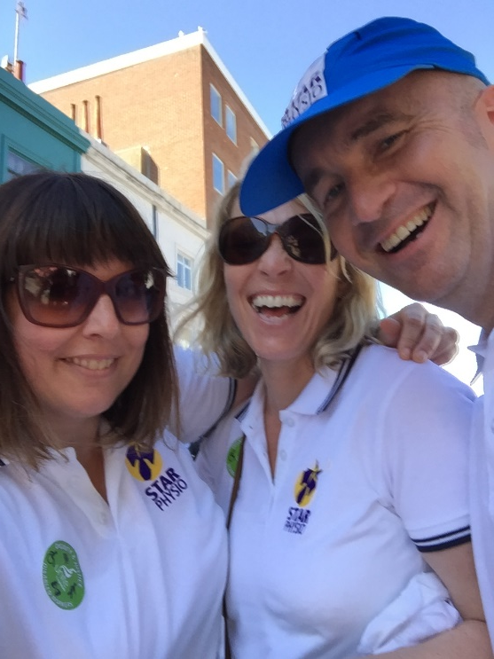
STAR PHYSIOTHERApY, THE JOURNEY SO FAR…..
Star Physiotherapy Community Interest Company
Company Number 11108149
‘MANY JOURNEYS, ONE MISSION’
It is our social goal to provide accessible rehabilitation for physically disabled children and their families in our communities.

Slide 42
WHO ARE WE? WHY ARE WE?
WHERE ARE WE?
WHAT ARE WE?
Star Physiotherapy Community Interest Company
Company Number 11108149
‘MANY JOURNEYS, ONE MISSION’
It is our social goal to provide accessible rehabilitation for physically disabled children and their families in our communities.

Slide 43
What’s one of those?
Star Physiotherapy Community Interest Company
Company Number 11108149
A social enterprise is a revenue-generating business with primarily social objectives whose surpluses are reinvested for that purpose in the business or in the community, rather than being driven by the need to deliver profit to shareholders and owners.
WhY NOT A CHARITY?
A charity fundraises and relies on donation reinvest in its cause, a social enterprise has the same re-investment goal but does this through selling goods or services…..in this case us and our skills to the community. In order to be a social enterprise we are registered as a community interest company, which basically means we are accountable for our profits being used for the good of the community.
‘MANY JOURNEYS, ONE MISSION’
It is our social goal to provide accessible rehabilitation for physically disabled children and their families in our communities.

Slide 44
Where it all began…….
Star Physiotherapy Community Interest Company
Company Number 11108149
‘MANY JOURNEYS, ONE MISSION’
It is our social goal to provide accessible rehabilitation for physically disabled children and their families in our communities.

Slide 45
We WON!!!????!!!!!!
Star Physiotherapy Community Interest Company
Company Number 11108149
NEXT STEPS?
HOLLY JOINED THE TEAM
EMBARKED ON A CROWDFUNDING CAMPAIGN
USED THE COMPETITION MONEY
    REGISTER THE BUSINESS
    INVEST IN TRAINING
    EMPLOY AN ACCOUNTANT
    BUY SOME MUCH NEEDED EQUIPMENT
    MAKE A CROWDFUNDING CAMPAIGN FILM
‘MANY JOURNEYS, ONE MISSION’
It is our social goal to provide accessible rehabilitation for physically disabled children and their families in our communities.

Slide 46
We PUT IT OUT THERE…..EEEKKK!
Star Physiotherapy Community Interest Company
Company Number 11108149
‘MANY JOURNEYS, ONE MISSION’
It is our social goal to provide accessible rehabilitation for physically disabled children and their families in our communities.

Slide 47
We PUT IT OUT THERE…..EEEKKK!
Star Physiotherapy Community Interest Company
Company Number 11108149
We raised the money we needed to go forward......
How are we investing this to reach our social goal
    More equipment – shower trolley/pool stretcher/steps
    Business development – Business development advisor (6 months)
    Fundraiser to look at potential premises/build
    Further training (Specific to needs of client base)
    Developing our 3 strands of practice
    Website development and support
‘MANY JOURNEYS, ONE MISSION’
It is our social goal to provide accessible rehabilitation for physically disabled children and their families in our communities.

Slide 48
SOME IDEAs…..
Star Physiotherapy Community Interest Company
Company Number 11108149
    Marketing Strategy for corporate sponsorship
    Fundraising events
    Local support - businesses
    Family/Parent/Carer involvement
    Professional support - CSP
    Networking and sharing our mission
    Selling our services to providers (Packages of care/training)
‘MANY JOURNEYS, ONE MISSION’
It is our social goal to provide accessible rehabilitation for physically disabled children and their families in our communities.

Slide 49
THE FUTURE…..
Star Physiotherapy Community Interest Company
Company Number 11108149
KNOWLEDGE
FUTURE
STRATEGY
VISION
‘MANY JOURNEYS, ONE MISSION’
It is our social goal to provide accessible rehabilitation for physically disabled children and their families in our communities.

Slide 50



HURDLES
Star Physiotherapy Community Interest Company
Company Number 11108149
‘MANY JOURNEYS, ONE MISSION’
It is our social goal to provide accessible rehabilitation for physically disabled children and their families in our communities.

Slide 51
ANY QUESTIONS/ideas/support?
Star Physiotherapy Community Interest Company
Company Number 11108149
info@starphysio.org
jo@starphysio.org
holly@starphysio.org
Steve@starphysio.org
https://starphysio.org
@starPTBrighton
‘MANY JOURNEYS, ONE MISSION’
It is our social goal to provide accessible rehabilitation for physically disabled children and their families in our communities.

Slide 52
Break

Slide 53
Finding and Using Data to Transform and Influence
Natalie Beswetherick
Director Practice and Development @CSP

Slide 54
The challenges we face
Health and wellbeing gap
Care and quality gap
Funding gap
Radical upgrade in prevention
Efficiency and investment
New care models
Notes:
These are the challenges outlined in Five Year Forward View and the 10 year plan will most likely be an iteration of these
Same challenges as we move forward…..

Slide 55
Quadruple Aim
Patient Experience
Satisfaction
Quality
Trust
Costs
Lower costs
Appropriate spending
Staff Experience
Professionalism
Joy at Work
Recruitment & Retention
Outcomes
Effective interventions
Less preventable illness
Less variance
Notes:
All will have heard of the ‘Tripe Aim’ – safe, effective patient centered care but after tragedies such AS Francis staff experience is also recognised as being really important

Slide 56
Sustainability and Transformation Partnerships
NHS organisations and local authorities come together to develop ‘place-based plans’ for the future of health and care services in their area.
Average population - 1.2 million people (from 300,000 to 2.8 million).
Providers and commissioners come together to manage the collective resources available for NHS services for their local population
Notes:
Most STPs are developing into different things e.g. ICSs
Need to be aware of whats happening with yours locally.
Do you know?

Slide 57
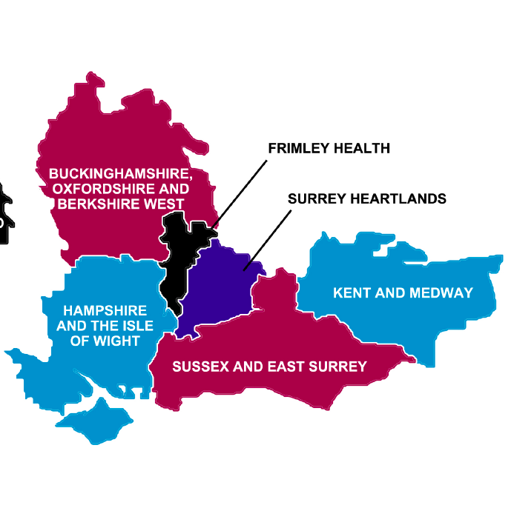
http://www.surreyheathccg.nhs.uk/policies/stp/813-frimley-health-and-care-system-stp-summary-document/file
https://bobstp.org.uk/media/1036/public_summary_final.pdf
http://surreyheartlands.uk/about-surrey-heartlands/our-plan/
http://kentandmedway.nhs.uk/wp-content/uploads/2017/03/Transforming-health-and-social-care-in-Kent-and-Medway-updated-Nov-2016.pdf
http://www.uhs.nhs.uk/Media/SUHTInternet/News/HIOW-STP-summary-Nov-2016.pdf
Notes:
STPs in area – simply googled and found the high level plans for your areas
E.g. Frimley Health;
1. Improve wellbeing and increase prevention, self-care and early detection.
2. Improve treatment planning for patients with long-term conditions, including
greater self-management and proactive management across all providers.
3. Provide proactive management for people who have multiple, complex and
long-term physical and mental health conditions, to reduce crises and
prolonged hospital stays.
4. Redesign urgent and emergency care, including integrated working and
primary care models providing out of hospital responses to reduce hospital
stays.
5. Reduce variation and health inequalities to improve outcomes and maximise
value for citizens across the population, supported by evidence.

Slide 58
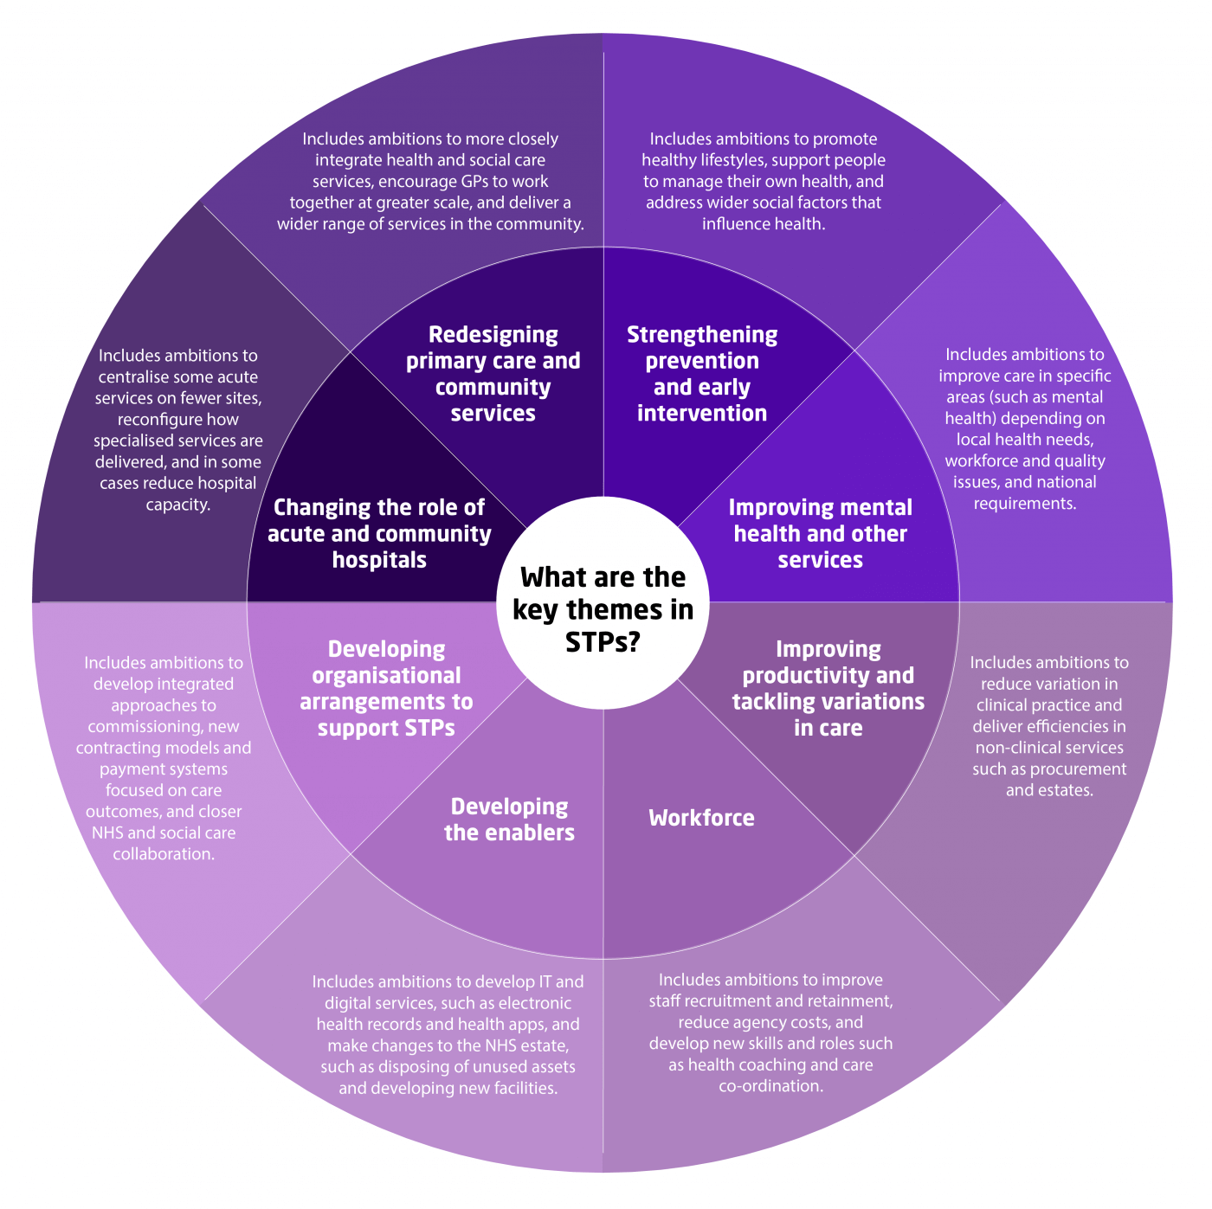
Notes:
Note that STps are often called or have morphed into something different …
Key themes across all; prevention, self management, tackling variation…

Slide 59
Common aims and objectives across the system
Local ownership –by care professionals and patients/citizens and carers.
People supported to develop confidence and skills to be as independent as possible, adults and children
People remain at home whenever possible.
Resources will be shifted to preventative, proactive care closer to home
Organisations will work seamlessly to ensure care is centred around individuals and carers
Mental and physical health and care needs of population addressed collectively and making best use of the public purse

Slide 60
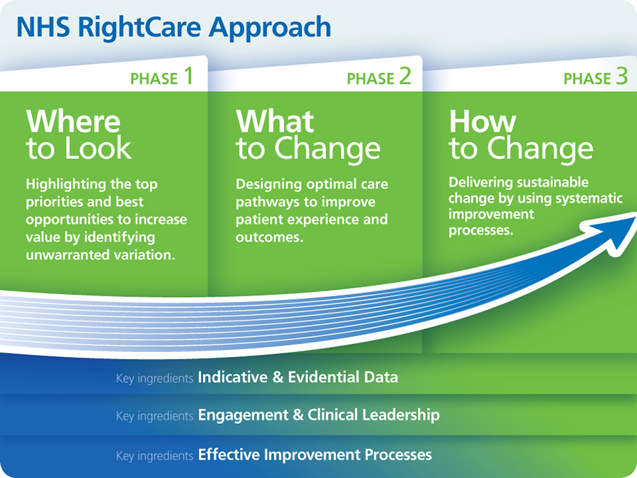
Notes:
Loads of great information on each area on RightCare website

Slide 61
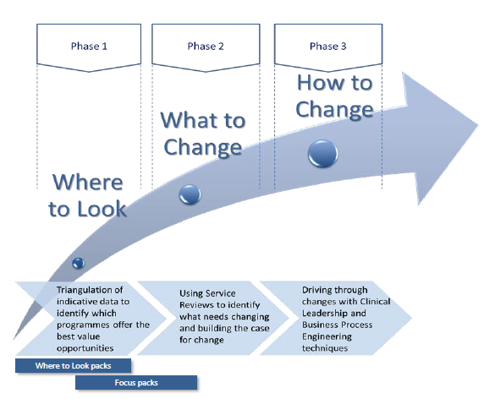

Slide 62

Notes:
Have a look at your own pack….

Slide 63
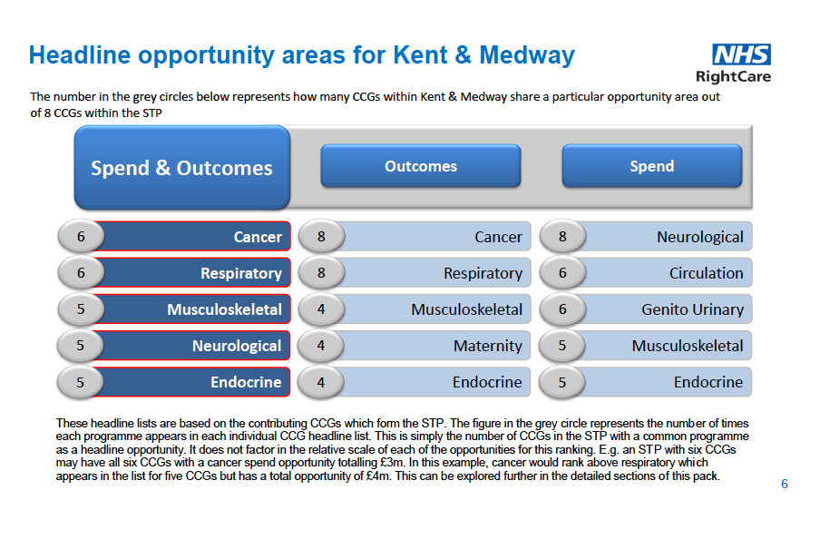

Slide 64
Joint Strategic Needs Assessment – usually at local authority level
Current and future health and wellbeing needs and inequalities within a population.
It is used to inform and guide the planning and commissioning (buying) of health, wellbeing and social care within the local authority area
Notes:
Use alongside RightCare data to get a greater understanding of what is happening at your local level
Also add your organisation and team data, Hip Sprint Data….

Slide 65
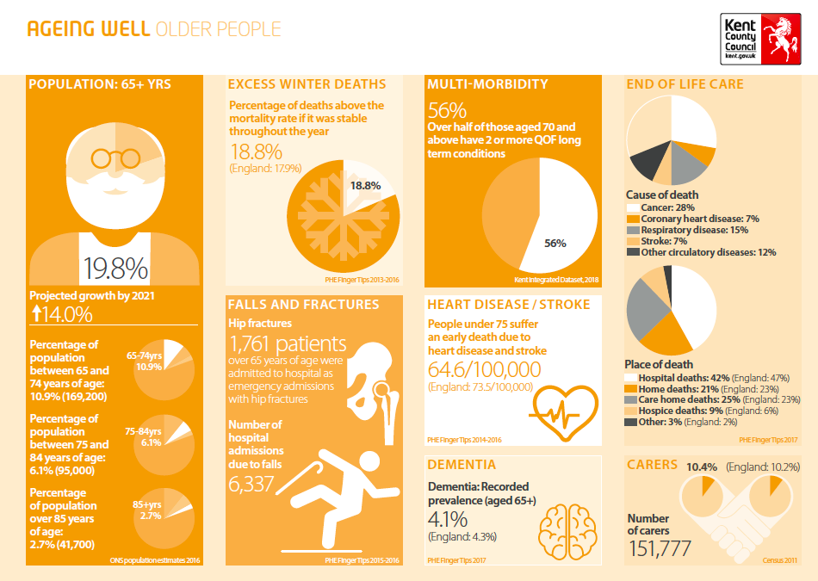
https://www.kpho.org.uk/__data/assets/pdf_file/0017/80027/JSNA-infogaphics.pdf

Slide 66
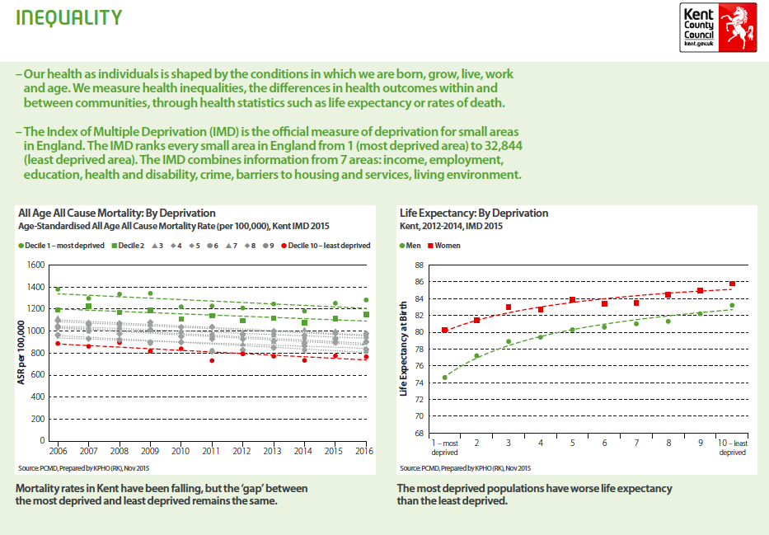
https://www.kpho.org.uk/__data/assets/pdf_file/0017/80027/JSNA-infogaphics.pdf

Slide 67
Data
Information
Evidence
Data is facts, intelligence, experience and statistics collected together for reference or analysis. This includes from qualitative and quantitative sources |  | Information is the product of processing, evaluation and critical appraisal of data |  | Evidence is the management, use and sharing of information

Slide 68
What data do we have?
And how do we use it to evidence the value of our services and how we can impact on patient care?
Can we link it to the data that is used in the wide system (CCGs, Local Authority, STP/ICS)
Notes:
If time could use as a short activity to let them discuss / explore what data they have and what they need

Slide 69
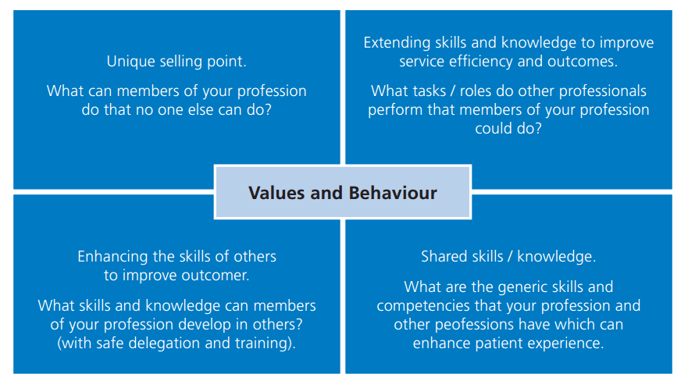
Readiness for future care
www.england.nhs.uk/ahp
Notes:
AHPs into Action
What data do we have to help us understand this about ourselves and our service

Slide 70
At this critical moment, health care needs leaders with the courage to develop, design, and test new models of innovation, collaboration, and governance that can take health care beyond its traditional limits.
Institute for Healthcare Improvement Leadership Alliance, 2016

Slide 71
Working lunch &
Rotating table top exercise

Slide 72
Break

Slide 73

The Art of Avoiding ‘No’
Essential Skills for a Successful Elevator Pitch
Jon Ryan, Head of Press & PR, Chartered Society of Physiotherapy

Slide 74
What we’ll cover in this session
How to identify and hone your strongest argument
Understanding your audience to tailor your pitch
How to deliver the pitch in a way that opens doors for you

Slide 75
What is a logline?
A simple one or two sentence description of your story.
It contains the hero, the hero’s goal and the central source of conflict.
Only information that is ABSOLUTELY ESSENTIAL gets included.

Slide 76
Let’s look at some examples..
A young F.B.I. cadet must confide in an incarcerated and manipulative killer to receive his help on catching another serial killer.
Three groomsmen lose their about-to-be-wed buddy during drunken misadventures, then must retrace their steps in order to find him.
Two imprisoned men bond over a number of years, finding solace and eventual redemption through acts of common decency.

Slide 77
So what should be in your pitch?
Your logline and an open-ended request to follow up.
Eg, ‘My service has reduced admissions by 30 per cent in the past six months and by expanding it, we can cut those numbers even further.’
‘I’d love the chance to discuss this further with you and show it could be done.’

Slide 78

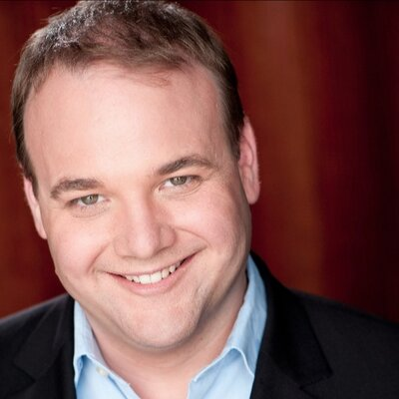

Slide 79
Know your audience
What are their objectives? And their pressures?
How can your offer help them meet those needs?
Prepare 2-3 different versions if necessary, to account for different people having different needs.

Slide 80

‘Now, how is that information gonna help me do my job?’
- Detective Mike Lowrey.

Slide 81

How to deliver your pitch

Slide 82
Delivery tips
Don’t panic!!
Calm, confident, measured – think about the image you want to project.
Practice saying it out loud and make it conversational.
Do not invade their personal space.. particularly in a lift.

Slide 83
And finally..

Slide 84
.. do not turn a pitch into a hostage situation.

Slide 85
Because what one word will that lead to?

Slide 86
Prison.

Slide 87
‘NO’

Slide 88
To sum up..
Know your message and your offer.
Know your audience.
Know when to leave.

Slide 89
Thanks for listening!
Jon Ryan
ryanj@csp.org.uk
@JonRyanCSP

Slide 90
What now?

Slide 91
Tell us what you think!
Visit www.menti.com
and insert code
92 69 00

