Slide 1


Research as a physiotherapist – What’s in it for me?
Dr Kathryn Mares and Louise Gilbert

Slide 2

Aims
To discuss some of the clinical research projects we are involved in
To highlight how this has worked from a clinical academic perspective
To share our experiences of working as research physiotherapists and as clinical academics.

Slide 3
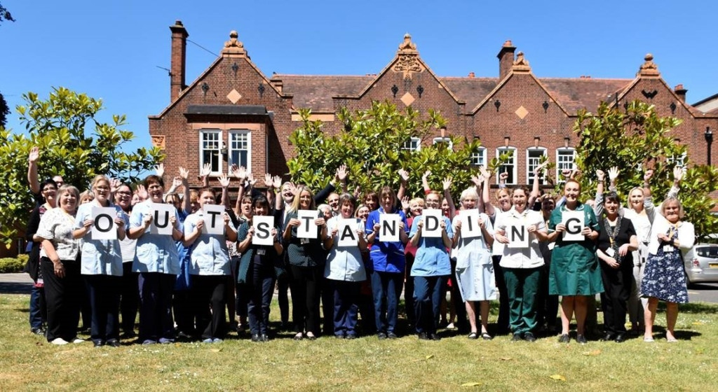
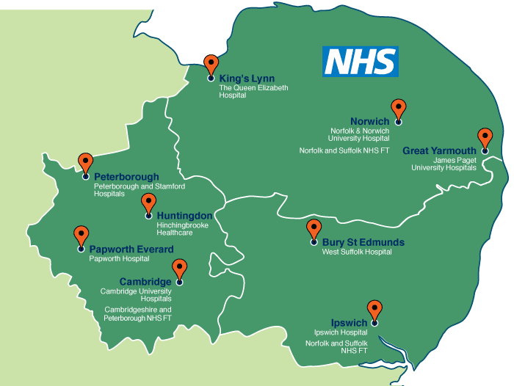
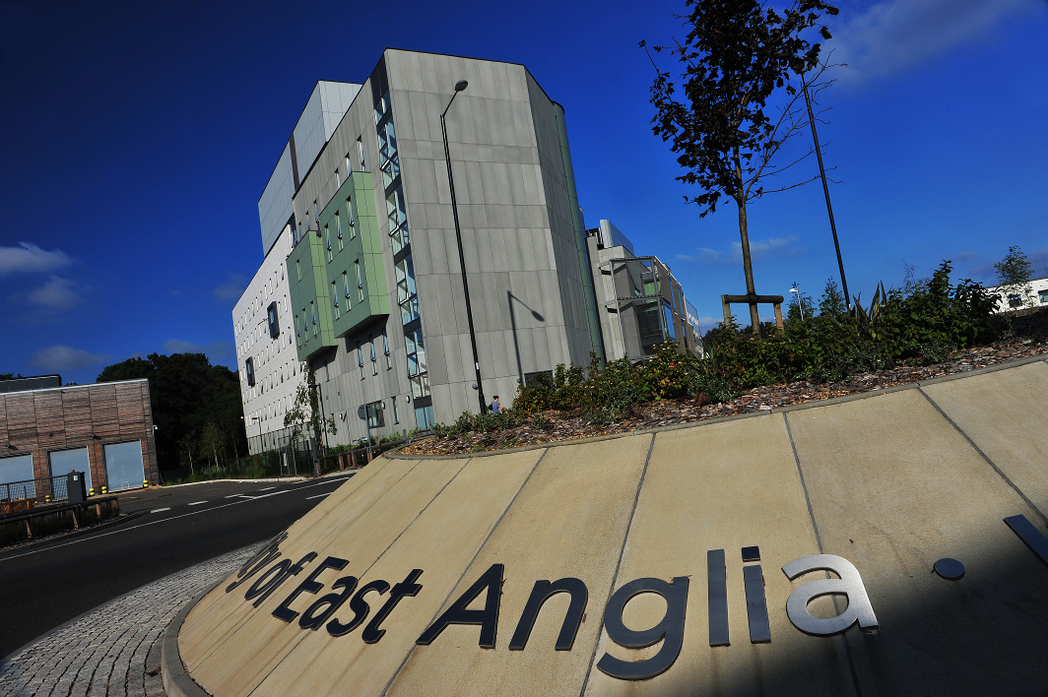
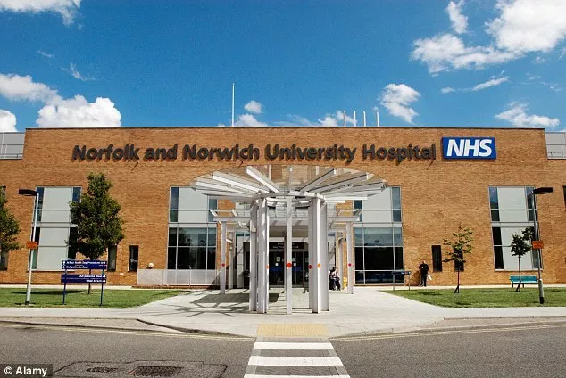
Stroke services in Norfolk

Slide 4

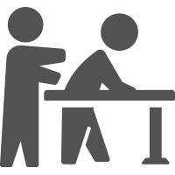



Stroke services in Norfolk
Acute event
Treatment
Stroke ward
In-patient rehab
ESD
+/-Community neuro rehab
6-month review
+/-Community teams

Slide 5

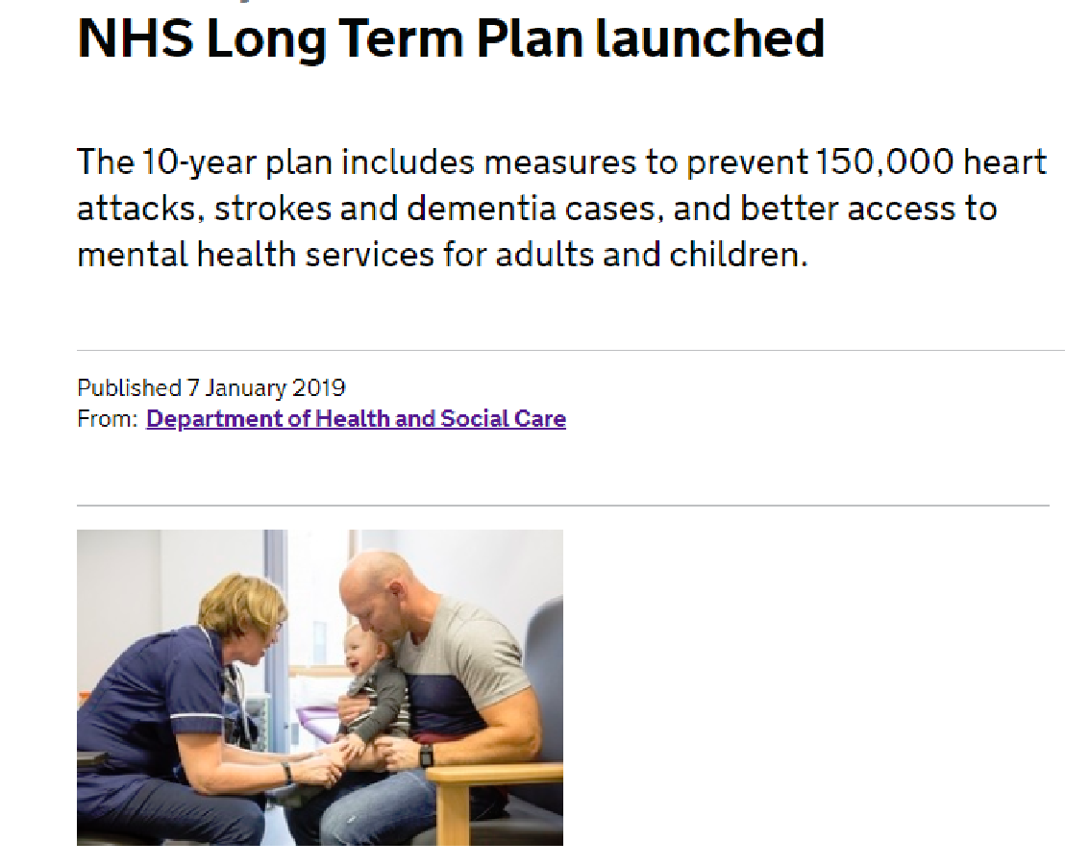
State of play: Stroke
More than 100,000 strokes in the UK each year; Almost 2/3 of stroke survivors leave hospital with a disability; People of working age are 2-3 times more likely to be unemployed 8 years after stroke; The cost of stroke to society is around £26 billion a year¹
Evidence suggests that therapies can be effective^{2,3} and that more therapy is a good thing⁴⁻⁷
Access to specialist stroke services is time limited and varies regionally⁸.

Slide 6

Challenges to clinical research: academic
It takes on average 17 years for research evidence to be embedded within usual care (Balas EA and Boren SA. 2000).
Meaningful clinical research involves co-production with all stakeholders.
Building relationships takes time.
Overcoming institutional barriers can be challenging.
Research may not be perceived to be important.

Slide 7

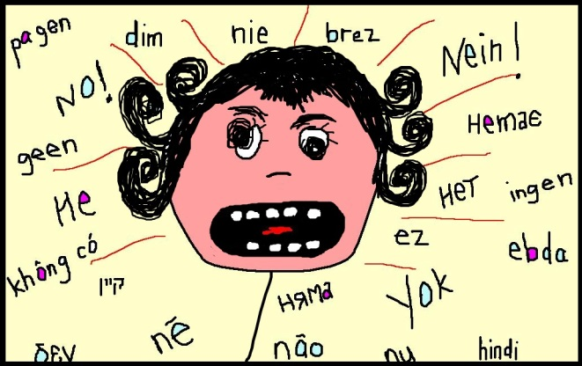


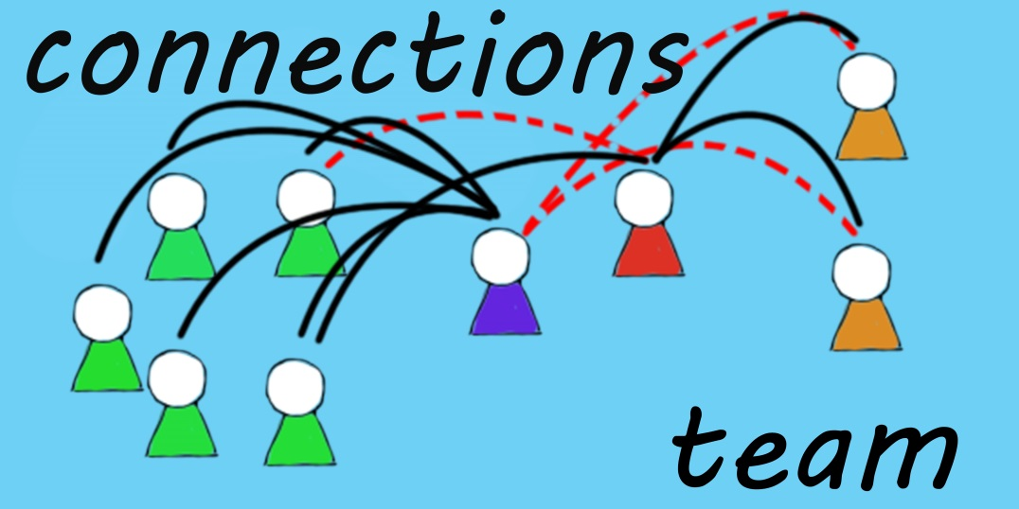
Challenges to clinical research: clinical
(Pager et al.2012; Janssen et al.2016)

Slide 8
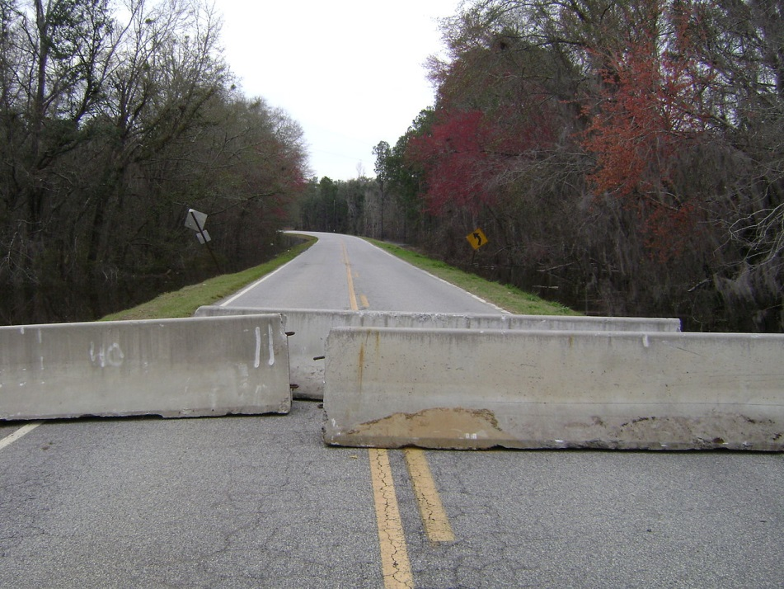
Challenges to clinical research
Lack of opportunity
Suitable training.
Lack of protected time (82%)
Inadequate funding
Insufficient experience
(Connolly B, et al. 2018)

Slide 9


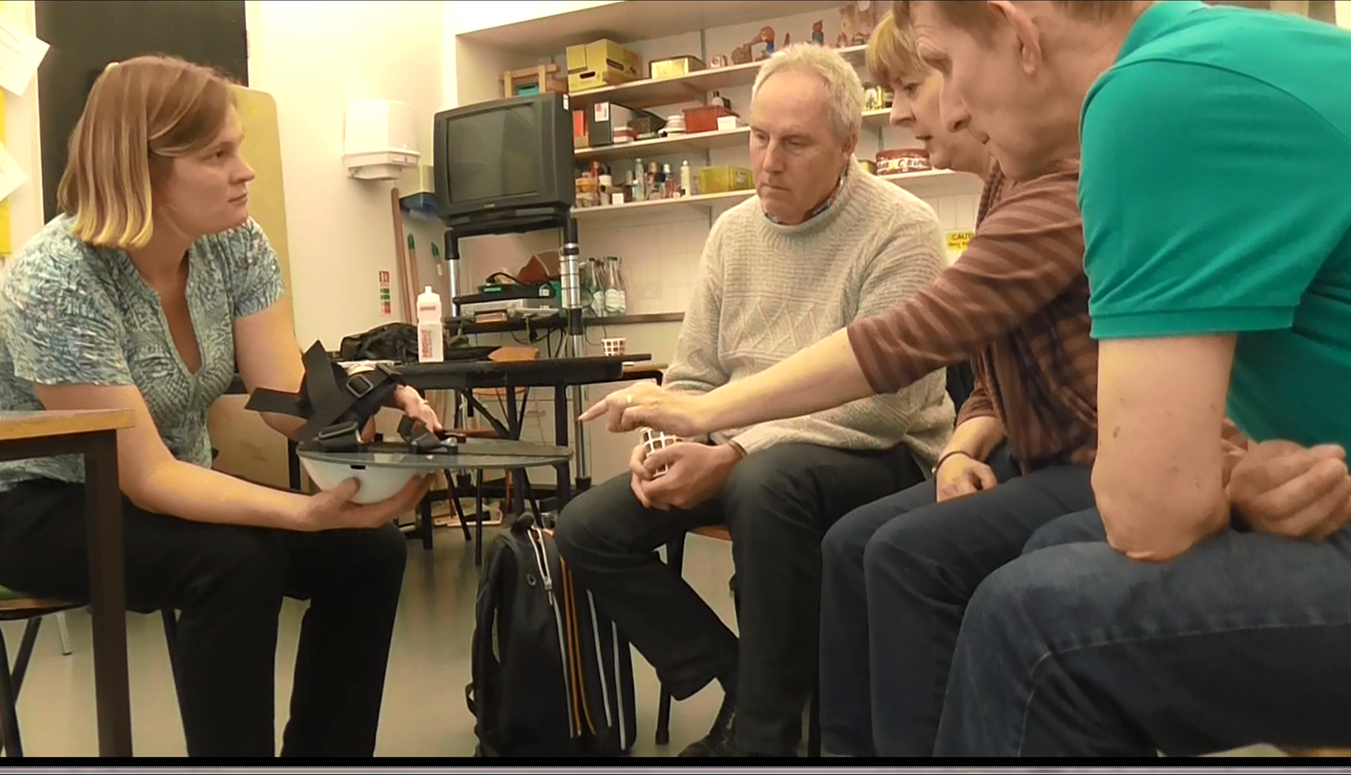
The ALLEX Board
Device for improving ankle movements after acquired brain injury.
Co production involving service users, clinicians, industry and academics.
Intervention development from a theoretical hypothesis
Initial aim was to develop a prototype device that could be taken forward for further trials.

Slide 10
Patient Research Experience Survey (PRES)
NIHR Coordinating Centre Accelerating Digital & PPIE Small Grants Fund
Academic team approached by the Clinical Research Network on a consultancy basis
Co-production of an aphasia accessible survey
Clinical Research Network
Eastern | East Midlands | West Midlands

Slide 11
Developing an APP to prescribe exercises to people after stroke (FeSTivAPP)
Idea for service improvement generated by the clinical team
Underpinning theoretical support generated by academics.
Digital technology developed through consultation with industry and service users.
Funding via UEA and Health Foundation
Proof of concept study

Slide 12

NHS Bursary
Feasibility testing of an orthotic already developed by a local company for use within the stroke pathway
An NHS bursary to buy a member of the clinical team out one day a week
To develop an ethics application and protocol
To develop a grant application
Mentorship by a member of the academic team is costed into the bursary

Slide 13


Achieved via….
Workshops to scope ideas
Regular meetings across sites
Facilitating and supporting service user involvement
Close links with R&D department
Attend research steering group meetings and Stroke CRN Eastern meetings

Slide 14

Reflections
Collaboration is essential so that research is clinically relevant and feasible.
Recruitment targets can be met more easily.
Meets strategic priorities (digital technology)
Research in a department will generate a research culture and capacity.
Wider service benefit (e.g. changes to delivery)
(Wenke et al.2017)
Research impact

Slide 15
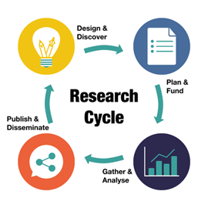
How can I do research as a physiotherapist?
Co-applicant
Research Associate
Participant
Student (MSc/PhD)
Advisor
Academic

Slide 16


How to…
Contact with Research and Development department
Links to Universities
Funding via for example Health Foundation; NIHR Research for Patient Benefit grant funding; Research and development depts.; university
Undertake a further degree - NIHR clinical academic funding and charities

Slide 17
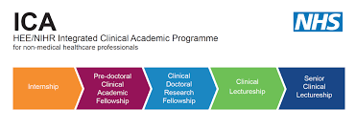
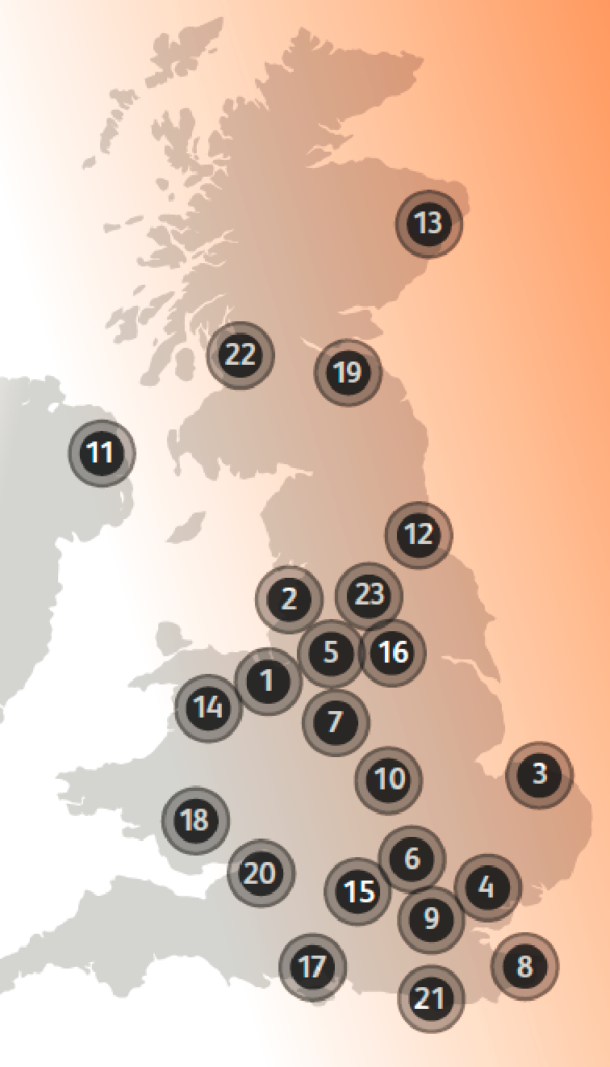



https://www.nihr.ac.uk/our-research-community/NIHR-academy/nihr-training-programmes/nihr-hee-ica-programme/
MSc Clinical Research
HEE funded Pre-doctoral internships
cahpr.csp.org.uk/
Chartered Society of Physiotherapists
Professional networks e.g. ACPIN

Slide 18

Research design Service
Helps researchers to develop and design high-quality research proposals targeted at NIHR and other national peer-reviewed funding bodies
Offers specialist advice on research methodologies and protocol development.
https://www.rds-eoe.nihr.ac.uk/
Research specific Training and development e.g. Good Clinical Practice
https://learn.nihr.ac.uk/
Clinical Research Networks
NIHR Clinical Research Network Eastern: Study support team/service
Email: CRNEastern@nihr.ac.uk

Slide 19

Research physiotherapy - What’s in it for me and my colleagues?
Improving care
Motivates me in my clinical role (increased confidence and job satisfaction)
Clinically relevant research driven by need
Team working
Opportunities – collaboration, meeting new people (industry), conferences
Learning new skills
Take a formal qualification
Involved in research without having to do an MSc or PhD

