Slide 1

CALL FOR ABSTRACTS
Submission period starts 14 February
www.
physiotherapyuk
.org.uk
Programme partners

Slide 2

Welcome!
CSP West Midlands Regional Network: Advancing the profession through First Contact Physiotherapy
#FirstContactPhysio

Slide 3
Visit us
@WestMidlandsCSP
Tweet us
#FirstContactPhysio

Slide 4
First Contact Physiotherapy:
the national scene
Sarah Withers
Head of FCP Implementation, the CSP
@sarahwithers20
#FirstContactPhysio

Slide 5
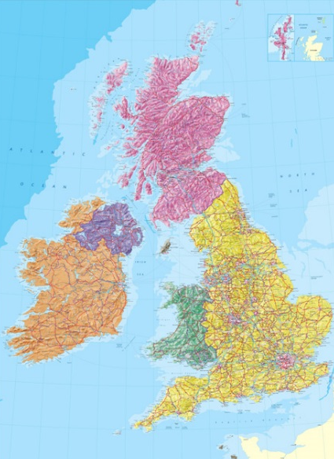

National Context - Background
By 2017, about quarter of all CCGs had commissioned at least one pilot FCP – but mainly small scale
In 2018, NHS England recommended that MSK pathways include FCPs - and instigated large scale pilots
In 2019, NHS England published its Long Term Plan
- this endorsed the pilots and requiring the roll out of FCPs in all local delivery plans.
In 2020-2024: progression of national roll out

Slide 6
First Contact Physiotherapy
What it is…
Expert Practice accessed in the same way as a GP
With access to other services and adjuncts as the GP team
With a focus on self management, community and social interventions to improve outcomes
High impact on improving many patients' care and the health care system

Slide 7
First Contact Physiotherapy
What it isn’t…
Fast track or self referral
A triage service
Primarily early input to physiotherapy advice
Some impact on improving some patients’ care and MSK services

Slide 8

Challenges across the UK
Implementation & mobilisation
Workforce
Demonstrating impact

Slide 9
FCPs within Primary Care: areas to consider
Operational processes
Provide diagnosis
Give patient advice and exercises – self-care
Discuss Fitness for work
Prescribe Medication
Give Injection therapy
Undertake Social prescribing
Give Physical activity advice
Person with MSK
condition booked in by receptionist to see FCP
In one session FCP will…
Knowledge
…so fewer steps and on the right path from the start
Local
Context
Knowledge
If needed:
Refer for course of physio treatment
Triage for orthopaedics
/rheumatology/ pain
Order investigations
Local
context
Operational processes

Slide 10



Resources @ csp.org.uk/fcp
Implementation guidance for FCPs in General Practice (developed by the CSP with the BMA and the RCGP)
Data collection guidance (and templates for Emis,
SystmOne & Vision)
Think Physio for Primary Care policy briefing
Job description example
Videos of FCP services (from HEE)
Calculator for estimating potential savings of FCP
Frequently Asked Questions on FCP
Case studies at innovations.csp.org.uk

Slide 11
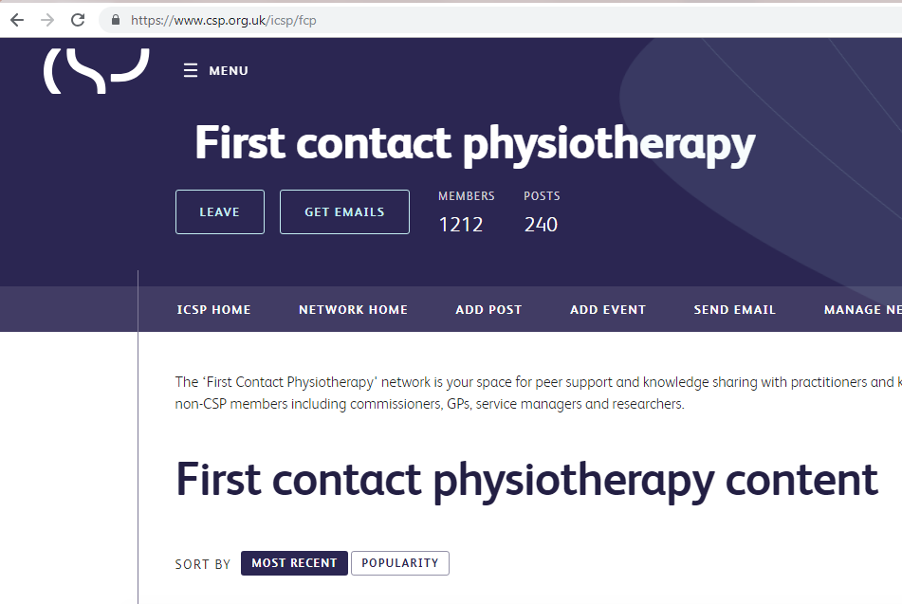
Support available
Join the growing FCP network www.csp.org.uk/icsp/fcp
or email fcp@csp.org.uk
Sign up to the twice monthly bulletin by clicking on ‘Get Emails’
Have a question or something to share? Post to start a discussion.

Slide 12
Growth in supply
41% increase in physiotherapy pre-registration university places in England, 2015/16-2018/19
30% increase in university programmes in England through expansion of existing courses and new providers entering the market in same period
Low attrition rates - 2.2% first year attrition for 2016/17
High translation to practice - 90% of recent graduates reporting having moved into physiotherapist roles after 6 months
Physio Degree Apprenticeship is now ready for delivery at both BSc(Hons) and MSc level

Slide 13
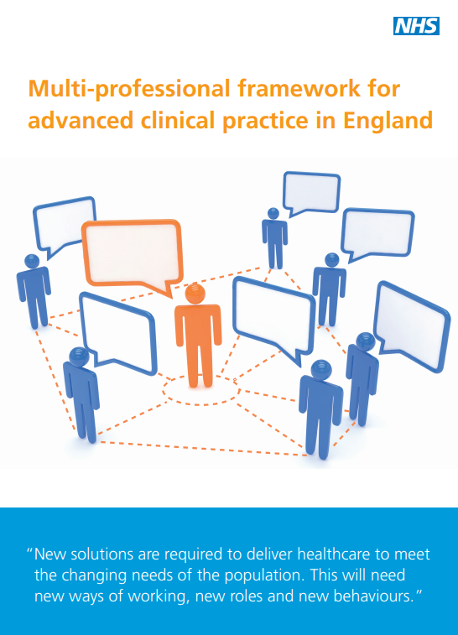

Advanced practice and FCP
The GP Contract Framework supports employing advanced physios at B7 & B8a who have the advanced skills and knowledge to:
  clinically assess, diagnose, treat and manage undifferentiated caseloads
  prescribe and administer therapeutic injections
  manage high-level risk and complexity
At present: around 9000 physios at B7 and above are
employed by NHS providers in England
The MSK Core Capabilities Framework should be
consistent with the clinical pillar for Advanced
Clinical Practice

Slide 14
The FCP workforce
Full roll out of FCP requires the expansion of FCP posts as stated in the NHSE Long Term Plan
1 FCP (WTE) per 10k population
FCPs form part of the 20,000+ new general practice posts included in the GP Contract Framework for 2020
First wave of FCPs are existing advanced practice roles in MSK community and triage services
- band 5/6 need to be developed to provide backfill.

Slide 15
What is required for FCP roll out?
Implementation of the HEE’s MSK Core Capabilities Framework
Generate sustainable FCP workforce supply
Align FCP initiatives with wider developments
Attend to FCP CPD needs

Slide 16
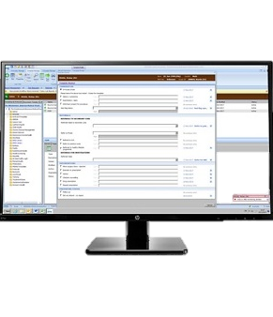
Demonstrating impact
NHS England evaluation of FCP
Last summer: 41 out of 42 STPs put forward an existing or forthcoming FCP service for the evaluation. Cited in LTP in January 2019.
Phase 1: provided local context (re: services’ funding, governance, staffing, providers, etc)
Phase 2: collation of appointment data captured on practices’ clinical data systems

Slide 17
Demonstrating impact
Phase 3: Demonstration of outcome and experience for patients (including PROMs and PREMs), GPs and physiotherapists.
Consists of:
  Stakeholder consultation to agree on service aims and success criteria.
  Online follow-up questionnaires post FCP consultation
  Interviews and focus groups with healthcare professionals and patients
Later in 2019 > Phase 3 opens to all qualifying FCP services across the UK

Slide 18
Key success outcomes
Maintaining safety
Improved access for patients to the musculoskeletal services as required
Improved GP capacity for other caseloads
Fewer inappropriate secondary care referrals
Improved conversion rates to surgery
Fewer inappropriate MRIs & X-rays
Reduced prescribing rates and costs
Fewer re-referrals for the same condition
Increased (and speedier) returns to work through issue of AHP Fitness for Work Reports
Improved patient self-care through supporting of self-management programmes and social prescribing
Improved ‘wellness’ healthy living message from FCP
Improved patient & staff experience

Slide 19
Areas of focus – Next steps
Implementation
Workforce
Demonstrating impact

Slide 20
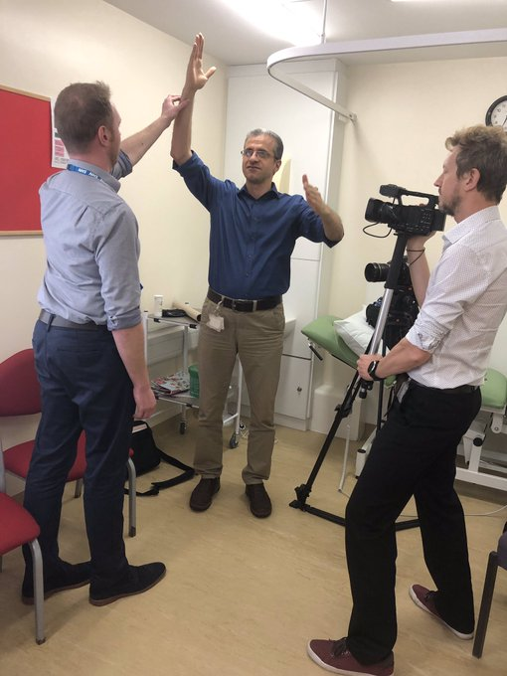
Fly the FCP flag!
Raise the profile of your FCP service locally and regionally
Promote your service on your website & social media (photos and video can help to make an impact)
Talk to your local media
(the CSP press team can help)
Invite your local MP for a service visit
Submit an abstract to the CSP’s Physiotherapy UK
conference & share a case study on the
Innovations website
More ideas are in the FCP Promotional guide in your packs
FCP service in Rotherham

Slide 21
FCP in the West Midlands –
where we are at now with implementation across the counties
(delivered by the FCP event panel)

Slide 22
Kay Stevenson
Consultant Physiotherapist
MPFT

Slide 23
Nadine Bibby & Kevin Bowers
Herefordshire NHS

Slide 24

South Warwickshire Foundation Trust
FCP Pilot
Samantha Berry
Roger Weddell

Slide 25
APP in GP Practice Pilots
2 Practices within Warwickshire
3 month trial – 0.5-1 day a week
20 minute appointments
Triage to decide best care – Core PT/Secondary Care/Diagnostics/pain medication
Notes:
SAM

Slide 26
Outcome of Pilot Studies
35% true first contact
40% Acute 60% Chronic
A variety of conditions seen
Outcomes
  Advice only 48%
  Physiotherapy 43%
  USS/MRI/nerve conduction/orthopaedics
  Prescribing
Notes:
SAM
True first contact (35%) favourably to service in Betsi Cadwaladr University Health board (33%) over 72 practices with 15 APP
D/C one visit advice only 48% and physio 43% are comparable to pilots in Cheshire windemere and Betsi Cadwaladr
Prescribing only small no patients but lots of advice on how to take medication

Slide 27
What went well
Service well utilised from the outset
High patient satisfaction
  Confidence to manage their problem GROC=4
  Confidence in physiotherapists competence to assess their problem 96% strongly agree
  Recommend service to family and friends 88% strongly agree
Notes:
ROG
We used a Global rate of change scale for how confident the patient was in managing the problem following their consultation
GP benefits to them More of an MDT approach- discussion re complex patients-2nd opinion re referral to secondary care or imaging
Also noted advantage to patients

Slide 28
What went well cont….
GPs reported they found the service beneficial
  MDT approach
  Ability to refer to APP when patient attended with 2 problems
Clinically rewarding and challenging!
  Development of clinical assessment skills
  Broadened clinical knowledge
Notes:
ROG

Slide 29
Lessons learnt
-it’s all in the planning!
Important to know the GP team you are working with
  Feel confident to discuss patients
  Improve MDT working
  Improve 2 way communication
  GPs confident to refer/discuss
  Reception staff need to understand the role
Knowledge of GP computer system
  Time saving
  Referrals
Notes:
SAM
Discuss especially re medication
Know when it is ok to disturb them and how
Gps know your areas of special interest /skill
GP reduce threat of position when confident in our skill and that it differs from theirs – reduce threat ( in our pilot it was notable that GPs referred more as time went on)
Reception staff need to be able to triage the right patients into the service
?spend time in each of their clinics- important to become part of the team

Slide 30
Cont…
Time to advertise the pilot to patients
  Patients need to know they can book!
  Patients need to understand the role of APP
Be prepared with plenty of resources
  Information booklets
  Web pages
Pilots need to be longer and enough hours
  Limited impact doing 1 clinic per week (max 12 patients)
  Limited impact over 3 months
Notes:
SAM
ROLE ie triage and give appropriate management not to give Rx
Limited impact in terms of clearly demonstrating the financial implications and following patient journey

Slide 31
Challenges vs Rewards
Sticking to 20 mins
Patients attending with vague symptoms
Prescribing
GPs fully understanding the role
Seeing patients early in their journey and reducing the risk of chronicity
Shortening patient journey
Giving patients confidence to self-manage
Notes:
ROG

Slide 32

Questions?

Slide 33
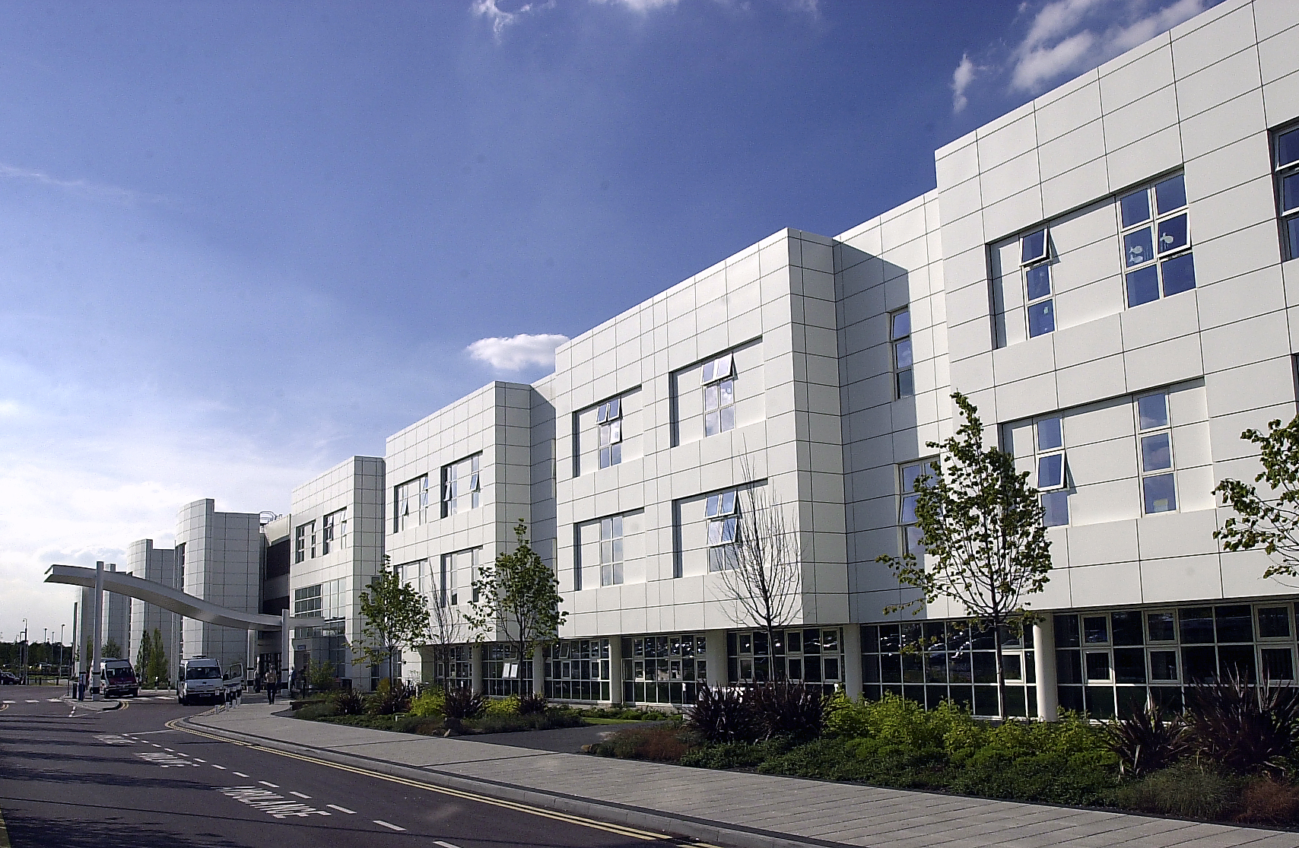

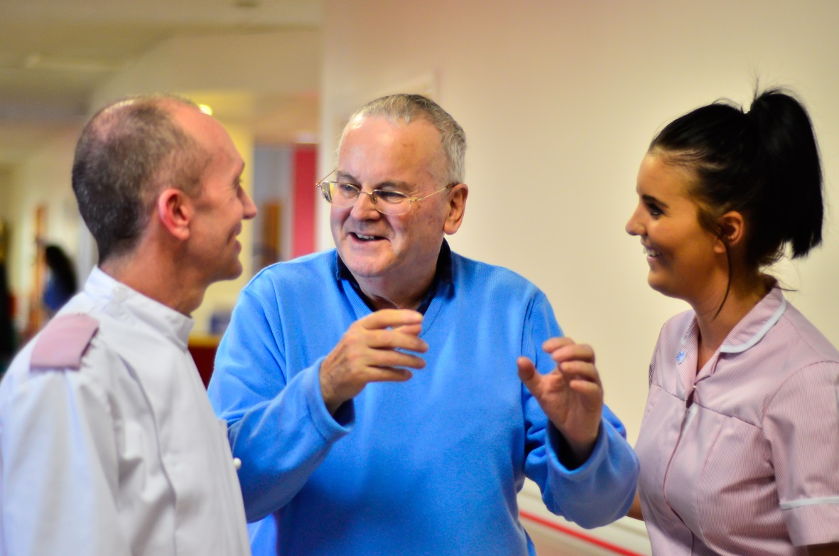
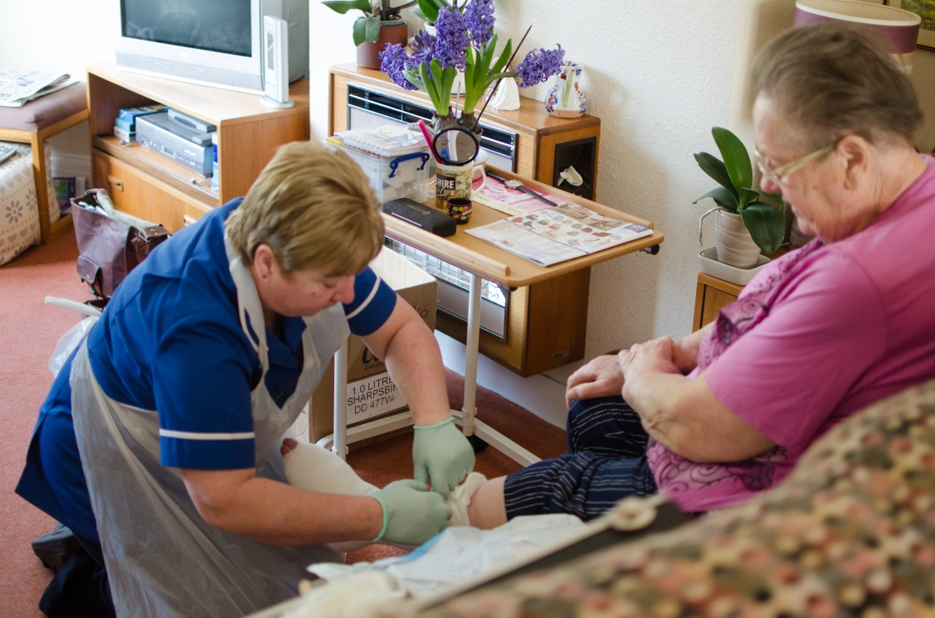
First Contact Physiotherapy in Dudley
Laura Gibbs-Grady
Interim Therapy Manager – outpatients and community MSK Physiotherapy

Slide 34
Our teams
Community MSK Physiotherapy | Orthopaedic Assessment Service
Band 5 = 2.71 WTE | BAND 8a = 3.94 Spinal, Lower Limb And Upper Limb Sub-specialisms
Band 6 = 3.20 WTE
Band 7 = 5.46 WTE
Band 8a = 0.61 WTE
Medicine & IC directorate | Surgical directorate
Notes:
Matt Hall manager for OAS present today and Jane Clint is also present from the service who are both band 8a’s.

Slide 35
Our FCP story so far…
6 GP practices across Dudley
10 sessions per week
x3 band 8a and x7 band 7
Mixture of bank staff and existing staff from physiotherapy and OAS team
4 hours per session
30 minutes slots

Slide 36
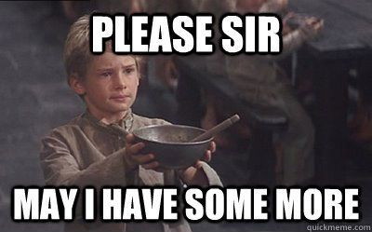
The biggest challenge!!!
Notes:
Talk about funding
Initially, very difficult to get any extra funding so started out of existing hours in physio team and then had some non recurrent funding from NHSE £50,000 to allow us to establish the pilot. We are now at the point of wanting to expand the service and have proposed a rollout plan to our commissioners that would initially start with x4 band 7’s and x4 band 8a’s for the first year however still waiting for green light from CCG to nstart recruitment process.

Slide 37
Other challenges
Clinical governance and structure
Managing urgent results
Data capture
Maintaining waiting lists
Commissioners expectations
Who benefits from the savings???
GPs!!!
Notes:
Clinical governance
Not enough band 8a’s locally or nationally to fulfil role and also locally we have debated whether they should all be band 8a’s as leads to a very expensive service? Certainly need clinical expertise of band 8a’s when it comes to imaging, diagnostic skills for complex cases but not all FCP cases are complex and the alternative argument is that band 7’s are more skilled in rehabilitation. We are hoping to have equal mix of band 7 and band 8a with one per integrated care team or PCN to allow for support and also a succession plan.
Urgent requests
Every GP surgery is run differently so do you mould FCP to fit in with the GP surgery working practice or do you standardise it and the GP’s have to fit in. This became apparent with the management of urgent results that FCPs have requested but are not there to action and can’t wait until next clinic. Our decision with the support of the CCG was that the on call GP in the surgery would action these results as they would do with their GP colleagues however some GP surgeries where opposed to this and wanted us to have an on call band 8a who actioned these referrals. Logistically this would be a nightmare to organise on a larger scale and we would need a data sharing agreement for all 49 GP surgeries.
Data capture
The EMIS template isn’t the easiest to use in clinic but I appreciate why we need it. Locally we are concerned regarding the red flag question, which I know has been raised by numerous other services. The data is collected by information team at CCG and we have had to go back and question it on numerous occasions for accuracy. Easy to do on small scale but harder on bigger scale.
Waiting lists
Pilot isn’t big enough to have a positive effect on our physio and OAS waiting lists but is talking clinicians out of services so both services are struggling. If recurrent funding isn’t agreed soon then the pilot will have to stop or reduce which is a shame when we have done the hard work to get it up and running.
Expectations
Commissioners initially thought that physios could be transferred from physio service to FCP once waiting lists reduced. They didn’t understand that the majority of FCP work is new activity not necessarily a transfer of activity. We also had to make it clear that the physio team would not reduce in WTE’s as expected as we would use the reduced activity to actually treat patients and offer more extensive rehabilitation which we struggle to offer now!
Cost savings
FCP reduces costs for the commissioners however what is the effect on the trust?
GPs
Signposting patients in to FCP clinics to skip the physio WL rather than for a true second opinion

Slide 38
Positives
Patients love it!!!
Physios love it!!!
Improved pathway
Early advice and the right messages early on
Closer working relationships with GPs
Opportunity to expand MSK services and career progression

Slide 39
Advice
Have clear structure from start with dedicated FCP lead
Set expectations for service early
Don’t presume everyone understands FCP
Don’t presume everyone wants FCP!
Set clear pathways for suspected sinister pathology
Notes:
We have been thrown in at the deep end by having to scramble a pilot together so we are learning this the hard way!!

Slide 40
Data
Notes:
Add in patient satisfaction results
Proves what all the other pilots and resources have been saying

Slide 41
Resources
Currently finalising service specification for FCP
Reception pack
Implementation checklist
EMIS crib sheet for new starters
Need competencies for band 7 and band 8a

Slide 42
Thank you for listening
Any questions?

Slide 43
Break

Slide 44
Table-top session 1 – FCP locally: Lessons learned so far –
Q&A with the FCP Event Panel

Slide 45
Lunch

Slide 46
FCP workforce development
Sarah Withers
Head of FCP Implementation, the CSP
@sarahwithers20
#FirstContactPhysio

Slide 47
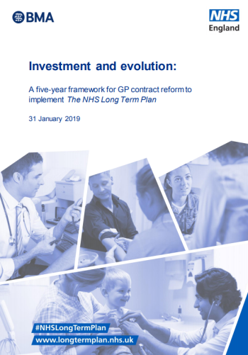
National roll out
In 2019, Five-Year Framework for GP contract reform outlines the roll out of FCPs through the Additional Roles Reimbursement Scheme
The Scheme will fund an estimated 20,000+ additional posts in 5 specific primary care roles by 2023/24 including FCPs at Bands 7 and 8a
From 2020, NHSE will reimburse 70% of the costs (including on-costs) for FCPs employed by Primary Care Networks

Slide 48
The FCP workforce going forward
Full roll out dependent on expansion of FCP posts
NHSE’s Long Term Plan and GP contract framework commits to this
1 FCP (WTE) per 10k
population
First wave of FCPs are existing advanced practice roles in MSK community & triage services
Physiotherapy is growing: 40% more graduate education places since 2015
> need more training pathways to backfill

Slide 49
What are your workforce challenges?

Slide 50
Solutions to meet the mix of needs?
Align with broader plans for recognition
Self-/peer-/employer-based assessment
Modules/e-learning support/ mentoring
Use of existing/emerging provision & models (e.g. the ACP apprenticeship)
Optimise MDT CPD opportunities / facilitate communities of practice

Slide 51
What training and development opportunities do you currently (or plan to) access or provide?

Slide 52

Next steps…

Slide 53
Table-top session 2 – FCP:
The local workforce

Slide 54
Table-top session 3 – FCP:
Working together & next steps

Slide 55
Break

Slide 56
Summary of discussions & what next?
Phil Hulse, Helen Owen
and Sarah Withers

Slide 57
Tell us what you think!
Visit www.menti.com
and insert code
21 13 47

