Slide 2

Karen Middleton CBE FCSP
Chief Executive, Chartered Society of Physiotherapy
middletonk@csp.org.uk
@KMiddletonCSP

Slide 3

Influencing the NHS England Long Term Plan
Published on 7 January 2019, the NHS England Long Term Plan is a major breakthrough for physio in England.
It sets out NHS England’s ambitions for service improvements for the next ten years, and a detailed strategy for how to achieve these over the next five.
The CSP worked hard to ensure that physio was positioned front and centre in the plan – and it worked!
However, the work is only just beginning and it’s vital that the physio workforce is listened to as the NHS Long Term Plan is developed. That’s where you come in!

Slide 4
Opportunities for physio
Across a range of conditions, and in a range of settings, physio and rehabilitation are highlighted in the Long Term Plan. There are significant opportunities for us to capitalise on.
^{Specific commitments include:}
  increasing the number of physios in primary care
  rolling out first contact physios
  improving access to rehabilitation in a wide range of areas including frailty, stroke, pulmonary and cardiac conditions

Slide 5
Physio at the heart of Primary Care
The plan references FCPs as part of its vision for primary care & puts FCP implementation on a firmer footing
The NHS Long Term Plan should ensure everyone in England has access to a FCP from their GP – so that a majority of MSK issues are dealt with entirely within primary care
Primary care is one of the most visible pinch points in the NHS, with many patients reporting long waiting times to see their under-pressure GP
Increasingly, physiotherapists are doing their part to ease those pressures by working alongside GPs as the first point of contact for patients with a musculoskeletal condition
This removes the need for a referral and speeds up access to specialist care
The long-term plan affords an opportunity to reshape the primary care landscape to further increase capacity and ensure more patients see the right professional at the right time.

Slide 6
Rehab: ensuring no-one misses out
Rehab matters - to patients, their families and carers, and to the system as a whole. Everyone has the right to rehab
It gives life back to people after injury or illness and reduces their need for health and social care services in the future
At present, access to it is inconsistent across the country, causing unacceptable consequences for too many patients
The good news is that rehabilitation is front and centre of the long term plan. It featured as an area for improvement across the clinical priorities in the plan
The long-term plan signalled a new approach to rehab, organised around symptoms and patient needs, rather than condition, by taking on board the potential for combined cardiac and respiratory rehab programmes
This was a point that the CSP highlighted in its submission to the plan.

Slide 7
Ageing well
The Long Term Plan sets out a series of bold ambitions for improving care for older people, including:
A renewed emphasis on proactive case finding of people living with moderate frailty risk, with patients identified through primary care records and offered targeted support, including for musculoskeletal conditions and falls prevention
A roll out of the Enhanced Health in Care Homes model, with all care homes nation-wide supported by a multidisciplinary team – including rehabilitative and therapeutic staff - by the end of the decade
The establishment of acute frailty services in all A&E centres, and the placement of therapists at the beginning of acute care pathways.

Slide 8
The future workforce
The physio workforce needs to grow, within broader changes to our health and care workforce. Growth is required across all professions, but with nurses, physiotherapists, other AHPs & non-medical professionals and support workers forming a larger part of the workforce
The physio workforce is growing and represents a solution to immediate shortages in other professions in the NHS. It is now going through a period of expansion
Since the changes to education funding, there has been an increase in student places of 41.5% (34% increase across the UK). This expansion needs to be supported and utilised in the transformation of rehabilitation pathways and primary care
There is no shortage of people wanting to join the physio profession, with high competition for university places. The skills and expertise this offers can also help drive the transformation of primary care and community services in the longer term
The long-term plan offers the chance to break down the barriers that exist and deliver a workforce that best meets the needs of patients.

Slide 9
What physio staff need to do: Think Physio Act Local
Each Sustainability and Transformation Partnership (STP) will develop a local plan to address what’s been set out in the LTP
Local plans for 2018/19 are being developed now and should be in place in every STP area by soon. Local five year plans should be in place by the autumn. Alongside these will be plans for developing the workforce that is needed in order to deliver and realise the ambitions that are set out
The CSP is taking action to highlight the contribution that physio staff can make to development and delivery of the plans with STPs, but we need to work with you to maximise this important opportunity
You can help position physio at the forefront when healthcare decision makers are developing plans and allocating resources in your local area
The focus is now on the STP local plans and influencing how these develop.

Slide 10
Reality check
We appreciate that this is not an easy ask of CSP members
There is a lack of AHPs in leadership positions – so may not automatically have a seat at the table
STPs are not transparent and partners in flux – so it’s not easy to know who to engage with
^{The} NHSE’s vision of ‘Integrated Care Systems everywhere’ lacks detail in terms of what these systems and organisations will look like
So influencing at this level will be extremely challenging, but absolutely essential
CSP members can rise to the challenge

Slide 11
Local examples
Caroline McNamara is joining us after lunch to give some local examples of opportunities in Leeds and how physio staff can capitalise on them
CSP staff recently met with the West Yorkshire Health and Care Partnership following a proactive approach from the CSP to the STP lead in the area. The HCP leads are very keen to get new thoughts, new solutions, find the right people to support programme work
Specifically we are looking for examples of innovative, evidence-based pelvic health services – local examples would be welcome. Please approach the event organisers with your ideas!
I am also meeting Suzanne Bolam, the Chair of South Yorkshire and Bassetlaw ICS AHP Council, and her network to discuss the ICS Council for AHPs. Suzanne is also joining us here today.

Slide 12
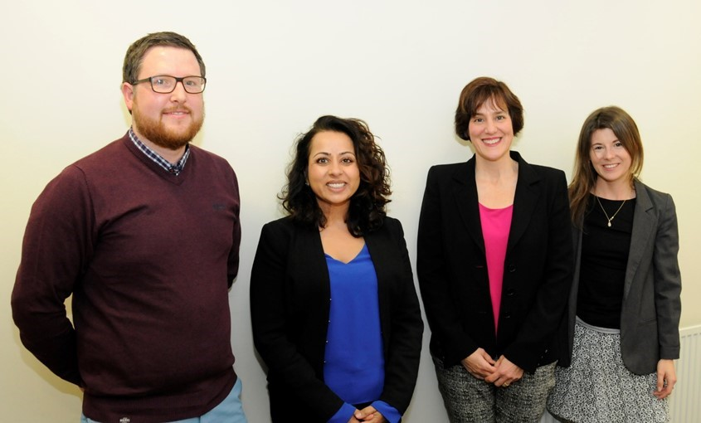
Local examples
Last week Rotherham based FCP Joe Henson met with Nikki Kanani, NHS England Director of Primary Care, alongside Sarah Withers, CSP Head of FCP Implementation, to promote first contact physio. This Sheffield ased meeting was arranged in less than one week following a proactive Twitter communications by Joe. This is a great example of following healthcare decision makers, being proactive and capitalising on opportunities to promote physio.

Slide 13
What can you do?
15 minutes
Review the examples of what you can do to promote physio
Think about what you can do and record your pledges
Share them on social media #physiofit4thefuture
Regroup and share ideas!

Slide 14
