Slide 1
My leadership Journey
Laura Proctor
Physiotherapist

Slide 2
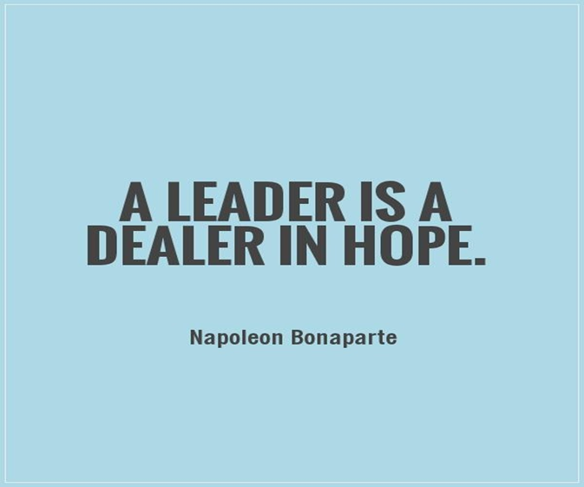

Slide 3
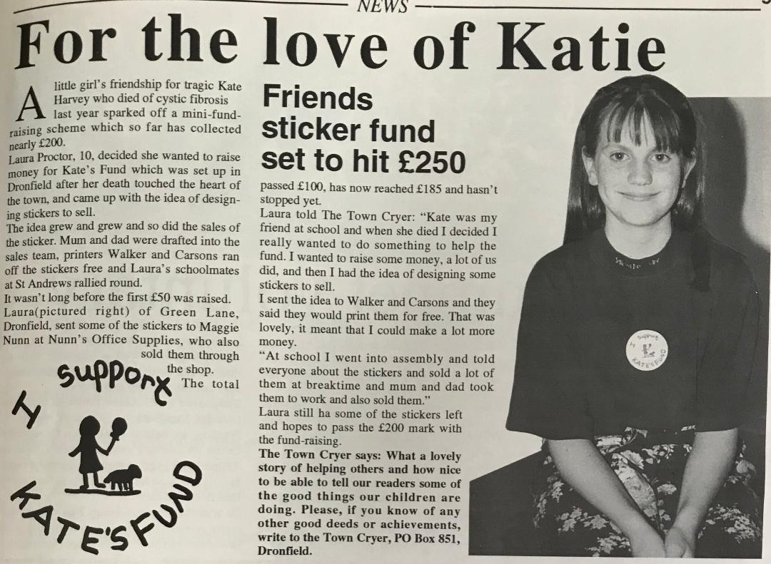

Slide 4
Recognise your strengths and play to them
Innovative
Determined
Compassionate
Motivated
Hopeful
Persistent
Courageous
Influential
Collaborator
I’m a leader

Slide 5
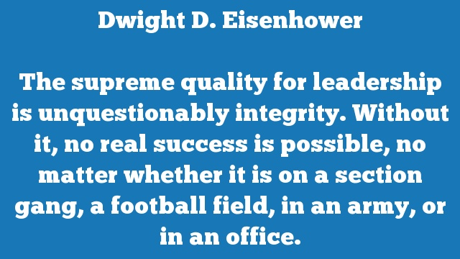

Slide 6


Slide 7
Do you recognise your strengths and play to them?
If not why not?
Reflective practice
360◦ feedback
Patient feedback
Clinical supervision
Coaching
Appraisals
Peer reviews
Myers Briggs type indicator

Slide 8


Slide 9


Slide 10


Slide 11
Clinical Leadership Fellowship
Future Leaders Programme HEE
Improvement Academy
PG cert leadership and management HSC
Coaching
Courses
Collaborations
Conference committee
Lead service improvement projects

Slide 12
Myers-Briggs Type Indicator
Own and celebrate who you are
Mirror effect
Limitations of same
Advantages of difference
Embrace strengths in others
Understand your pitfalls
Areas for improvement

Slide 13
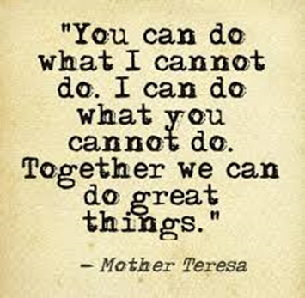

Slide 14
360 feedback shrunk my Imposter syndrome
Fixed mind-set thinking….. Dread
Growth mind-set thinking…. Improvement opportunity!
Leadership behaviours and their impact
Affirming
9 year old leadership traits e.g. Positive in the face of challenges
Constructive
Imposter Syndrome is ubiquitous
Facts from feelings risk of escalating thoughts
Getting perspective

Slide 15

The problem with patient experience feedback
Sheard et al, (2018) What's the problem with patient experience feedback? A macro and micro understanding, based on findings from a three‐site UK qualitative study, Health Expectations, 22 (1), p46-53.
Why do I rate PET?
Appeals to my leadership style and values
Leadership opportunities

Slide 16


Slide 17


