Slide 1
FIRST CONTACT PRACTIONER IN MSK CARE
Catherine Whiles
Clinical Specialist Physiotherapist
First Contact Practitioner in Physiotherapy
MSK Service
Adult Community Services & Long Term Conditions
Blackpool Teaching Hospitals NHS Foundation Trust

Slide 2
Implementation FCP
Part of NHSE implementation plan
At least one neighbourhood as an early implementer site for FCP
CCG presented with 3 options
Remain within current MSK Service financial envelope
Rapid access Physiotherapy FCP model developed
July 2019
3 GP Practices
Run with existing staff from the MSK service within the local area

Slide 3
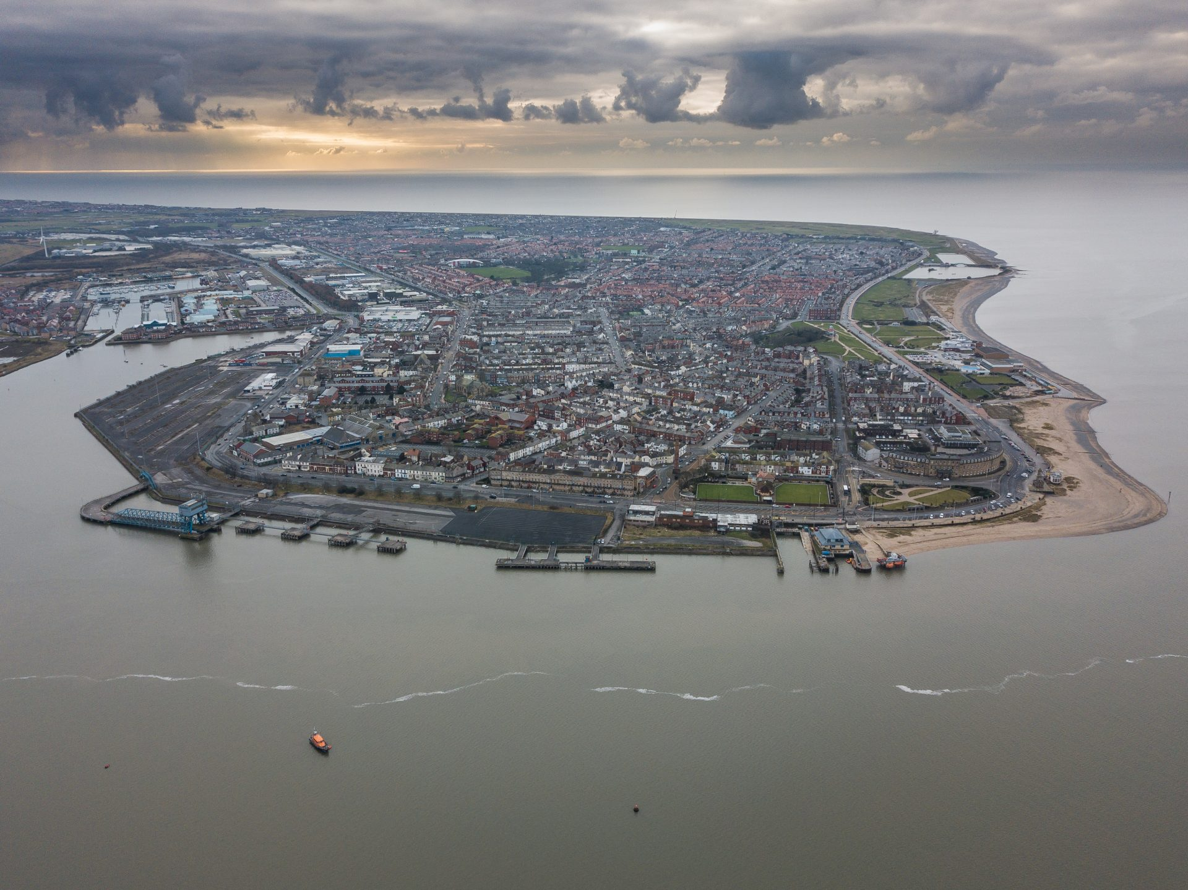
Who We Are
Fylde coast health care made up of:
Blackpool teaching hospital NHS Foundation Trust
Blackpool CCG – 21 GP practices
Fylde and Wyre CCG – 19 GP practices
Neighbourhood:
Broadway Medical Centre
Fleetwood Surgery
The Mountview Practice

Slide 4
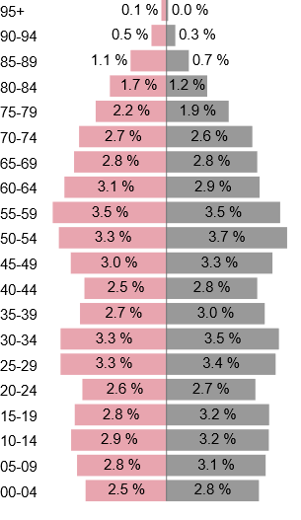
FLEETWOOD
51.8% 48.2%
28,394 – total number of registered patients January 2019
26.6% of the population is 60 and above
Female Male
Notes:
Fleetwood is part of the Fylde and Wyre CCG
Age and sex profile of registered patients from January 2019 roughly 50/50 split male and female
Total number of patients 28,394
26.6% of the population is aged 60 and above

Slide 5
MSK SERVICE
Community based service
2 Tier service
Consultant Physiotherapist, Extended Scope Practitioners, Consultant Orthopaedic Surgeon, GP with special interest in MSK
Clinical Specialist Physiotherapists, Physiotherapists, Physiotherapy assistants
Offers single point of access, providing triage of referrals to MSK and T&O, clinical assessment, including investigations when required and appropriate management or onwards referral

Slide 6
SERVICE
CHALLENGES
BENEFITS
IT – community / GP systems
Implementation
Care Navigator Education
Utilisation / empty clinics
First line management at appropriate time
Rapid access to MSK service
Time
FFT satisfaction

Slide 7
Patient Satisfaction
Excellent care
Very quick appointment, extremely helpful and knowledgeable, made me feel at ease
Quick service, referral to physio organised promptly
Left the appointment reassured that I was treated well and that everything was explained to me throughout
Great from start to finish
Excellent treatment
Very impressed with the service, hope it continues
Very impressed. I was able to see the correct person without a long wait
Notes:
Since 1st July -30th September we have seen 252 patients as a first contact.
174 of those were streamed from reception, 78 were streamed from GP.
Patient satisfaction –
out of those recorded 100% said they were satisfied with the care they received in the clinic
100% felt that the health professional treated them with respect and dignity in their appointment
94% were extremely likely to recommend the service to friends and family, with 97% saying they would recommend.

Slide 8
PERSONAL
CHALLENGES
BENEFITS
Title
Integration primary care team
FCP module – mentor
Consulting styles
Isolation
Fear of missing something
Support
Uclan Module
New skills
FCP/MSK service
Quality Improvement

Slide 9
THANK YOU

