Slide 1
Virtual Pulmonary rehabilitation
Presented by
Caerwyn Roberts
Clinical specialist Physiotherapist
Pulmonary Rehabilitation service
BCUHB WEST

Slide 2
WHAT IS PULMONARY REHABILITATION?
An individually tailored programme of exercise and education for people with long term lung conditions
The education programme helps patients understand their lung condition and manage their symptoms

Slide 3
Organisations that support the provision of pulmonary rehabilitation

Slide 4
Pre-covid service in our area?
2 Full Time staff – Physio and OT – responsible
for running the classes and co-ordinating the service.
3 Venues in West delivering 4 F2F classes –
Ysbyty Penrhos-Stanley (Holyhead) x2 classes
Ysbyty Gwynedd (Bangor)
Ysbyty Alltwen (Tremadog)
We accepted referrals from whole of West area for people willing to travel to a current location.
We worked hard to keep the waiting times down for all, which we had successfully done over the past couple of years

Slide 6
Timeline PR service West
Pre-pandemic face to face classes stopped March 2020
Staff Re-deployed to acute ward setting for 6 Months period
Virtual Pulmonary Rehabilitation classes started Jan 2021 - Increased to 4 virtual classes running at the same time.
May 2021 – attempted to re-start F2F classes in hospital sites but limited by space – decided to use Leisure centre halls
Hospital site classes moved to Leisure centres Aug 2021.
Weaned off Virtual classes Dec 2021
Increased back up to 4 face to face classes in both hospital and leisure centre settings
Also doing telephone appointments and individual video calls
Most MDT talks remain virtual today

Slide 7
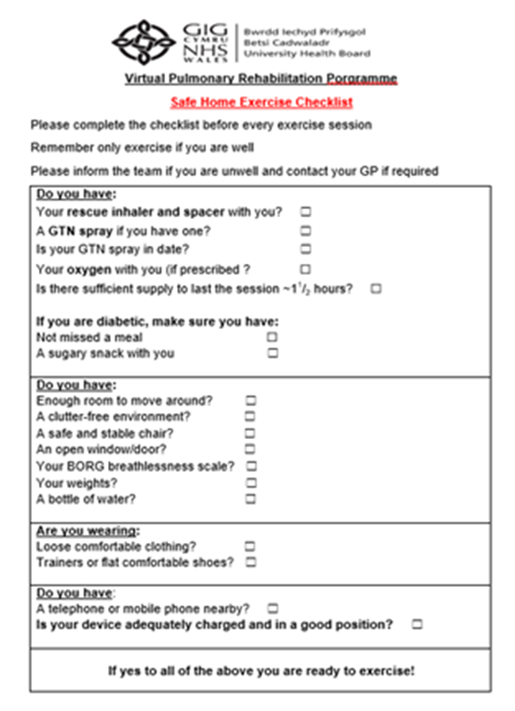
How does Virtual Pul Rehab work? – prep work
Starting point –
Pathway
SOP – including Covid regulations
Risk Ax
Managing unwell patients
Safe home exercise checklist
Inclusion/exclusion criteria in place – how does this differ to Face to Face – balance and managing tech at home

Slide 8
How does Virtual Pul Rehab work? – the platform
Approached Information Governance and completed a DPIA (data protection impact assessment) for the use of Zoom
Got Zoom licences – issued to individuals
Ensured all settings on Zoom adapted to needs – loads of options here to refine things ☺ – i.e. patients need to be admitted from waiting room into class and can be put back there – ensures confidentiality. Patient’s can’t use chat function chat to each other privately only to host
Settings allow for patient privacy and structure of sessions

Slide 9
How does Virtual Pul Rehab work? – in practice
Using Zoom platform – brief Ax for safety to exercise then everything is online
Surprising how much can be done remotely/virtually – everything barring the obs – Bp, Sats and exercise tests done remotely
Telephone Ax – full PR Ax
Video calls used for inhaler technique review, managing breathlessness and other educational aspects
Usual set up - small room a few meters long for 2 staff to sit in (one to take the class and another to observe patient safety, count exs, timing etc.)
Projector connected to laptop works well for groups - large on wall so clearer for observation

Slide 10
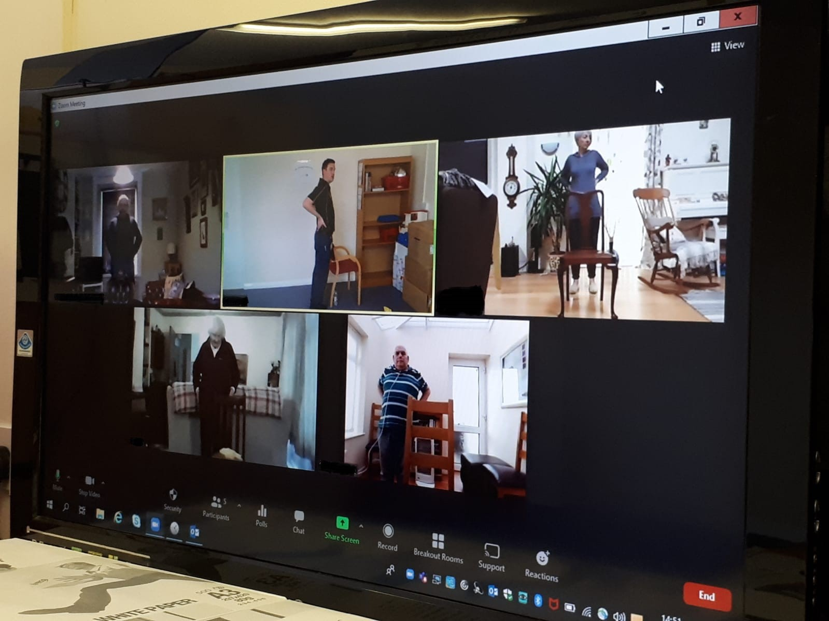
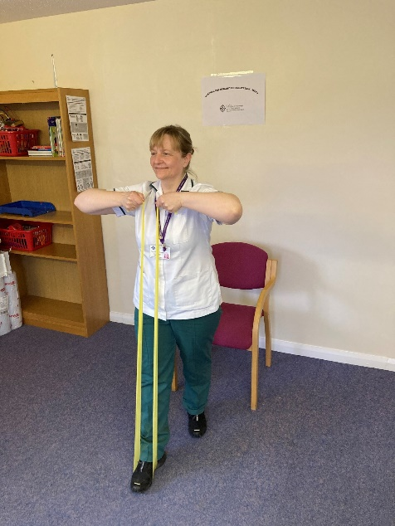
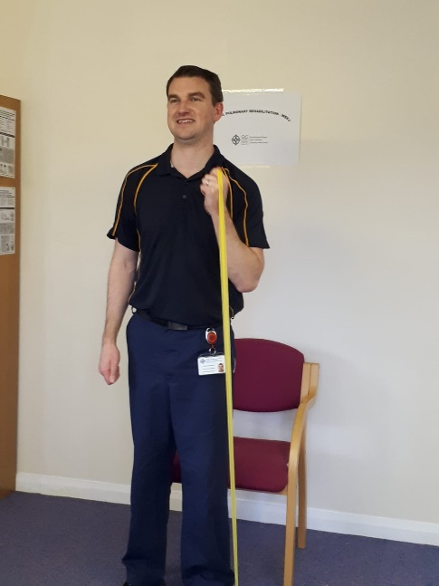

Slide 11
What do the patients think of the service?!
Some feedback comments include:-
Got her through the last few weeks of lockdown!
Being on screen makes you more motivated to do the exercises and it even added to social support as in the F2F group you may only speak to the person exercising next to them
Structure was better than the F2F sessions she had previously completed.
Manage breathless better
Increased confidence in what he can/can't do. Made him aware that SOB was normal, that he wasn't getting worse and that he can cope
F2F PR sessions you may have to wait for the piece of equipment that you want and you could avoid the exercises that you didn't like as much or found difficult – can’t with VPR!
pt reported that he was very happy with VPR and looked forward to it.

Slide 12
Objective results
1st 8 patients that complete the Virtual Pul Rehab programme in West

Slide 13
Summary
Excellent results and is certainly another option in terms of delivering effective care using these technology platforms
For classes patient need internet access, Ipad/laptop or similar (phone not big enough) – around 10% of our waiting list had these and were willing to give it a go
Can be made to work with family support and some basic troubleshooting skills – don’t need to be tech savvy!
Huge benefits in terms of travelling time, cost, energy expenditure and bringing care closer to home for some rural areas
Also reduces the need for big clinical spaces that meet Covid regulations/rehab spaces have been lost to other services
Need to look at incorporating these new ways of working into our future service delivery

Slide 14
Thanks for listening!
Any questions?

