Slide 1

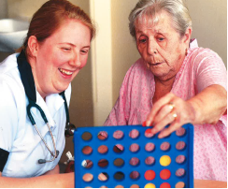

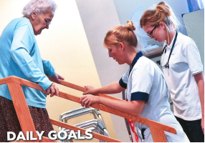
Recondition The Nation
Dr Amit Arora
Vice President (Workforce), British Geriatrics Society
Clinical Director, Emergency Care Improvement Support Team, NHS England
Creator: National Deconditioning Awareness and Prevention Campaign and Recondition The Nation
NHS Care of Experience week
27.4.2023
amit.arora@uhnm.nhs.uk @betterageing

Slide 2


Slide 3
Dictionary definition
Decondition
Oxford Dictionary
Cause to lose fitness or muscle tone, especially through lack of exercise. ‘sedentary lifestyles that decondition their bodies’
Medical Dictionary, © 2009 Farlex and Partner
A loss of physical fitness due to failure to maintain an optimal level of physical activity or training
Inactivity for any reason may lead to deconditioning

Slide 4
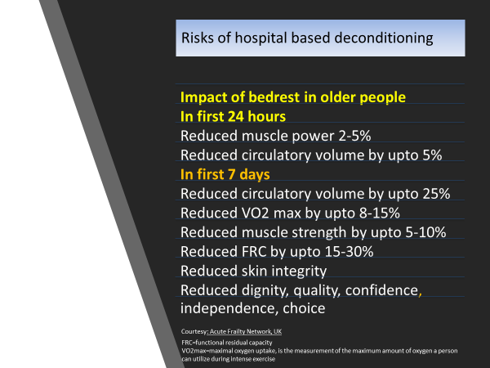
What does the evidence tell us?
Hospitalised patients are 61 times more likely to develop disability in ADL’s than those not hospitalised
17% of older medical patients who were walking independently 2 weeks prior to admission needed help to walk on discharge
Patients spend up to 83% of their time in bed, and 12% in a chair
Risks of hospital based deconditioning
For 60% of patients on bed rest there is nothing documented to explain why
50% of patients experience functional decline between admission and discharge
Hospital admission in past 12 months is single most predictive risk of functional decline
Deconditioning contributed to delayed discharge in more than 47% of older patients
Up to 50% of older people become incontinent within 48 hours of admission
Once discharged, on 39% of those with a new or additional ADL disability were back to their usual level of function after one year

Slide 5
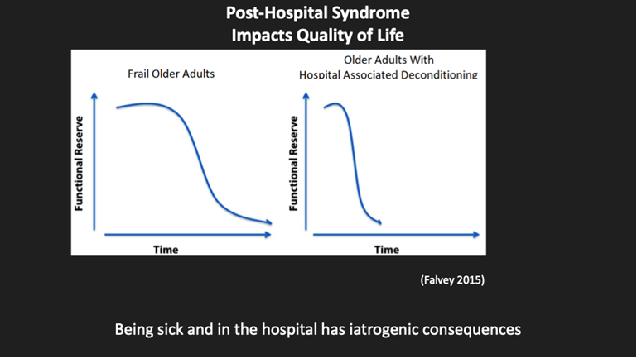

Slide 6
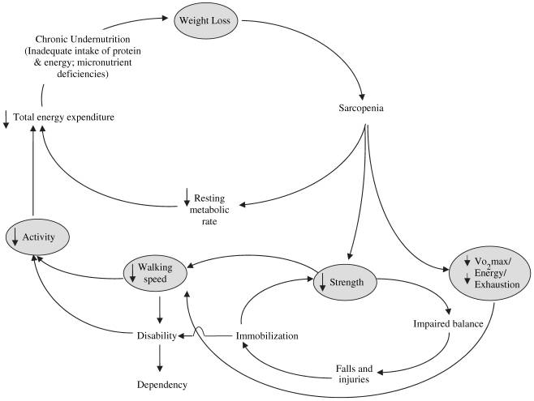
The “cycle of frailty” and the roles of inactivity and immobility
Cycle of frailty. (Xue QL, Bandeen-Roche K, Varadhan R, et al. Initial manifestations of frailty criteria and the development of frailty phenotype in the Women’s Health and Aging Study II. J Gerontol A Biol Sci Med Sci 2008;63(9):984–90, by permission of the Gerontological Society of America.)

Slide 7
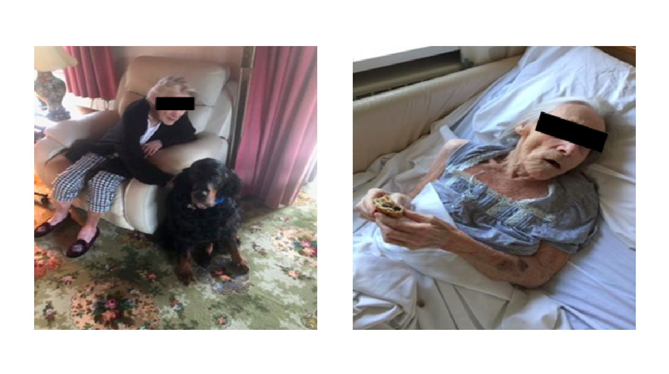

Slide 8
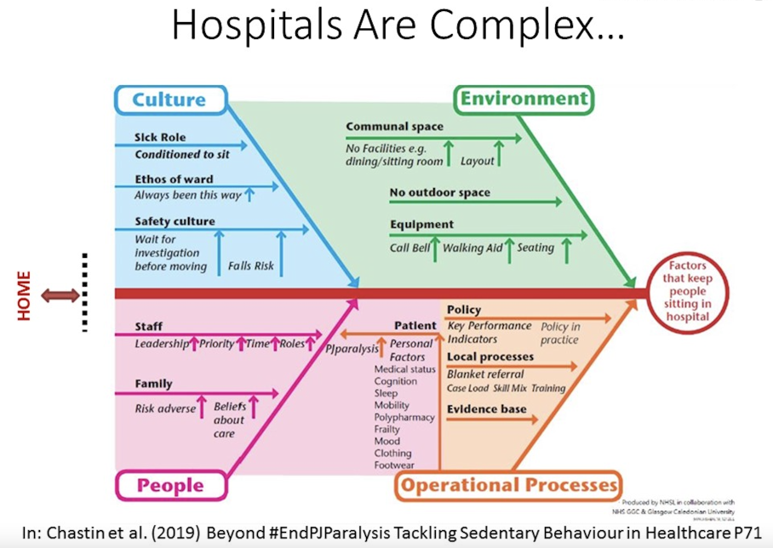
Barriers and Enablers to helping patients move more

Slide 9
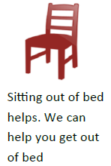
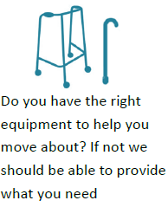
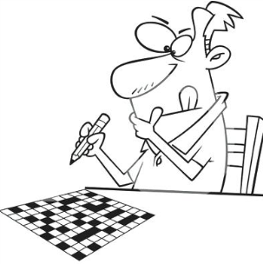
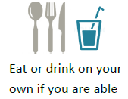
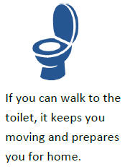
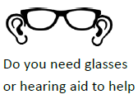

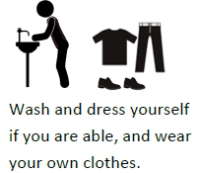
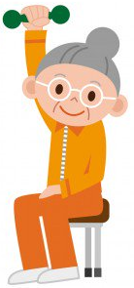
How can we prevent deconditioning- some examples?
What do you currently have in place?
What could you implement?
Please download free resources on deconditioning from:
www.bit.ly/deconditioning or British Geriatrics Society Website

Slide 10
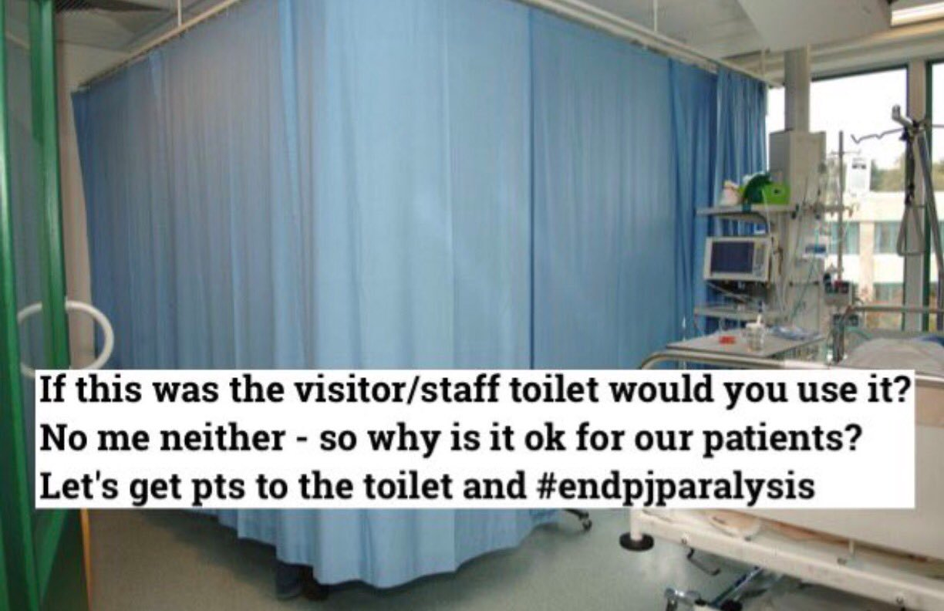

Slide 11

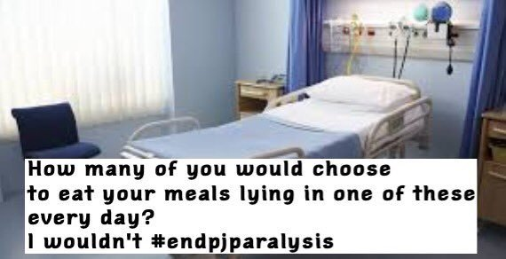
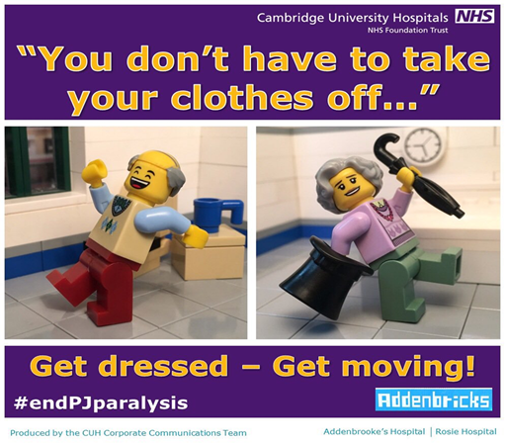
Enabling independence?

Slide 12
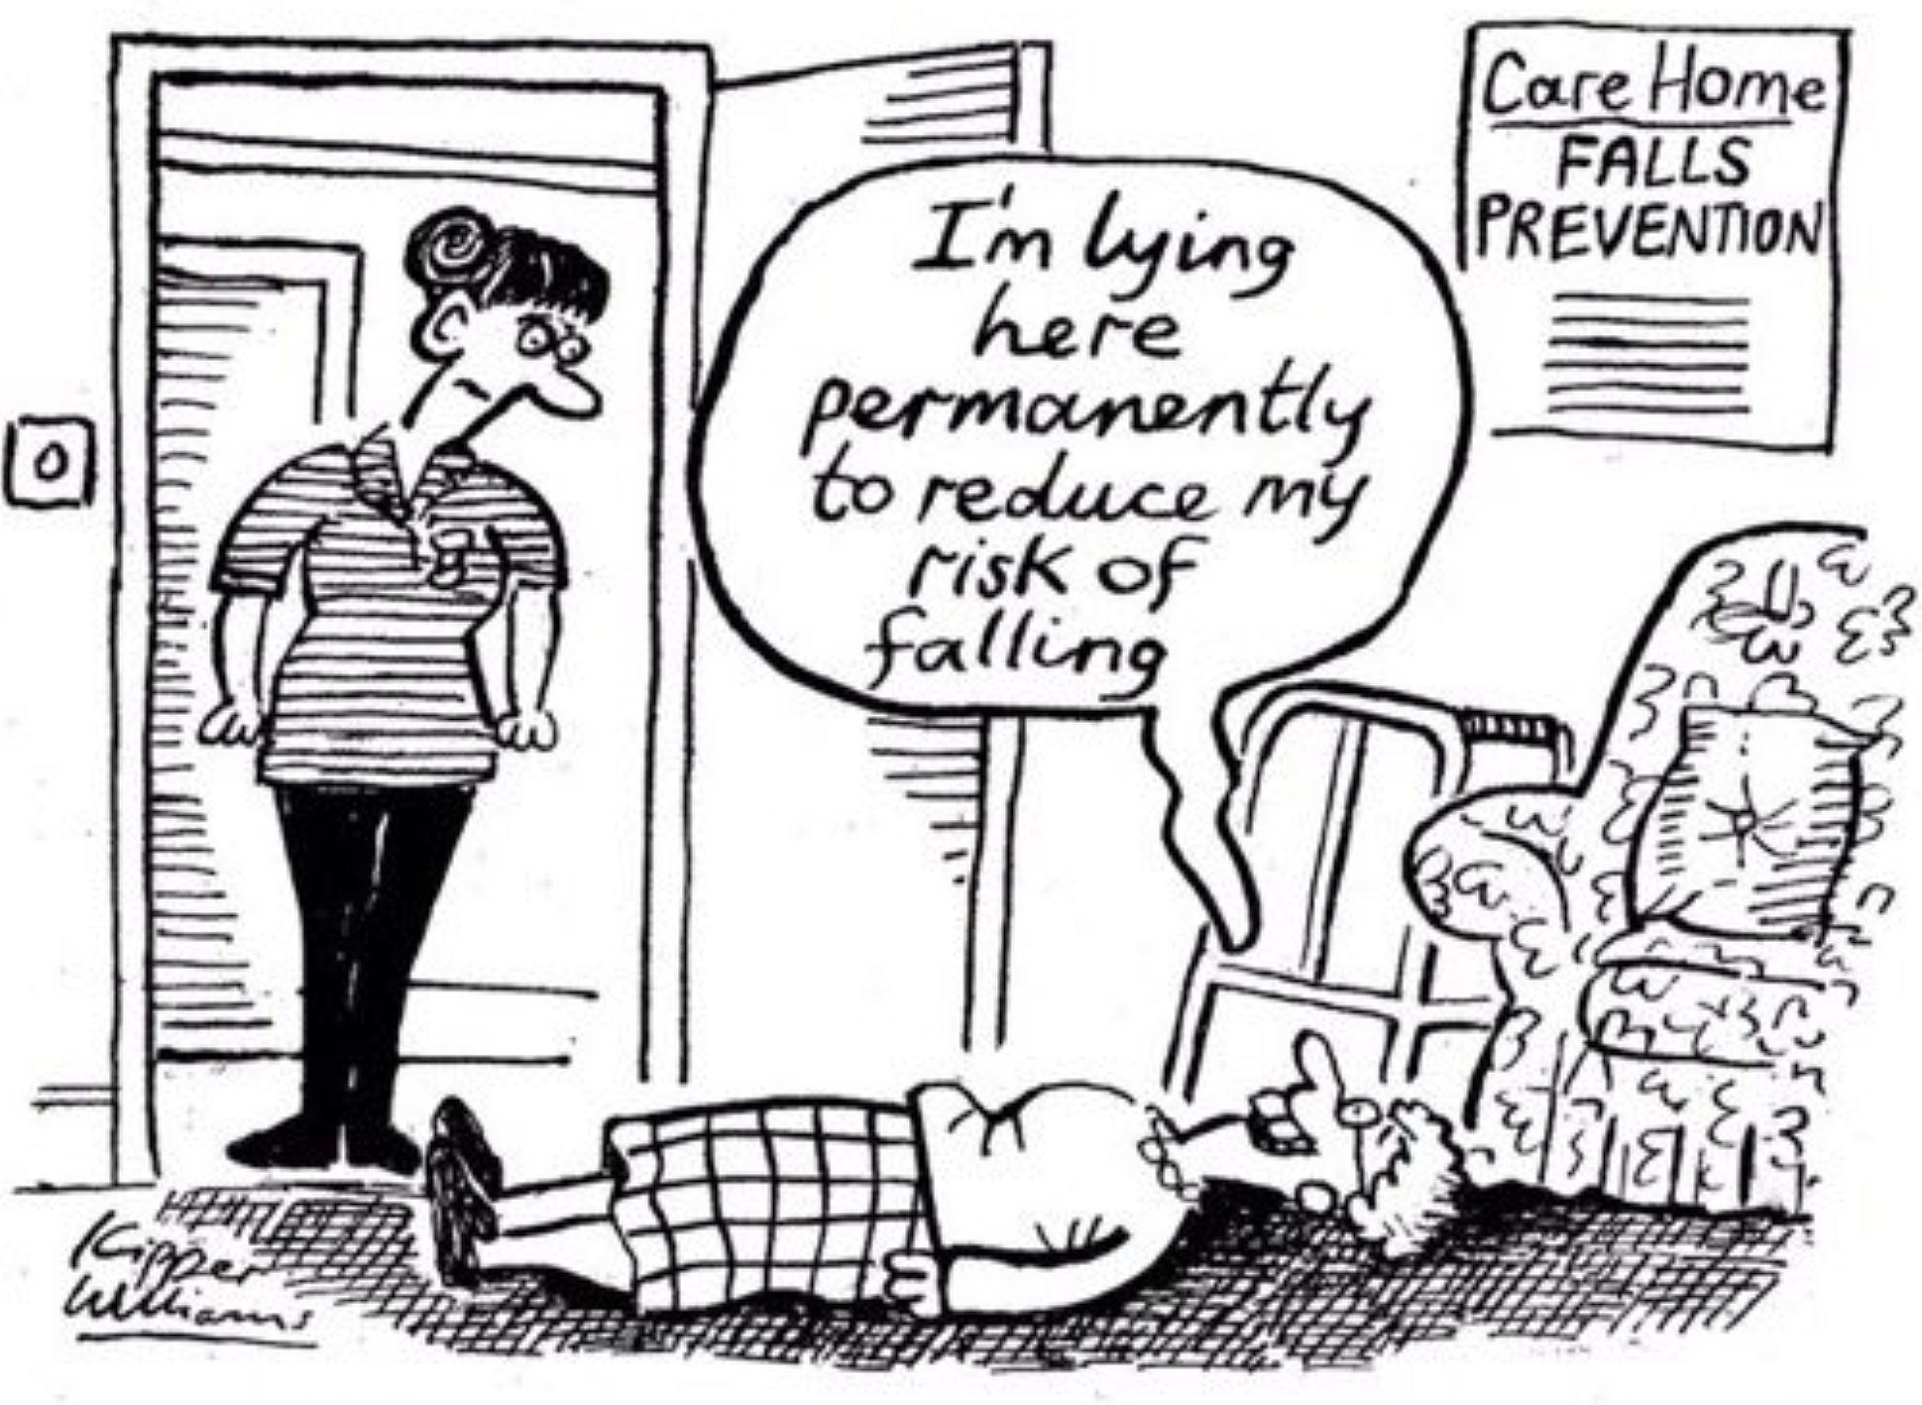

Slide 13
The strategies
Prevention, Protection, Promotion
Community strategies
Culture and behaviour change strategies
Innovate, Improve, Inspire, Influence, Inform, Implement
Creating a social movement, giving into the hands of many
Make Every Contact Count

Slide 14

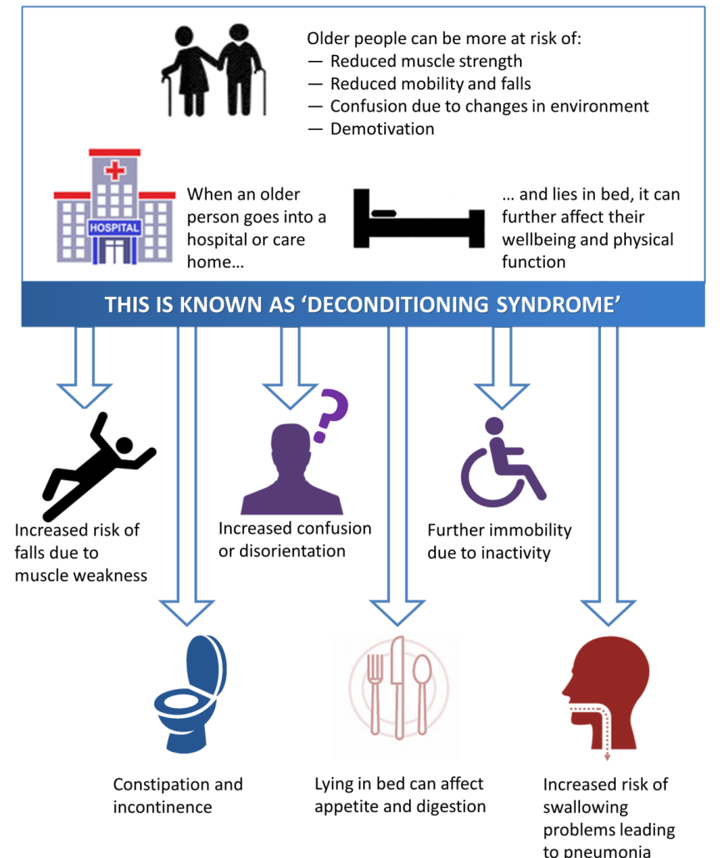
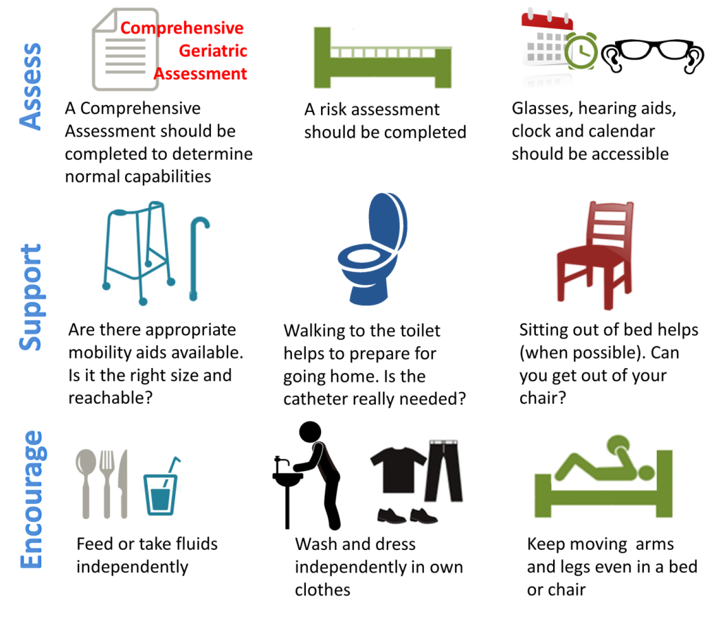
A Campaign For Deconditioning Awareness – “Sit up… Get dressed… Keep on moving…”
Prolonged bed rest in older people can
lead to substantial loss of muscle strength
and physical activity
PREVENTING DECONDITIONING
AND ENABLING INDEPENDENCE FOR OLDER PEOPLE
Thinking about how to support and encourage movement helps to:
Reduce the risk of harm from falls, infection, thrombosis and delirium
Reduce length of stay in hospital
Reduce the likelihood of having an increase in their future care needs
This is often made worse by multiple medications, sensory impairment, dementia and current illness
Sit up… Get dressed… Keep on moving…
Department for Older Adults
© 2016 University Hospitals of North Midlands NHS Trust. All rights reserved.

Slide 15



Purpose of the mission to #ReconditionTheNation
Time to move again: from deconditioning to reconditioning | Age and Ageing | Oxford Academic (oup.com)

Slide 16
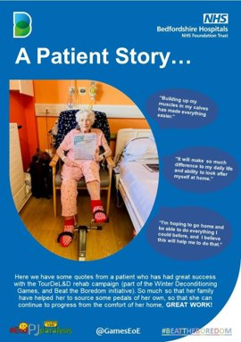

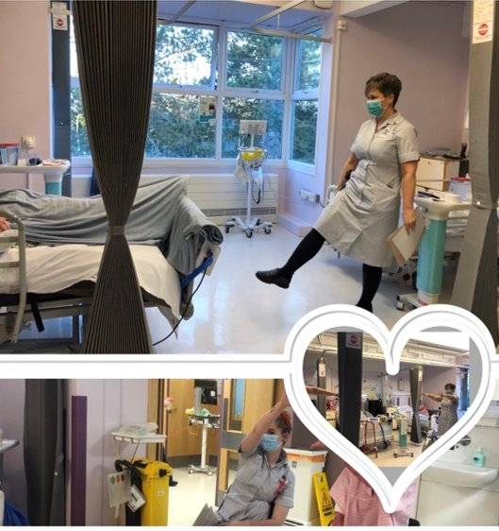
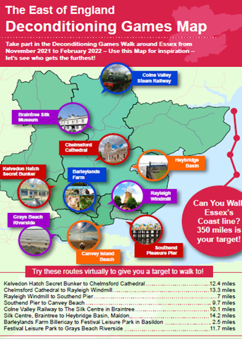
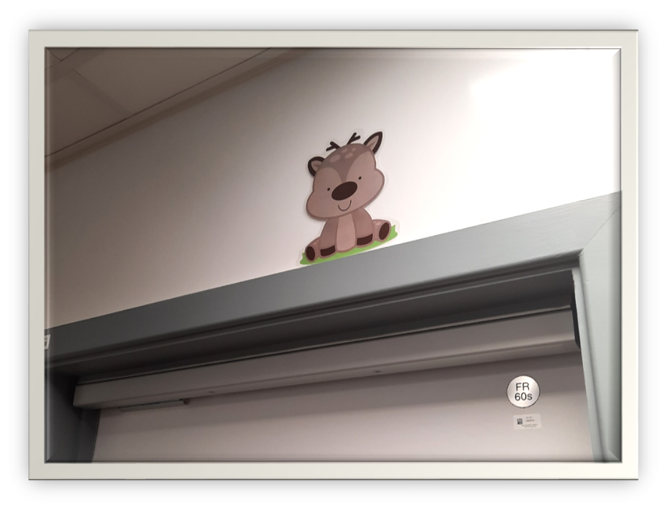
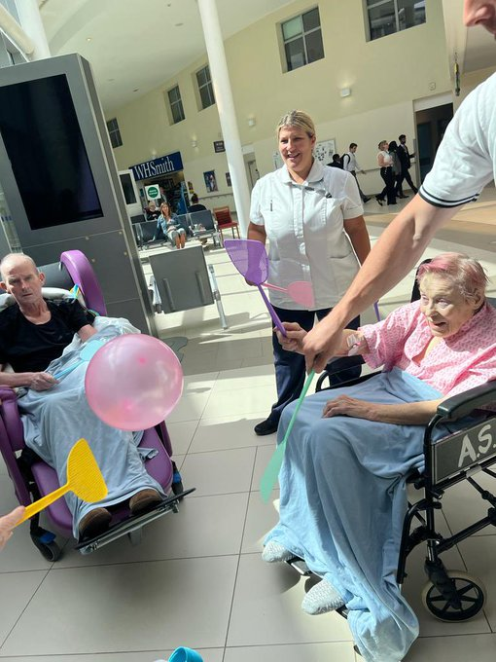
Challenge to walk the Essex Coastline
One home did a virtual walk to Southend seafront
When they reached the number of steps, residents went to Southend for tea
Woodland walk
Winter Wimbledon

Slide 17
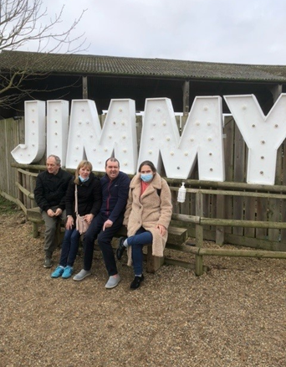
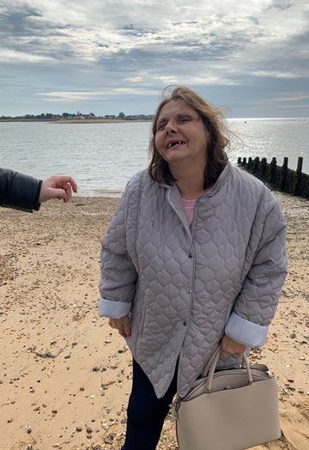
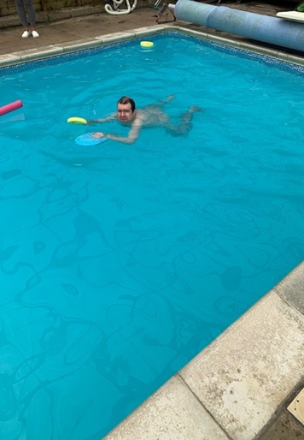
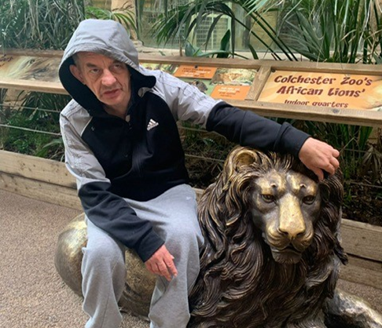
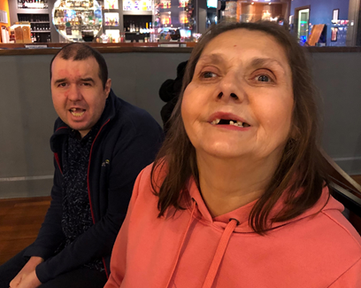
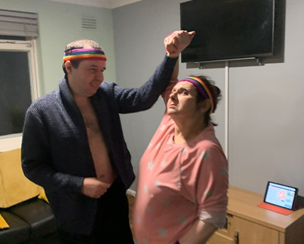
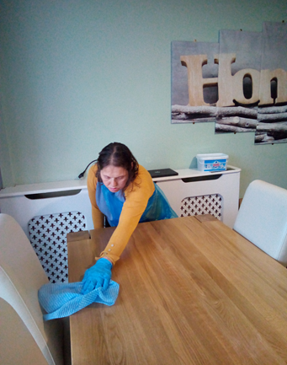
Four Winds - Residential Home for People With Learning Disabilities
What did they do?
We went for walks to the beach, around the lakes and to local towns
We went swimming, bowling and had day trips to help us remain active and fit
We enjoyed exercise and dance classes as a part of our weekly activities
We got involved in the cleaning, laundry and day to day tasks in the home
What did they achieve?
More structure and planning into our week-to-week activities, we have created an activity board where the individuals can choose want, they like to do each day.
Getting the people, we support to get involved in the day to day running of the home, by helping more and making the activities fun to do
We are planning on going to more trips, further afield
Since doing the de-conditioning games, the people we support have lost 14lbs all together
We are going to keep doing our best to stay active and now that the days are brighter, we are not staying indoors ☺

Slide 18

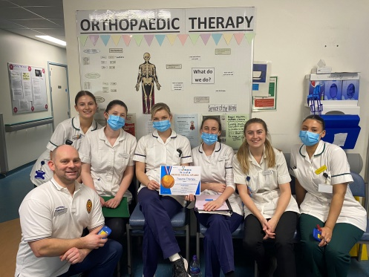
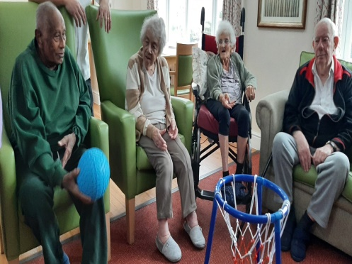
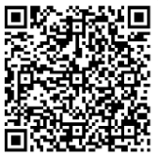
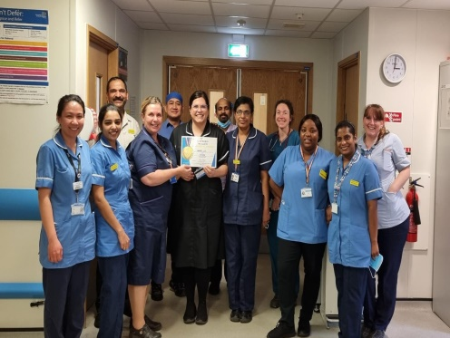
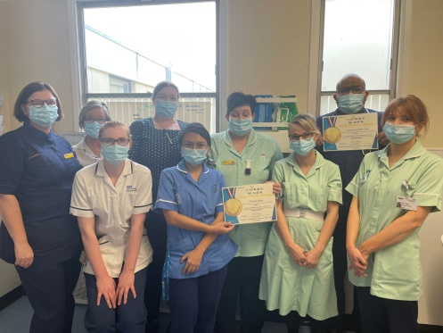
Recondition the Nation: a campaign to get the nation moving
The Recondition the Nation campaign was launched in November 2022, building on the massive success of the Winter Deconditioning Games held across the East of England last winter. Last year, 178 teams from hospitals, community services, care homes, voluntary organisations, social groups and others, participated to help support and empower people in their care to keep active. This year we are hoping to make a difference to even more people.
This campaign is about preventing deconditioning by encouraging everyone to try innovative and fun ways to promote physical activity and emotional well-being.
The campaign has two key aims. Firstly, by taking small steps to reduce the harms of deconditioning, we can improve peoples’ independence, and help people get home from hospital sooner. Secondly, through enabling health and care staff to improve patient outcomes we can reduce moral injury and support their well-being.
With your help we can make a difference to even more people. You can join the national campaign to #ReconditionTheNation by developing your own innovative and fun ideas to help people in your care stay active. Are there activities you could try that might be enjoyable to do together? How about trying balloon badminton, or seeing how many miles your team can clock up with a static bike pedal? Would you and the person you care for enjoy a weekly aerobics class, or how about joining an inclusive choir? Or could your team do a virtual walk to the moon?
We have now awarded over 600 medals since launching in November, across the health and care sectors and the numbers of participating teams continuing to grow weekly. Medals are available to individuals, teams, organisations including care homes, voluntary sectors, individual carers, informal carers, family members and indeed anyone who is keen to make a difference. These are games for everyone. The medal application process is simple to complete and only takes a few moments. You can apply for medals here.
Resources for how to get involved, and examples of how others have used this opportunity to aid people in their care to ‘Sit up, Get Dressed and Keep Moving’ are available here.
We have also been running a series of learning events throughout to hear from experts in the field, and showcase the great work colleagues across the health and care sector are doing. Please see the timetable of events and joining links can be found here, for more interesting sessions over April and May 2023.
Tell us what you are doing, and apply for medals here or by using the QR code below. Order your free #ReconditiontheNation Ambassador’s pin badge here.
Come and join us to #ReconditionTheNation
For any queries, email us on england.eeci@nhs.net
Follow us on Twitter @ReconGamesUK

Slide 19
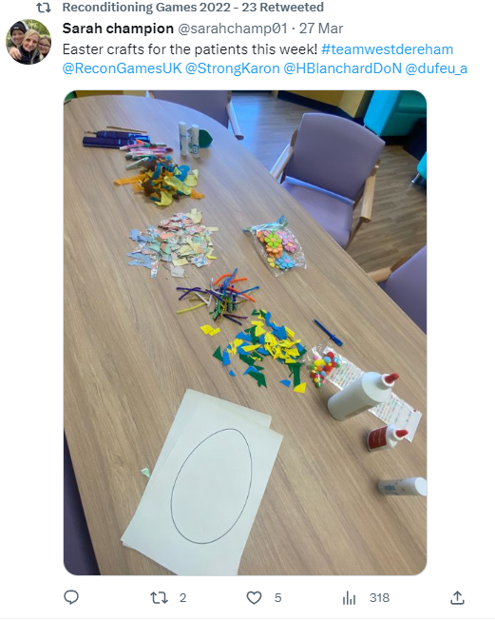
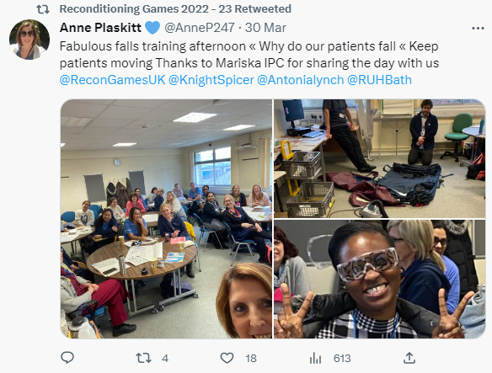
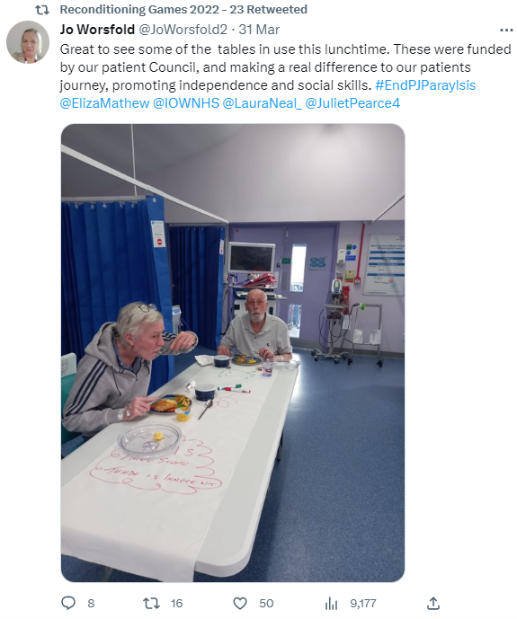
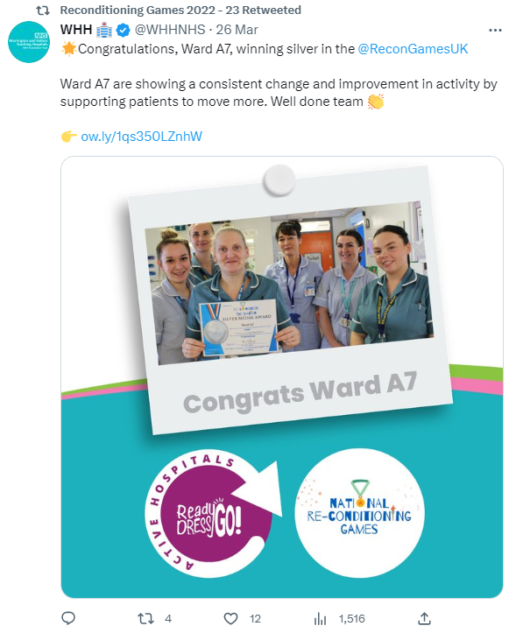
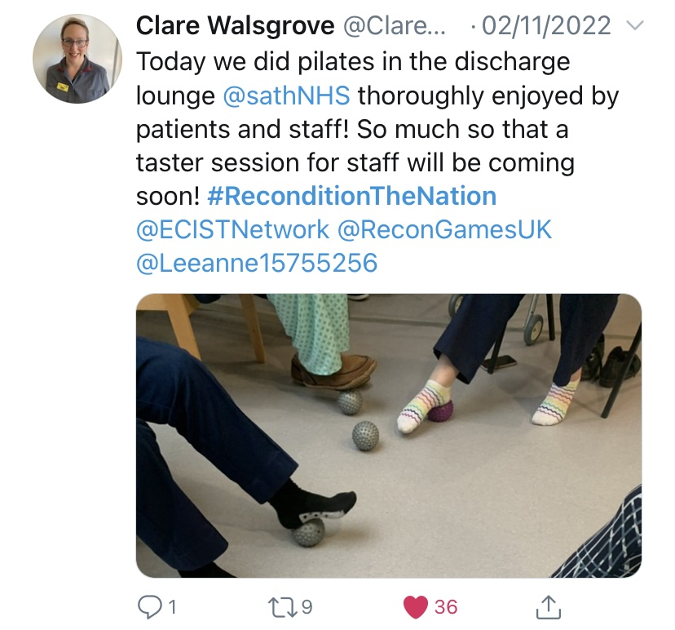
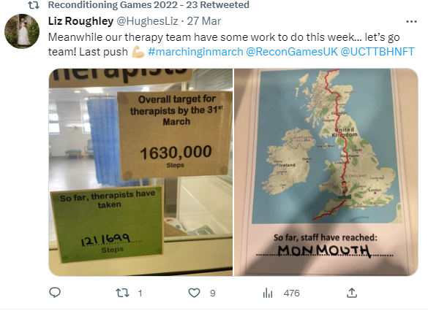
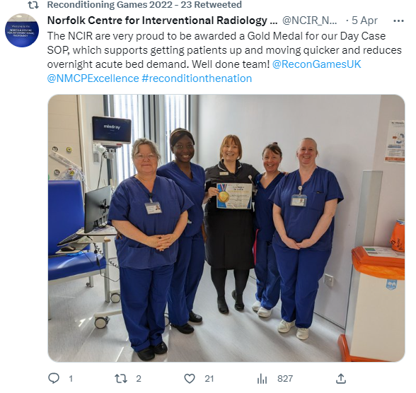
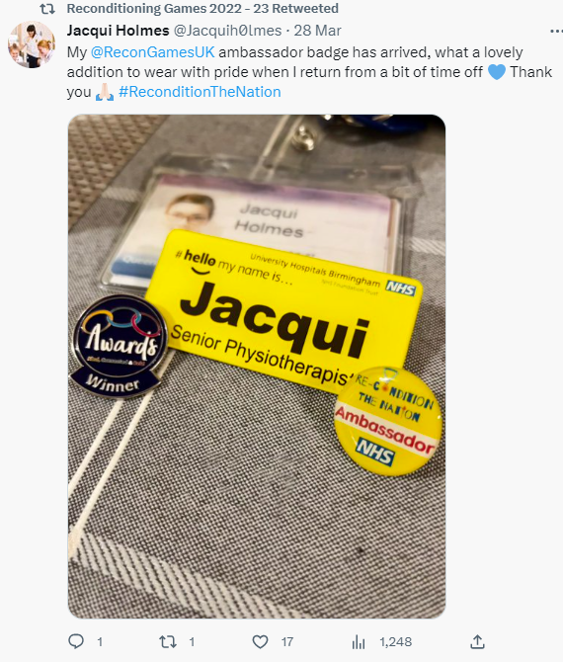
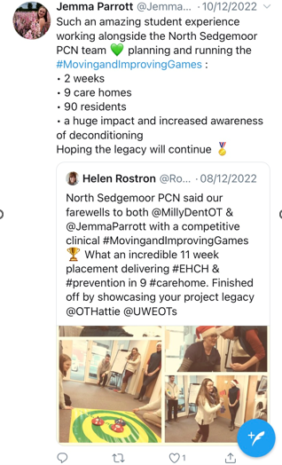
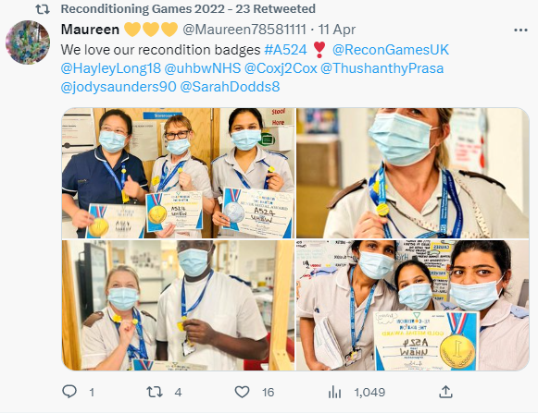
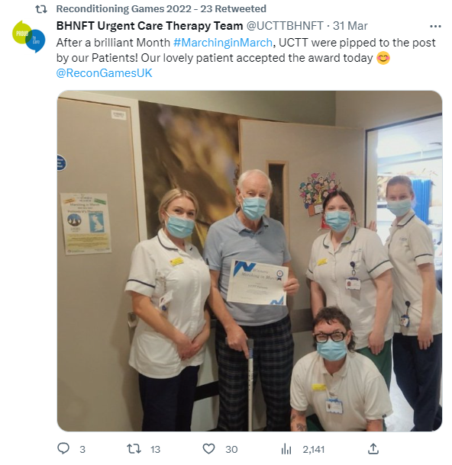
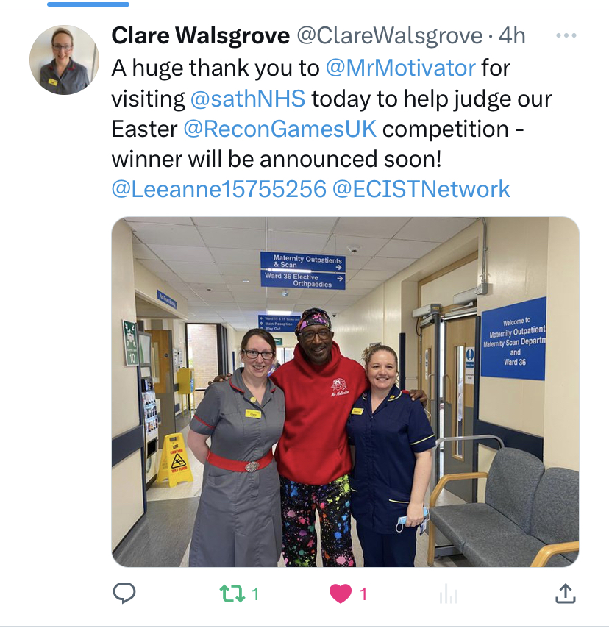


Snapshot of Twitter engagement
Residents enjoying games and activities led by students in Sedgemoor
Mr Motivator visiting Shrewsbury and Telford to judge the Easter competition
Patients beating the staff in a walking competition in Barnsley

Slide 20



Medals data: April 2023
Close split between gold, silver and bronze, representing different stages of improvement jounrney
Type of medal awarded
Medals awarded by region
All regions represented
Medals awarded by organisation

Slide 21

Recondition the Nation Futures page visits and downloads
44-269 document downloads a month, demonstrating active engagement with materials, with numbers sustained throughout the campaign
Moderated views of between 288-859 a month

Slide 22

Example of evaluation of impact: Warrington and Halton Teaching Hospitals NHS Foundation Trust Active Hospitals: Ready, Dress Go! programme
Further step change and exceeding target at point of medal being awarded
Step change on introduction of Read, Dress, Go! And Recondition the Nation

Slide 23

Example of evaluation of impact: Warrington and Halton Teaching Hospitals NHS Foundation Trust Active Hospitals: Ready, Dress Go! programme
Large reduction in falls since launch mid August 2022

Slide 24

Example of evaluation of impact: Queen Elizabeth Hospital King’s Lynne NHS Foundation Trust, Feltwell Ward
More patients up and out of bed by lunch, daily showers and therapy goals
Huge reduction in formal and informal complaints
Positive impact on staff wellbeing

Slide 25

Example of evaluation of impact: North Middlesex University Hospital NHS Trust, Frailty Awareness Month
Considerable reach internally and online
Large numbers of patients out of bed for lunch, and assessed for CFS

