Slide 1
Leadership for a purpose
Karen Middleton
Chief Executive, Chartered Society of Physiotherapy
middletonk@csp.org.uk
@KMiddletonCSP

Slide 2
Becoming an agent for change
This is a story about four people named Everybody, Somebody, Anybody and Nobody.
Change was needed and Everybody was sure that Somebody would do it.
Anybody could have started it, but Nobody did it.
Somebody got angry about that, because it was Everybody’s responsibility.
Everybody thought Anybody could do it, but Nobody realised that Somebody wouldn’t do it.
It ended up that Everybody blamed Somebody when Nobody did what Anybody could have.

Slide 3
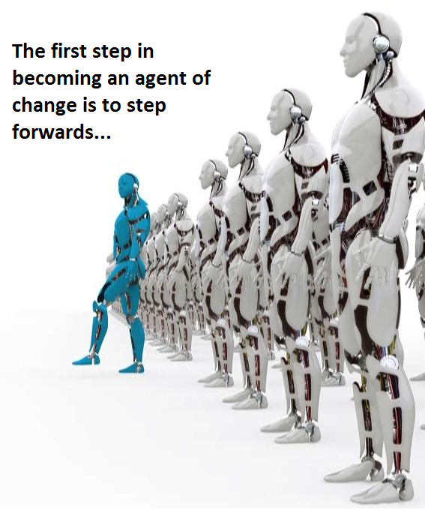

Slide 4
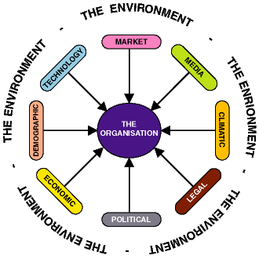
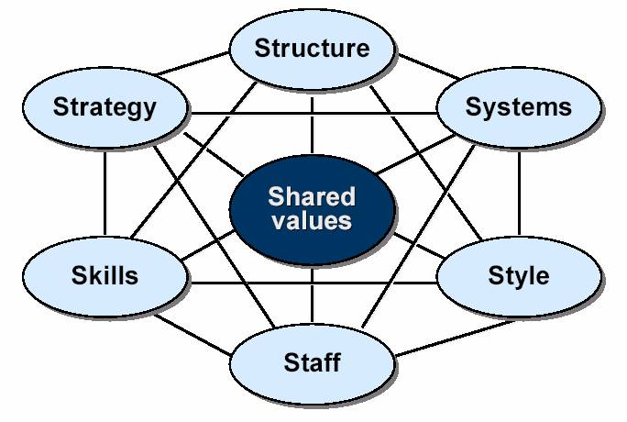
The role of the leader
Internal focus
External focus
Notes:
Internal focus – McKenzie 7 S model (organisations, teams, working groups and projects). Ensuring the following is fit for purpose.
Strategy does the organisation or team have a clear direction / plan
Structure Is the way the organisation or team is structured fit for purpose
Systems are the processes and procedures of the company, which reveal business’ daily activities and how decisions are made
Skills are the abilities that firm’s employees perform very well. They also include capabilities and competences.
Staff element is concerned with what type and how many employees an organization will need and how they will be recruited, trained, motivated and rewarded
Style represents the way the company is managed by top-level managers, how they interact, what actions do they take and their symbolic value.
Shared Values are at the core of McKinsey 7s model. They are the norms and standards that guide employee behavior and company actions and thus, are the foundation of every organization
External Focus – keeping an eye on the external environment for risks, opportunities and changing contexts.
For the NHS:
Politics
Demographics (e.g. aging and LTC)
Workforce shortages
Funding
Increased / changing demand
Science and tech developments (e.g. genomics, telemedicine, virtual reality etc)

Slide 5
The public we serve – ‘Think like a patient,
act like a tax payer’ Simon Stevens, CEO NHS England
‘Leaders must wake people out of inertia. They must get people excited about something they’ve never seen before, something that does not yet exist’
Rosa Beth Moss Kanter (Leadership for Change: Enduring Skills for Change Masters).

Slide 6
Leadership versus Management
Management is a set of processes that can
keep a complicated system of people and
technology running smoothly. Leadership is a set of
processes that creates organisations in the first
place or adapts them to significantly changing
circumstances. Leadership defines what the future
should look like, aligns people with that vision, and
inspires them to make it happen despite the obstacles’
Kotter, J. (1996) Leading change. Harvard Business School Press
Notes:
Loads of definitions
Doing the right thing rather than simply doing things right
Contact sport
Visibility – working from home
This definition – management is about budgeting, planning, organising, staffing and controlling and problem-solving
Leadership is more liberating – ‘enhancing others to higher levels of performance

Slide 7

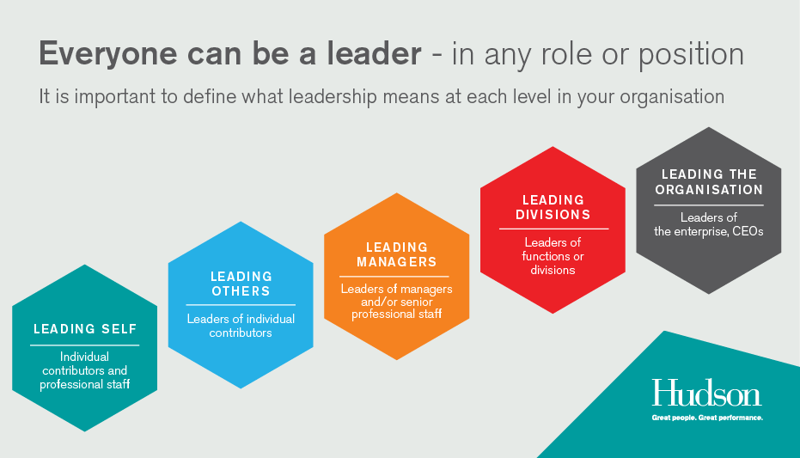
Leadership at ALL Levels
Notes:
Make it clear that leadership spans across all levels of an organisation – from porter to CEO.

Slide 8
So what holds us back?
Complacency
‘They’ do
Victim-mentality
Some skills are missing?

Slide 9
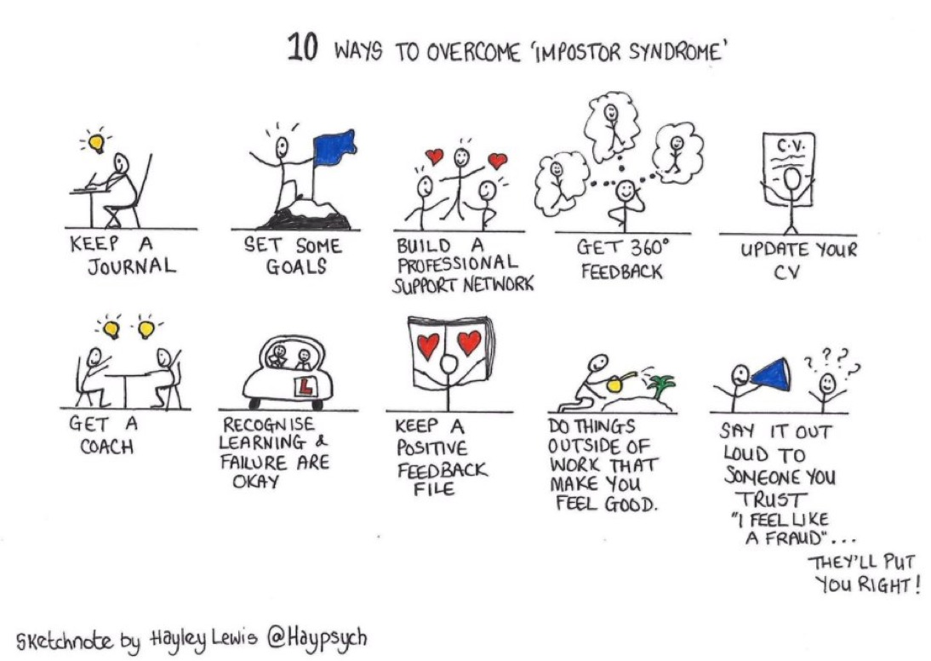

Slide 10
Lessons learnt – top tips!
Observe others and ‘notice’
Understand and take action to defeat the Imposter Syndrome
Feedback is a gift – seek it out
Develop emotional intelligence
Understand your impact on others
‘To thine own self be true’
Don’t do it to be popular
It’s about people, people, people

Slide 11
Lessons learnt – top tips!
Learn to tell a story
Get a coach
Get a mentor
Take a secondment
Learn to network
Read
If you don’t look after yourself, no one else will
It’s not about strength, it’s about resilience
Make the time to nurture in the way people have nurtured you

Slide 12
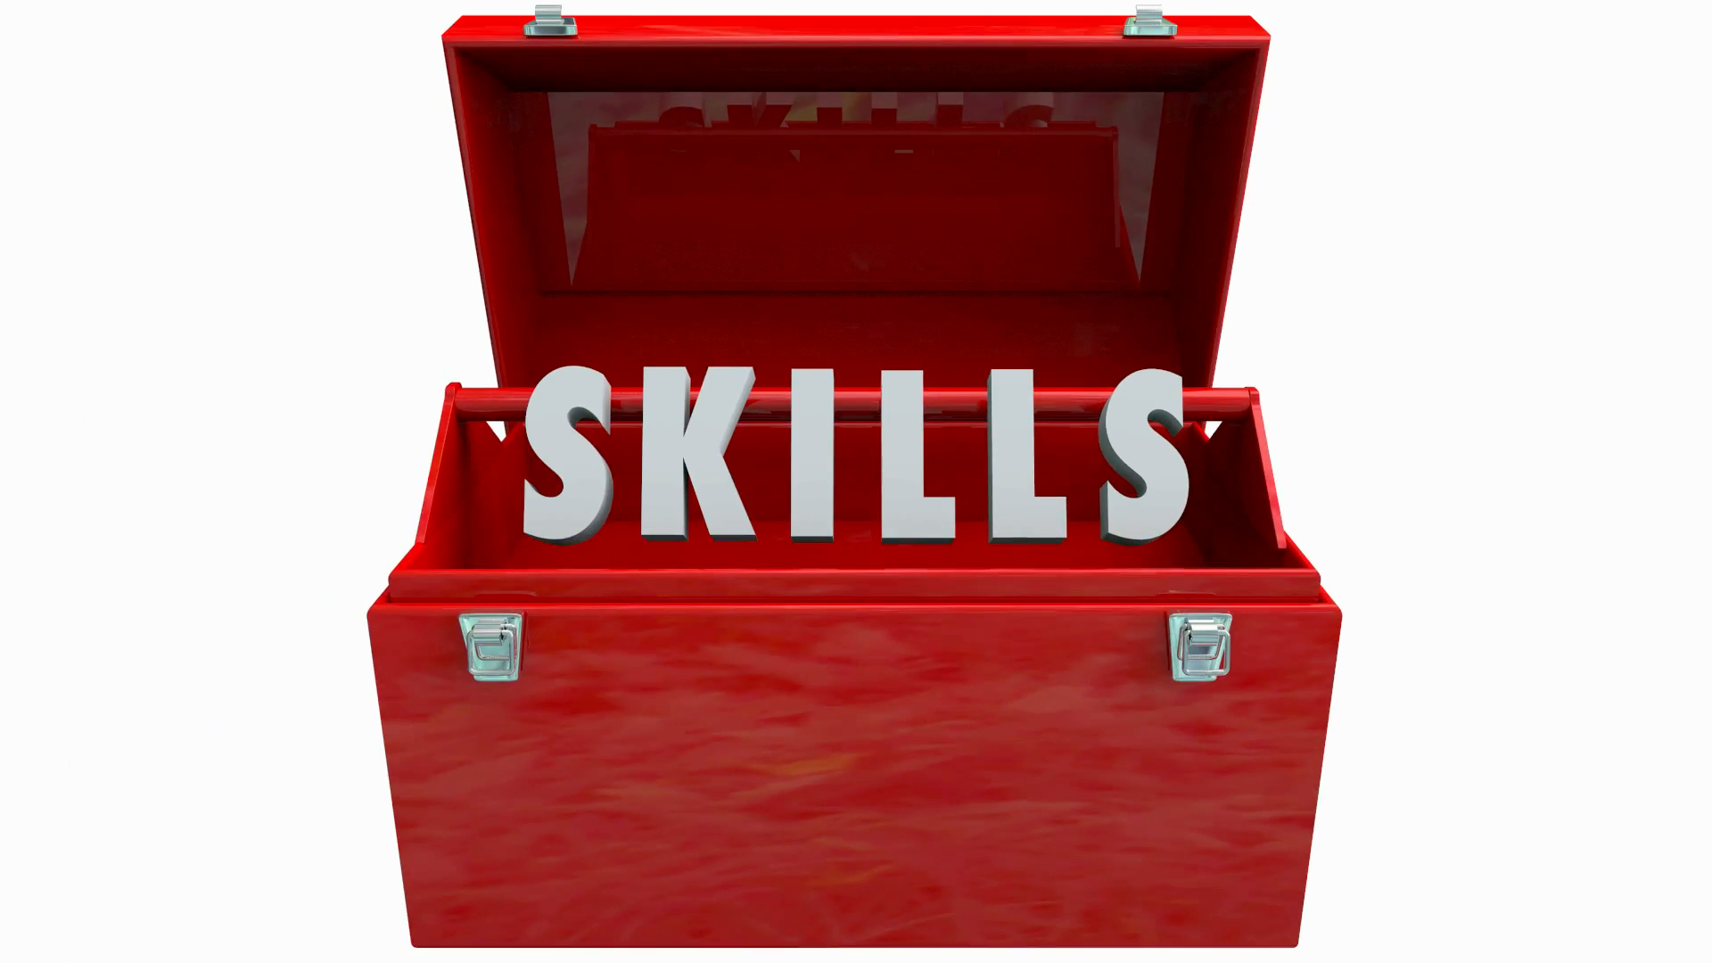
Professional vs Clinical
Notes:
Absolutely key therefore, that we don’t just focus on clinical skills.
We are all guilty of it. We qualify, we get out there and just want to improve as a clinician. BUT, don’t neglect the skills you need to progress professionally, as a leader.
JUST as important that we have expert leaders, as well as expert clinicians, as without LEADERS, we will have no VOICE, and therefore no PROFESSION.

Slide 13
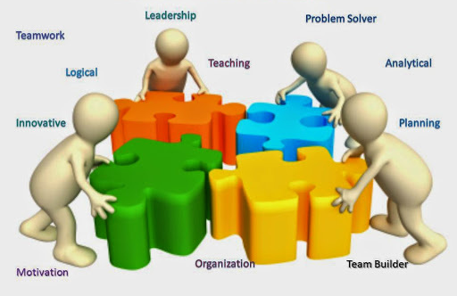
Transferability
Notes:
You are about to graduate, into one of the best career professions, in the UK.
Your skillset gives you;
OPPORTUNITY & CHOICE
You could work in all the different sectors. In lots of different jobs, as you are developing a skillset that EMPLOYERS WANT.
Problem solving
Reasoning
People skills
Communication
Innovation
Analytical
Design
Logical thinking
Emotional intelligence
Empathy
Many physiotherapists work as CEOs (Hillingdon CEO is a physio – one of the longest (if not the longest) running CEO in the NHS at present – you may have other examples.
Physios work in government, as teachers, as chief inspectors and superintendent police officers.
Wherever you end up – you will take your physiotherapy identity with you and the dialogue.

Slide 14

Don’t forget ‘bolt-ons’
Notes:
Bolt ons – ‘different’ things that can ‘add’ to your leadership journey – build your skills, and fill the gaps in your development.
These all ADD to you and allow you to tick the boxes and give examples for personal specs.
Board positions – ERNs, PNs, Council, Charity
School or other organisation Governor
Non exec roles
Charity trustee etc.
Cross sector experience
Voluntary experience
Consultation groups
Patient groups

Slide 15
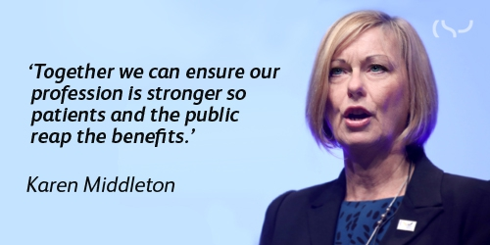

Slide 16
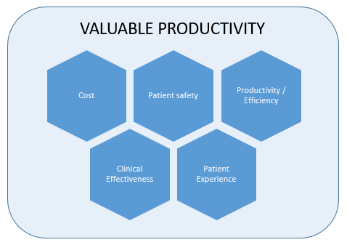
How to measure success
Notes:
How to measure success
Must be able to measure and show impact under each of these domains with parity of esteem. Physio bias is towards clinical effectiveness but must be able to show benefit and impact under all of these domains. Any quality improvement framework or quality dashboard should include elements under each of these.
It include the NHS definition of quality:
Patient safety
Clinical effectiveness
Patient experience
As well as cost and productivity consideration. (Cost with quality = value). Physiotherapy is valuable – particularly working towards to the top of licence.

Slide 17

#TeamGP: First Contact Practitioner
General Practice physiotherapists can safely and effectively manage patients in primary care. This not only improves the patient experience but frees up GP time to lead, manage and spend on other patients
Physiotherapists in primary care don’t need supervising and have their own insurance cover
Many can independently prescribe and provide injection therapy, and soon should be able to issue fit notes. Making this part of your business model can optimise resources and reduce costs
Physiotherapists with advanced practice skills have a particular role to play in taking on many of the tasks currently carried out by GPs
As well as reducing the pressure on GPs, General Practice Physiotherapists has been shown to reduce demand on physiotherapy services.
http://www.csp.org.uk/professional-union/practice/primary-care
Notes:
What do the network think the opportunities are for their specialism within primary care? A call to action for all specialties to consider, not waiting to be dictated to.

Slide 18
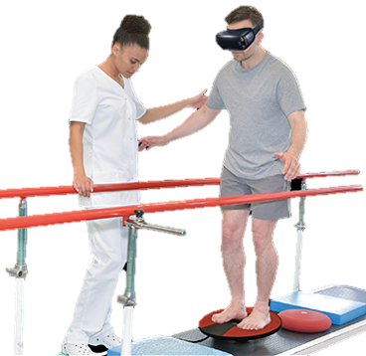
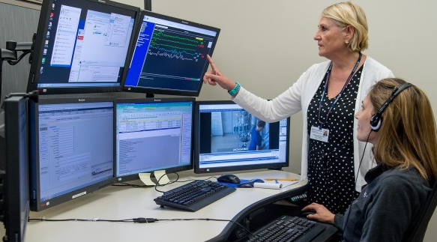
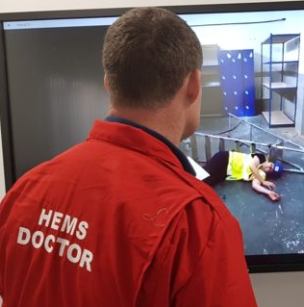

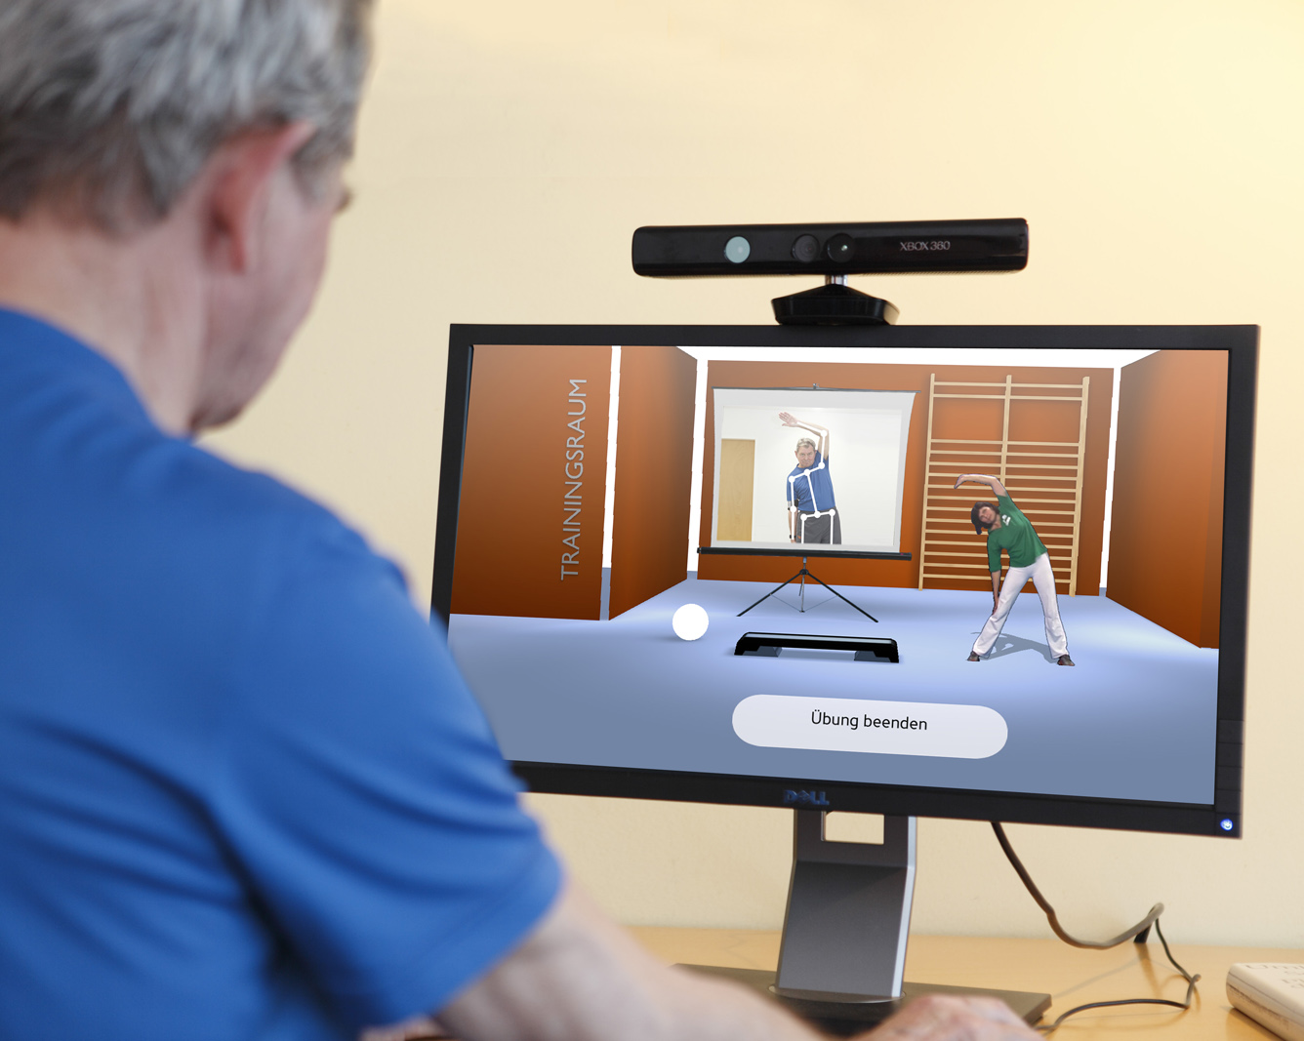
‘Teched up’ practice
The digital trends of connectivity, mobility and big data will impact health and social care and present new
opportunities for public physiotherapy provision.
Notes:
We are now becoming more digitally connected.
Advances in digital technology within health organisations will create new
ways for public physiotherapy services to deliver care and provide opportunities for greater collaboration between physiotherapists and other health professionals. Digital technology will provide an important platform for greater dialogue with the community that ultimately supports improved services.
Sustainability:
New digitally-enabled public physiotherapy will be particularly important to smaller, more local practice. The sustainability of smaller services will depend on maximising the potential of e-Health services to improve patient care, connecting the workforce with online professional support and development, and using technology to achieve greater efficiencies of service delivery.
Big data:
Public healthcare services will increasingly have access to insights made possible by ‘big
data’ analysis. This analysis will bring together data from various sources such as state
health systems, and healthcare organisations to inform the planning, delivery and evaluation of public health services. These new insights will influence how, where and to whom public physiotherapy services are provided.
Connectivity and mobility:
The ‘internet of things’ will offer ever more opportunities for collaboration amongst health professionals and engagement with patients. Physiotherapists will have the capacity to deliver public health services well beyond the walls of their physical facilities
through mobile devices and video conferencing technology.

Slide 19
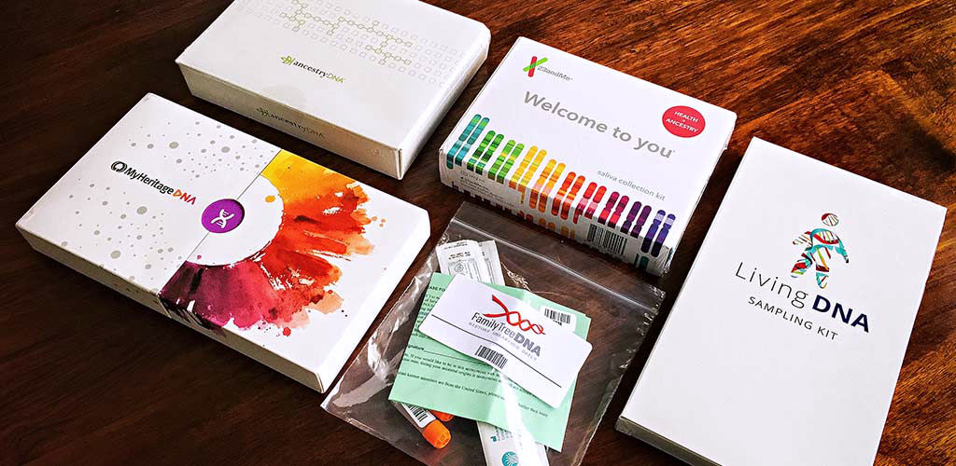
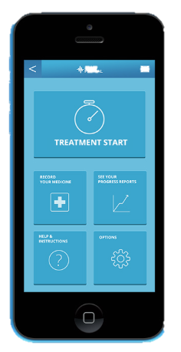
Proactive Intervention
The emergence of personalised medicine may create entirely new
areas of practice for physiotherapy services focused on prevention and early intervention.
Notes:
The growing influence of digitally connected, personal health devices and apps will
create new opportunities for people to be engaged with their own health. Patients will be
in the position to provide more detailed information to inform their decision-making and
treatment options. Likewise, physiotherapists will be able to effectively track and monitor patient progress in real-time.
People can now but DNA kits and send a sample of their genetic material away to get a report on their genetic profile, some of these services can include the likelihood of developing some conditions. Personalised approaches to care based upon an understanding of the patient’s genetic profile and responses is now possible.
The physiotherapy profession, along with many other medical groups, needs to act now to determine how the future of the profession can adapt to this new wave of personalised, genomic medicine.
Understanding genetic mechanisms involved in aging or disease through interventions such as physical exercise may open entirely new avenues or perspectives on protocols for prevention or management of common chronic conditions.
Physiotherapists already play an important role in the prevention and rehabilitation of many common diseases and disorders, and through genomics we can address the factors associated with non-communicable diseases with person-centred health service delivery.

Slide 20


Slide 21


2018, a time for reflection…
Notes:
In slide show – if you click on the NHS logo, it will go to the Prezi.
If that’s too much faff or it doesn’t work, the following slide have the key points from that.

Slide 22

Why is it the best moment in the history of the NHS to be a physiotherapist?
Physiotherapy is a solution
Physiotherapy is high value
Investment in physiotherapy and AHPs improves pathway productivity
Physiotherapy reduces variation
Physiotherapy in the UK has the world leading scope of practice
Physiotherapists are part of a vibrant CSP community of 58,000 members
Notes:
Model hospital shows that AHP investment correlates to improved system productivity. The physiotherapy offer includes:
Reducing dependence
Increasing resilience
Expediting care and discharge
Sharing skills and promoting self management
Working across boundaries (e.g. early supported discharge)
A commitment to collaboration (with other professions and with patients)

Slide 23
Notes:
Beginning to think about the role of the CSP to help in this new era as well.

Slide 24
Professional Advice Service
Campaigns and Regional Engagement Officers
ERUS Organisers
Regional networks
Improvement & Transformation support
CSP online mentorship platform
CSP: How can we help?
Physiotherapy UK
CSP Leadership Development Programme
Virtual learning environment
Web resources & news
Regional Senior Negotiating officers
Notes:
Support opportunities…
In addition we have 125 staff working in support of members centrally. Working nationally and internationally on behalf of members. Working with the full range of national stakeholders.
Providing numerous opportunities for members to network and share practice or develop new approaches for the profession.

Slide 25

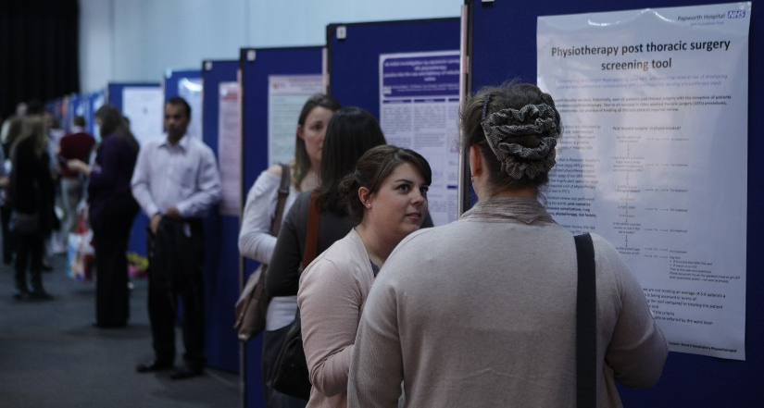
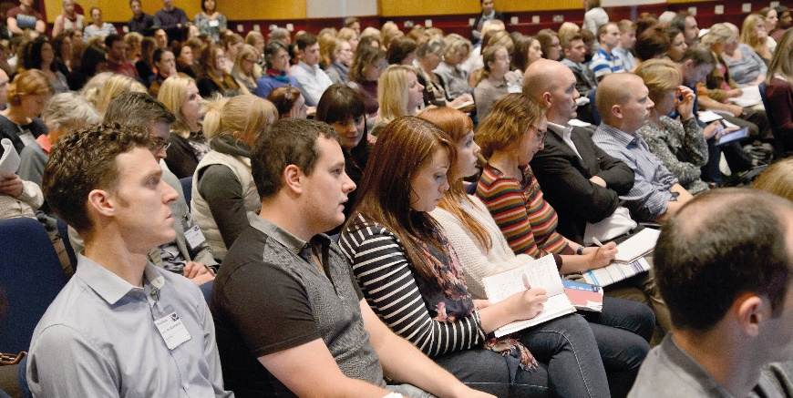

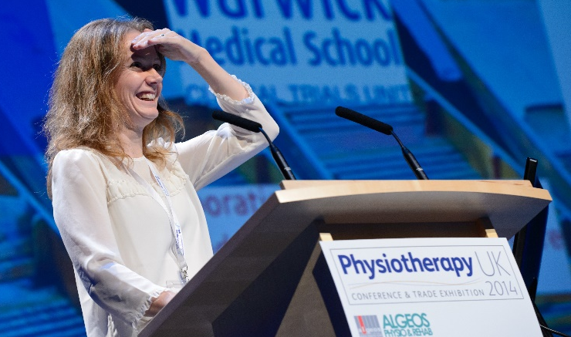

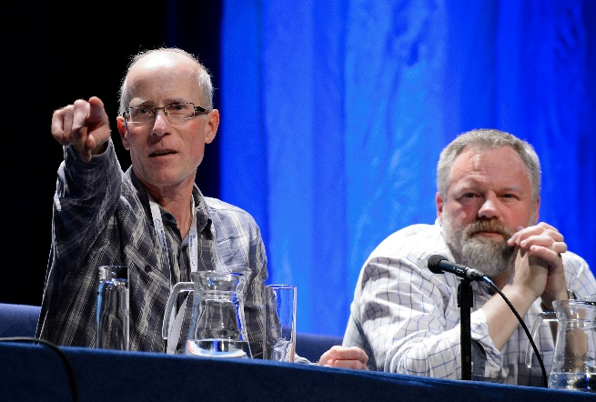
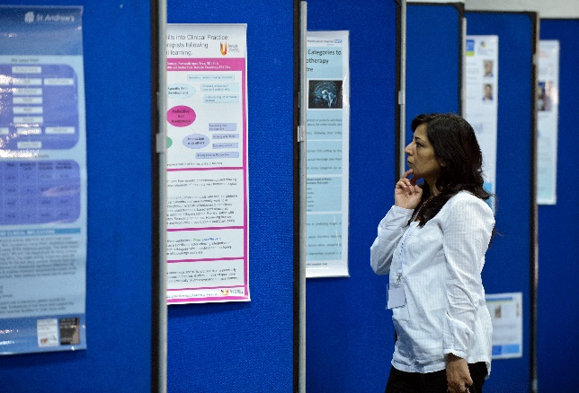

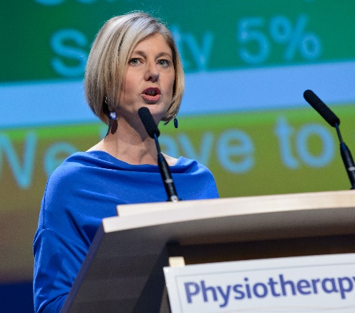
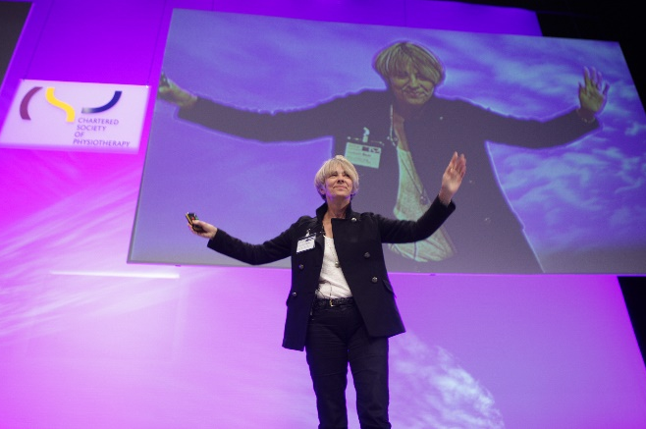





Only
£99
before 31 July
2 days of world-class CPD
in partnership with
#Physio18
www.physiotherapyuk.org.uk

Slide 26

Any Questions

